Slide 1
State of the Park October 2011
A Quick Tour
Land Acquisition – Initial Focus
Formation of the Park Committee
Addressing Immediate Issues
Long term planning
CI Strategic Plan
Policy
The Park Master Plan Committee Now
Next Steps

Slide 3
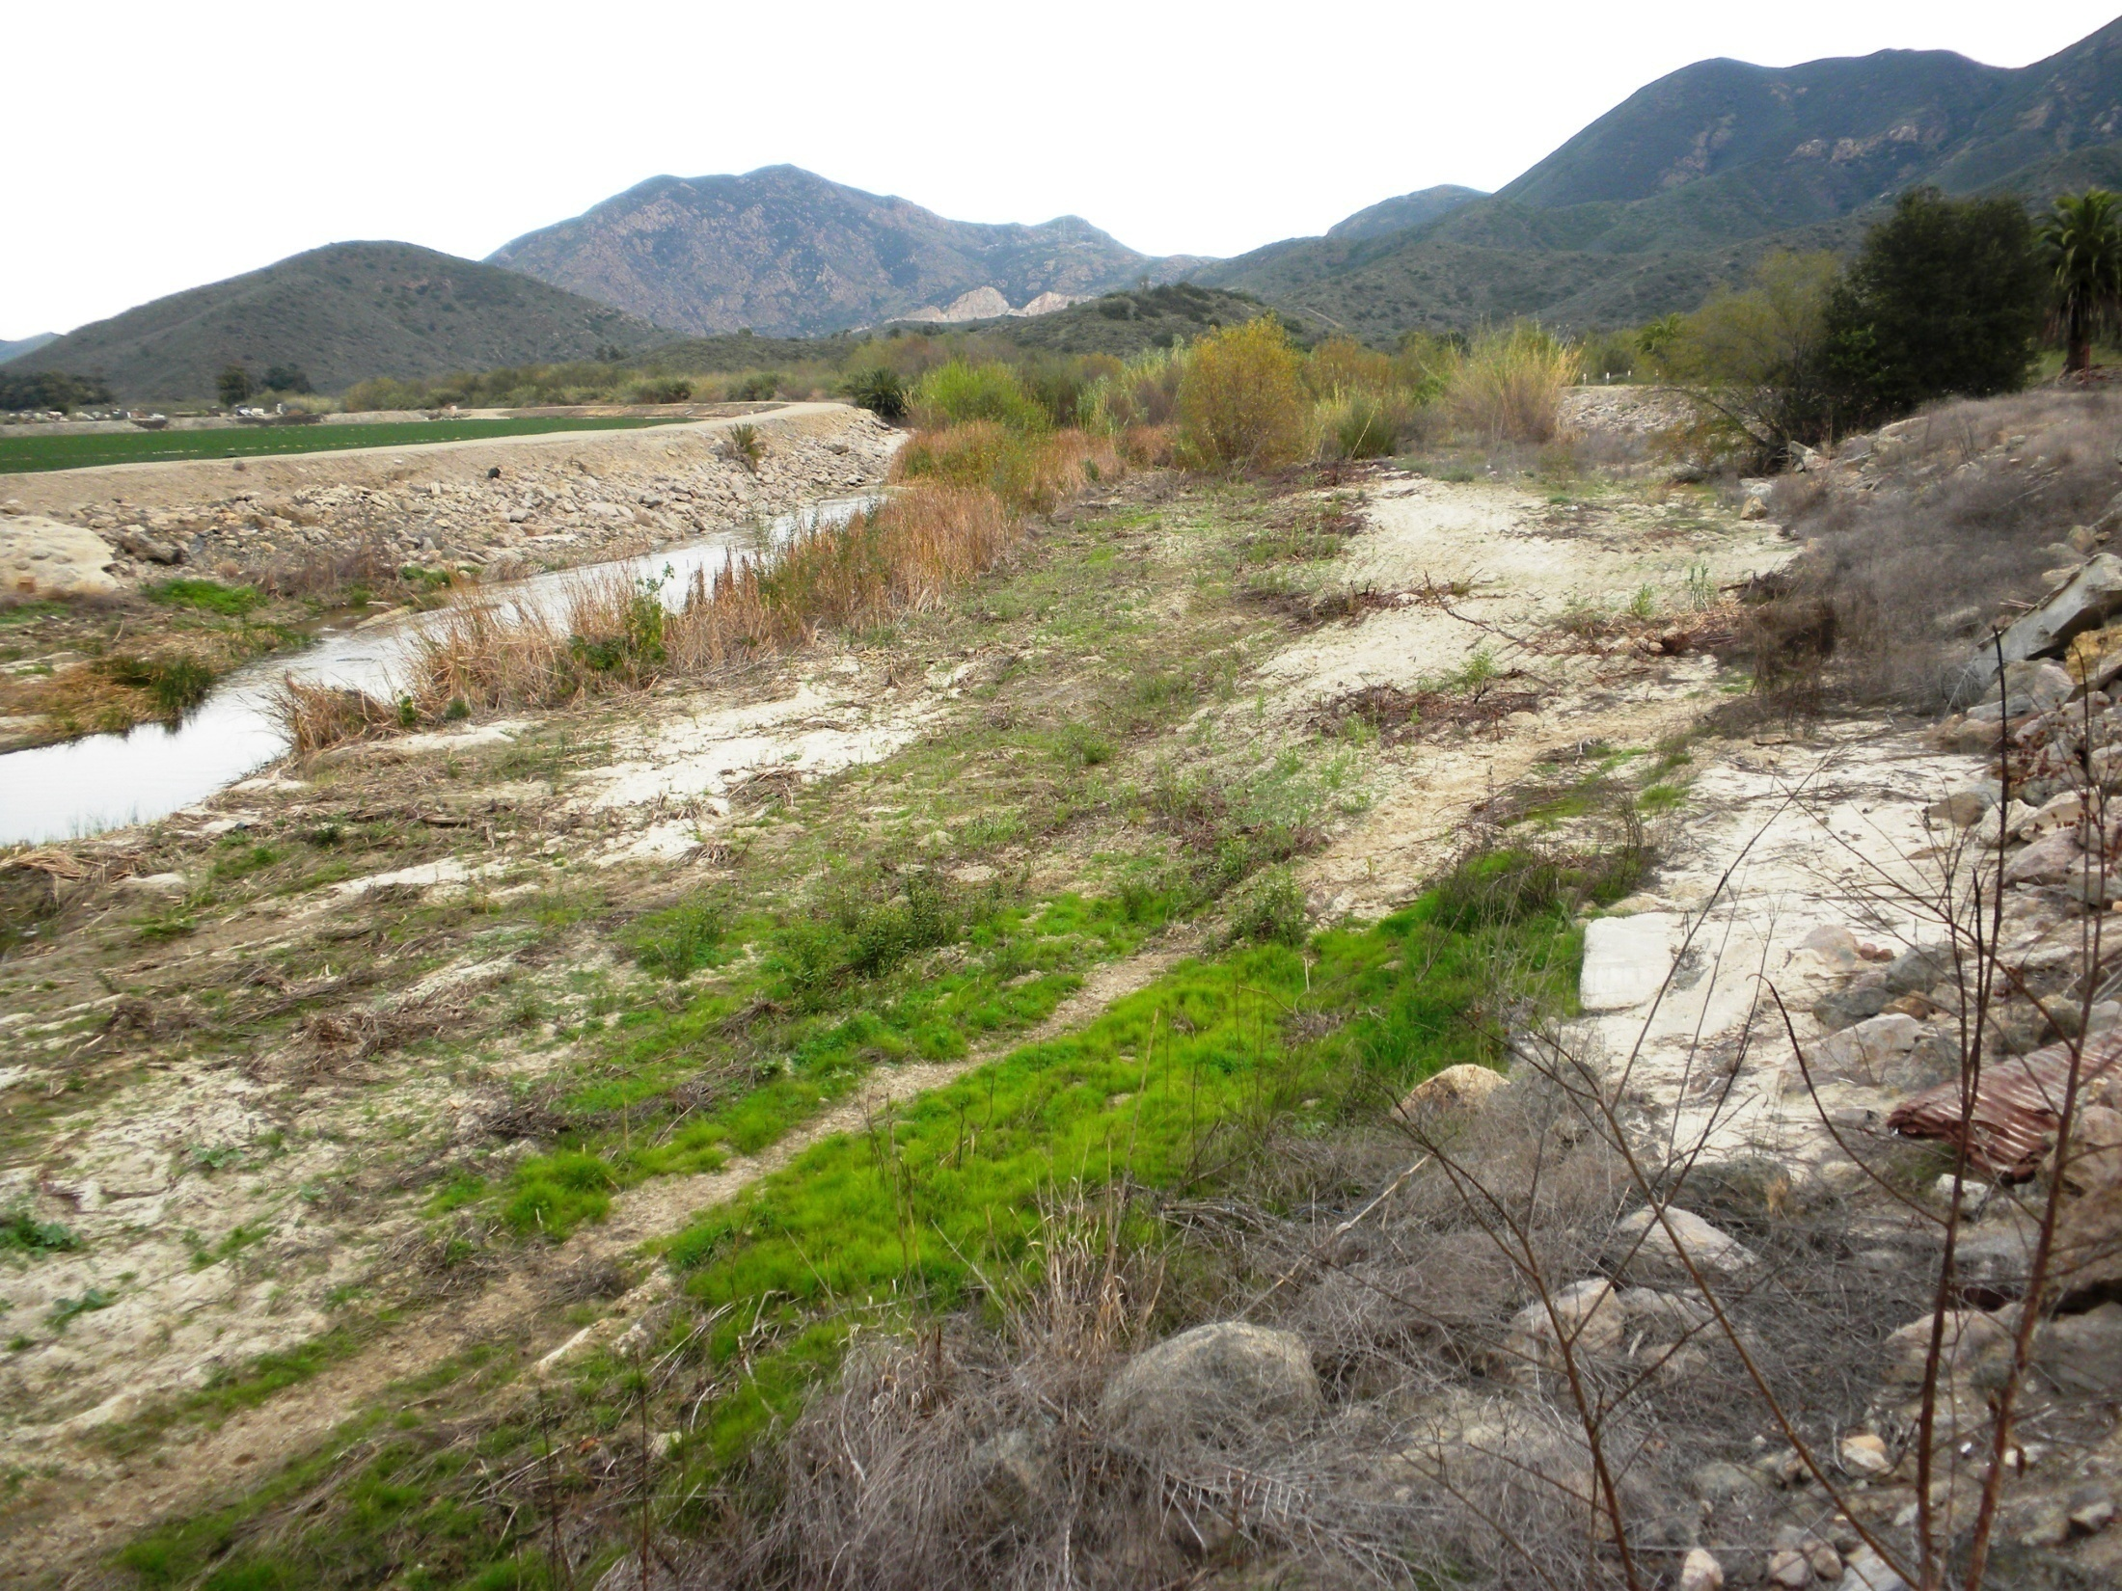

Slide 4
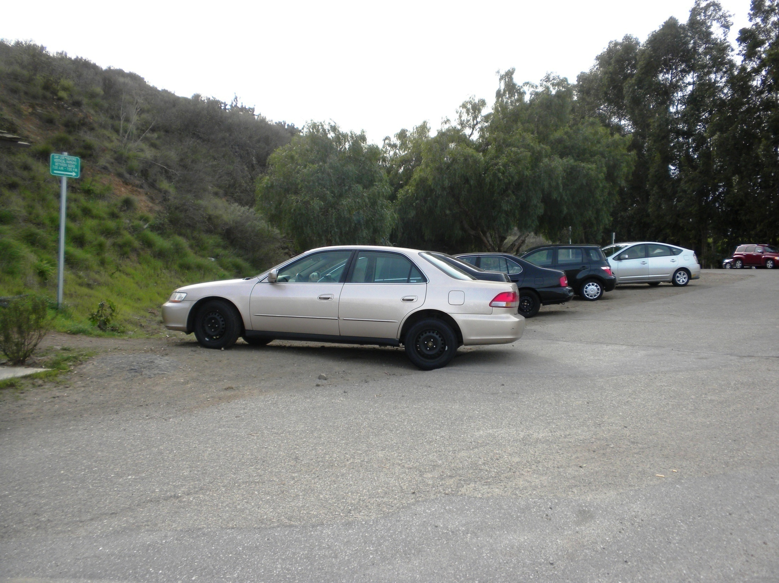

Slide 5
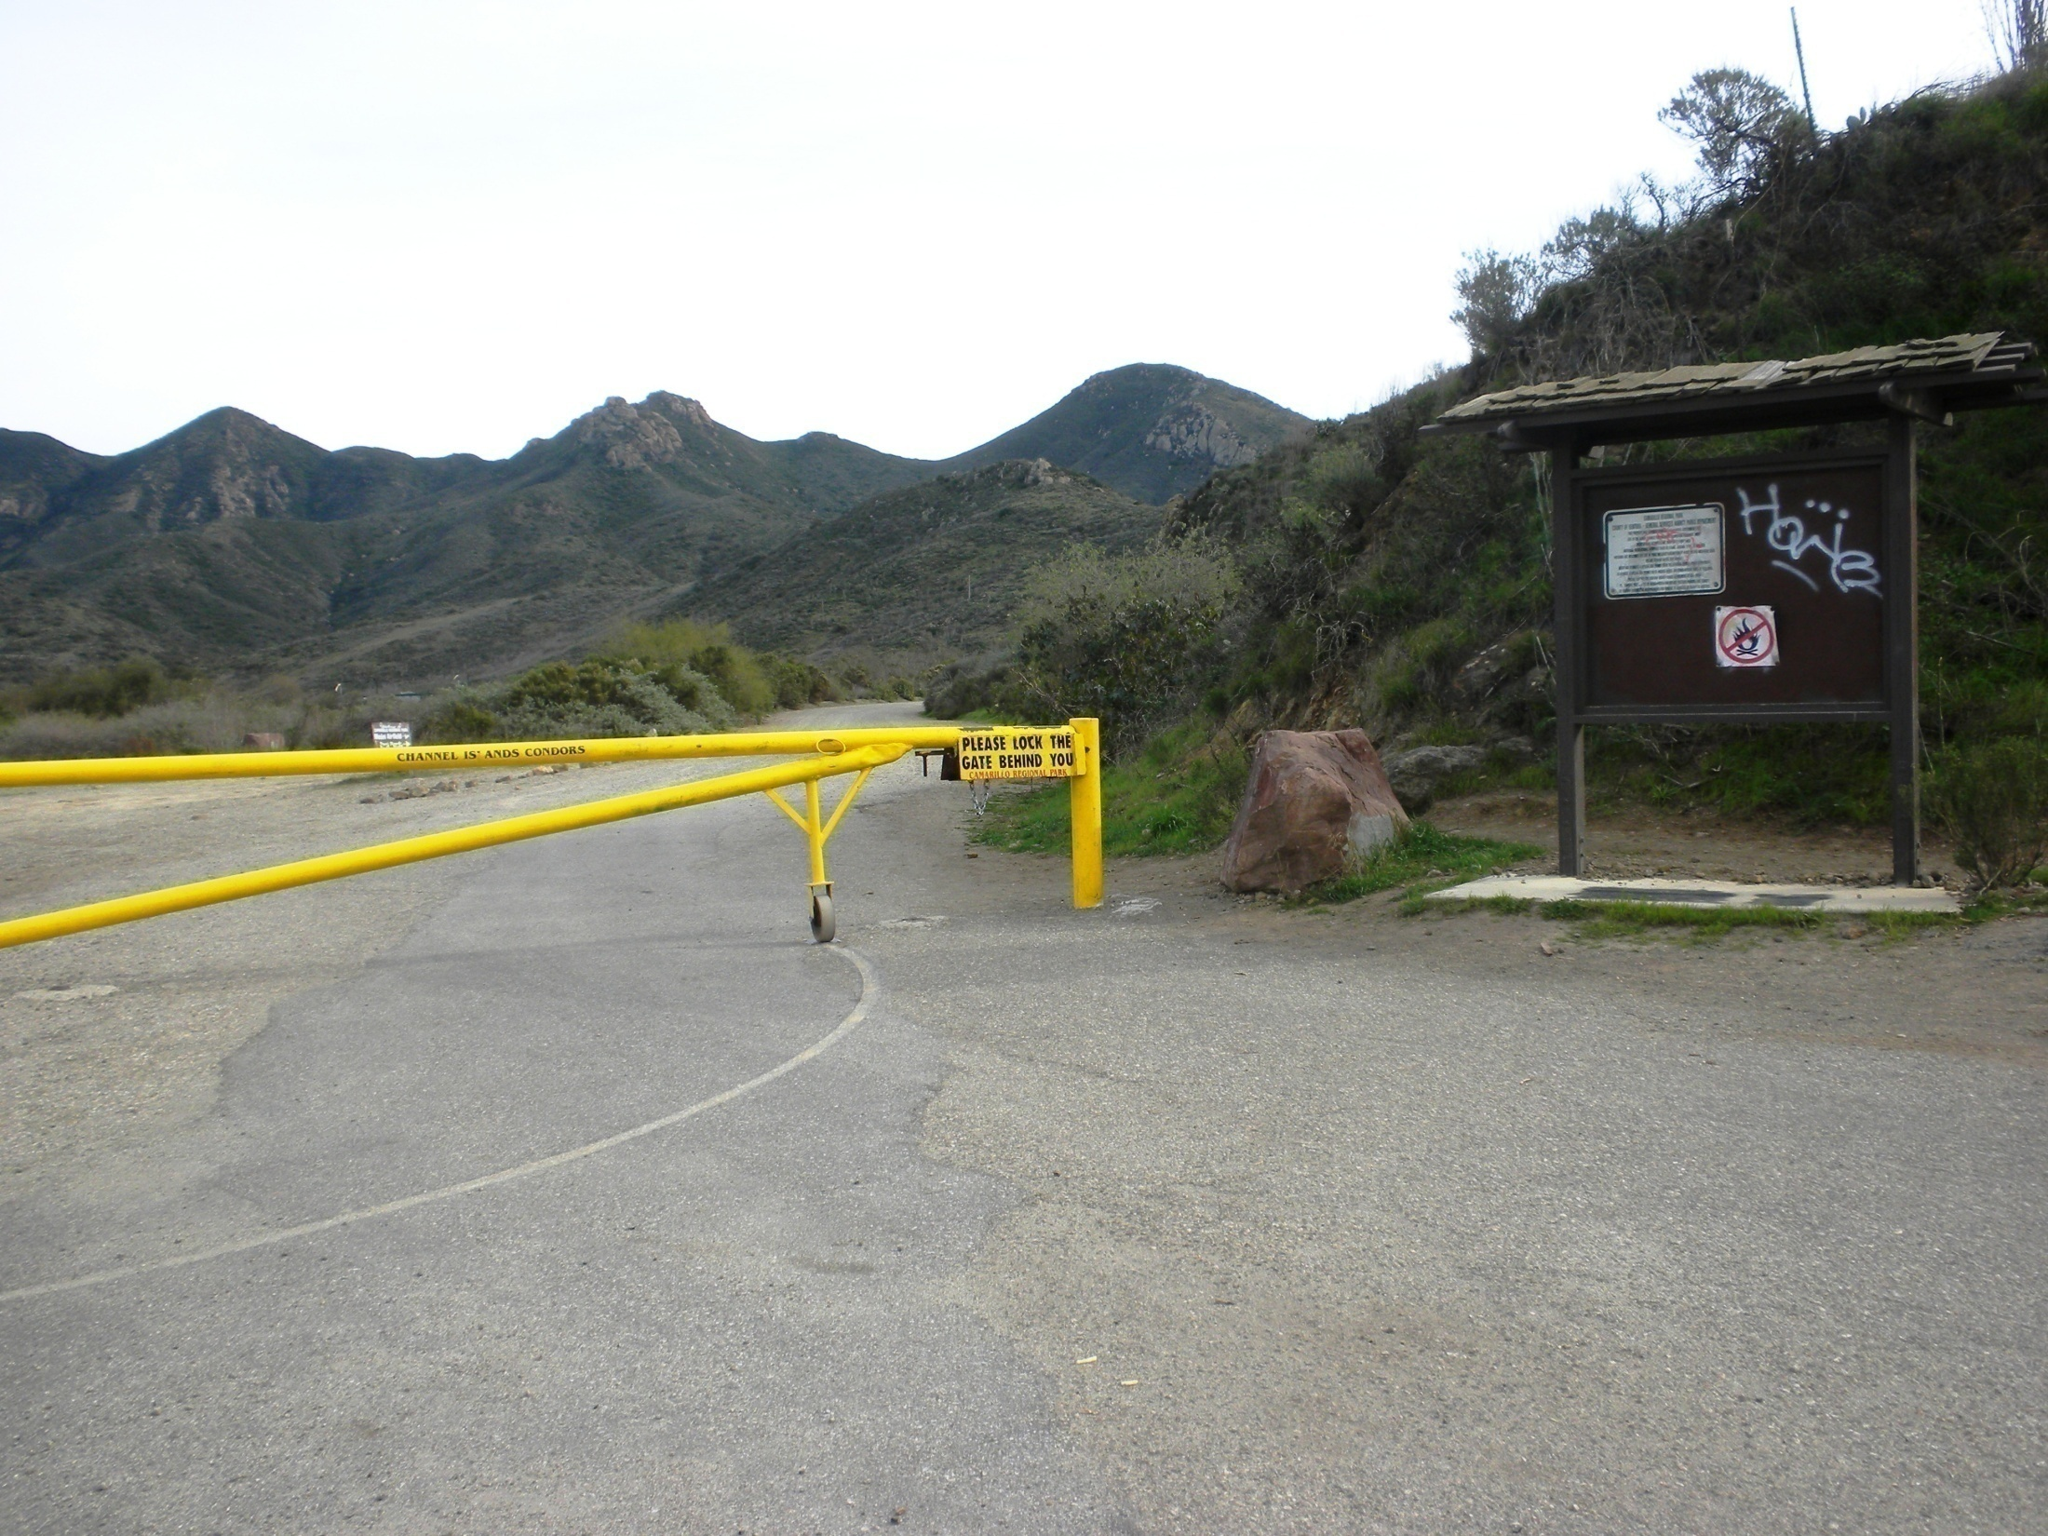

Slide 6
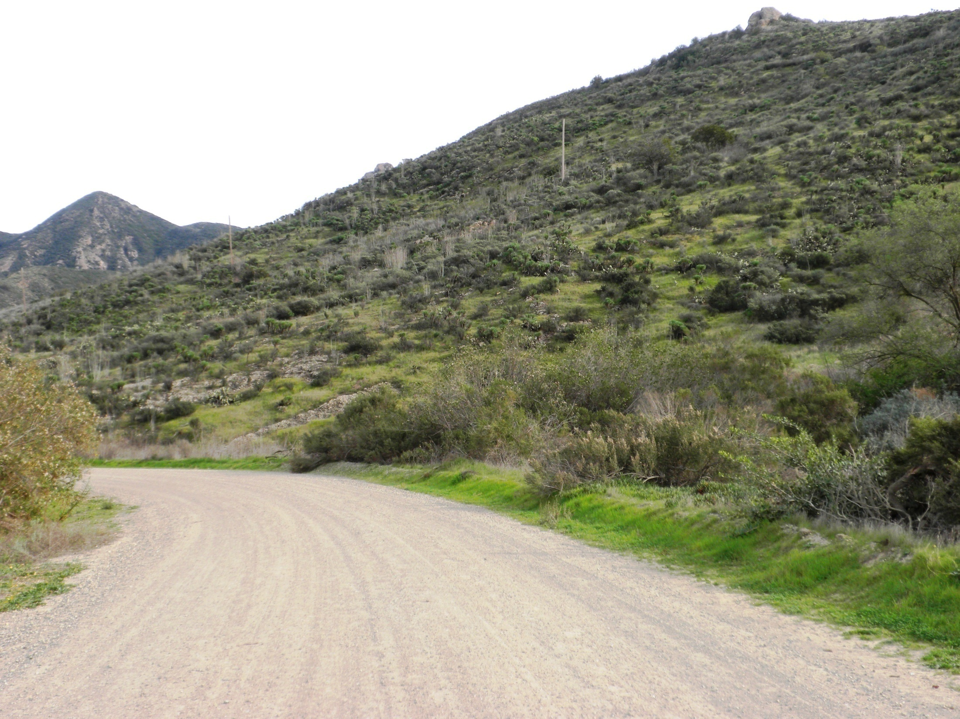

Slide 7
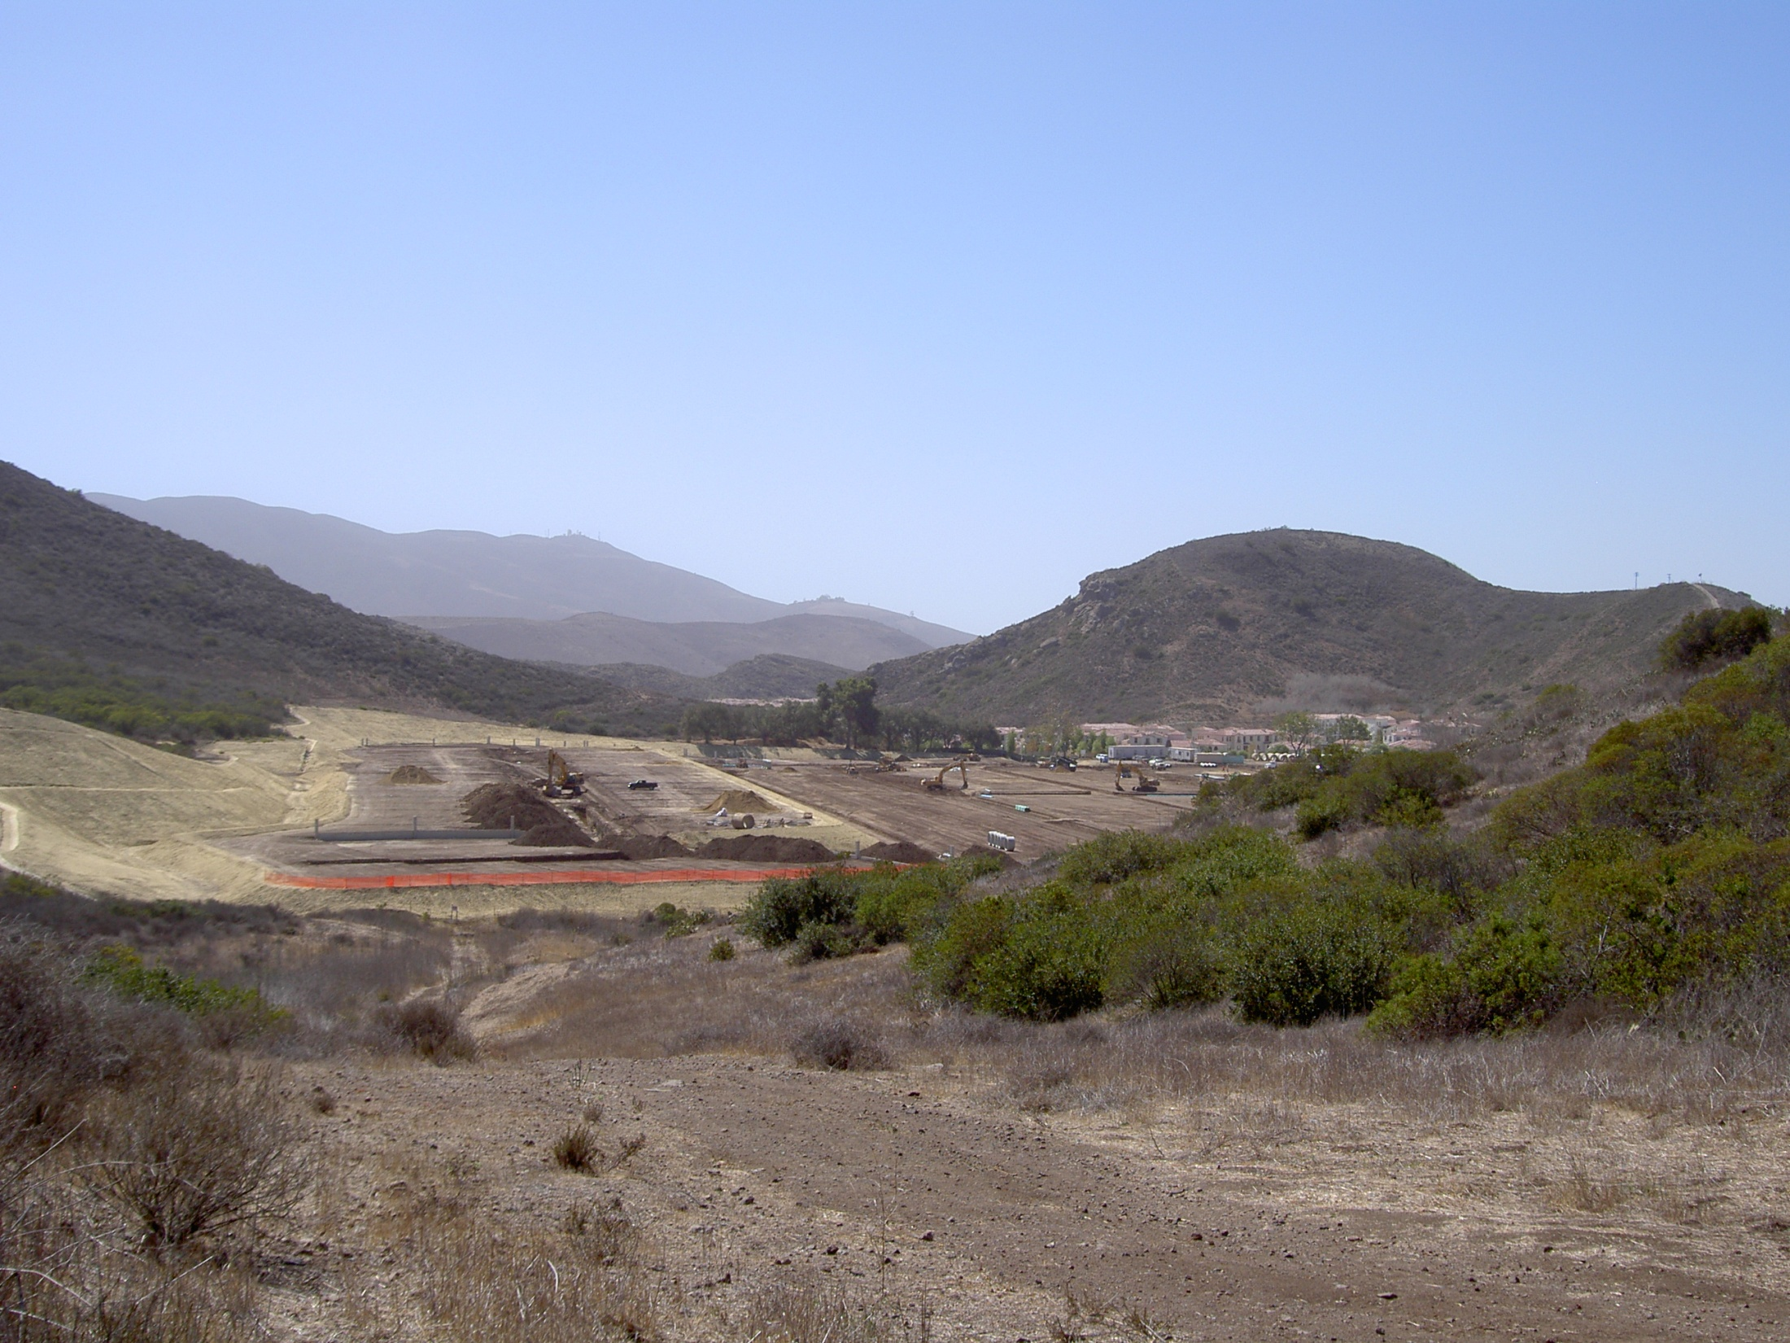

Slide 8
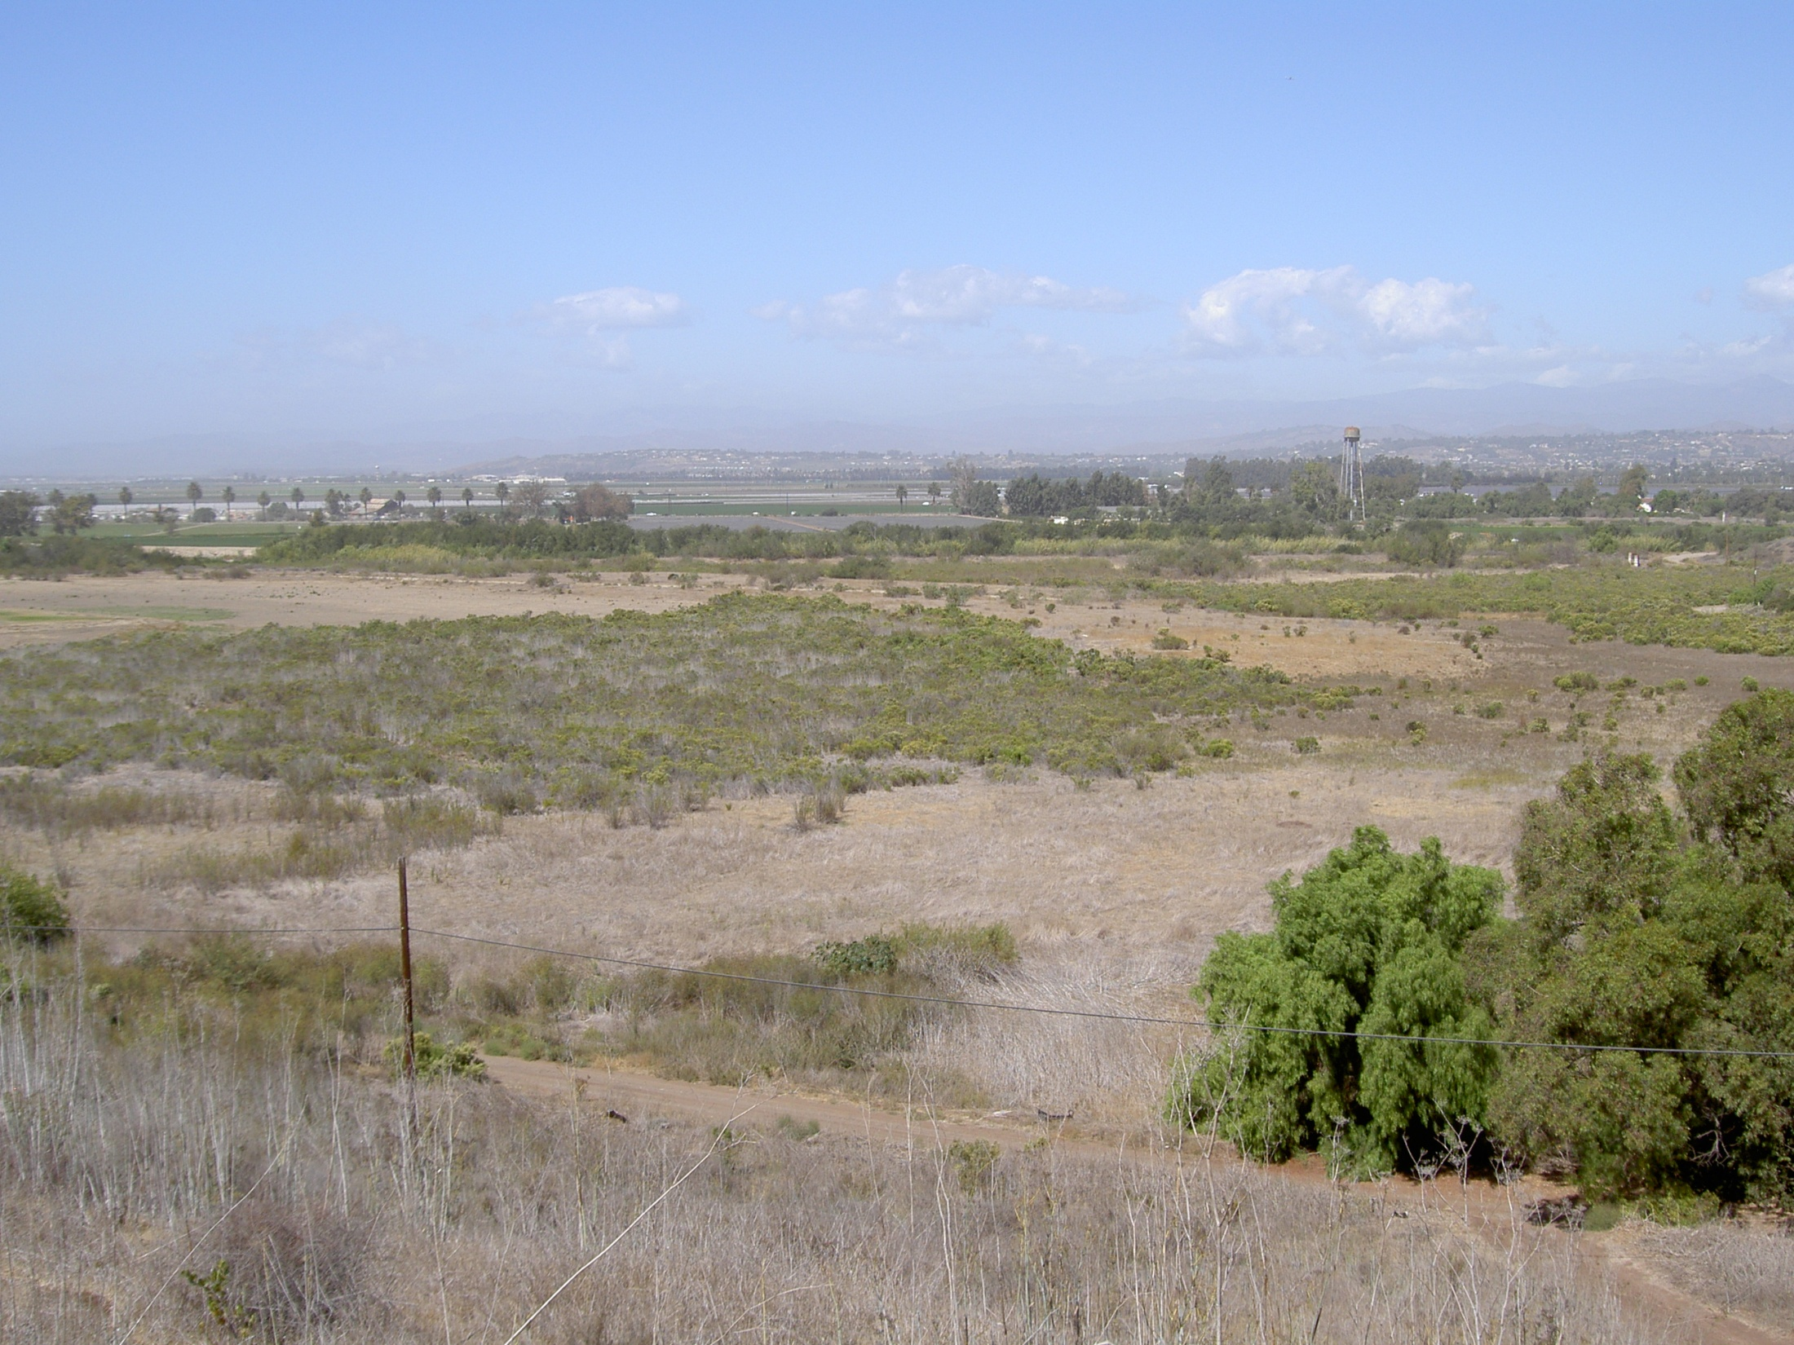

Slide 9
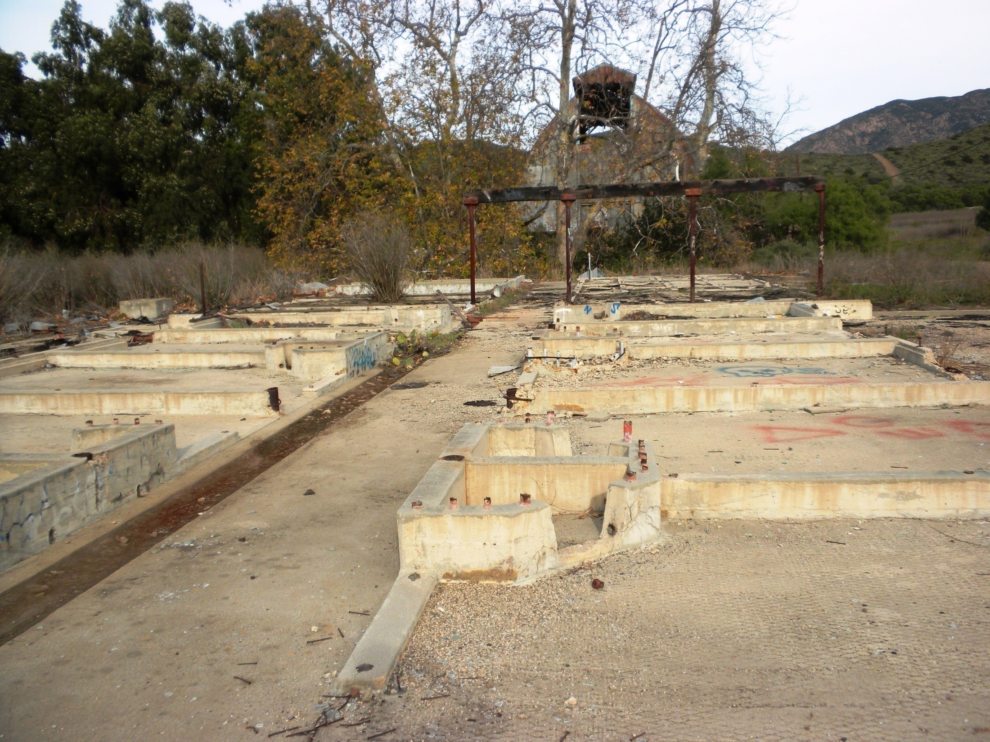

Slide 10
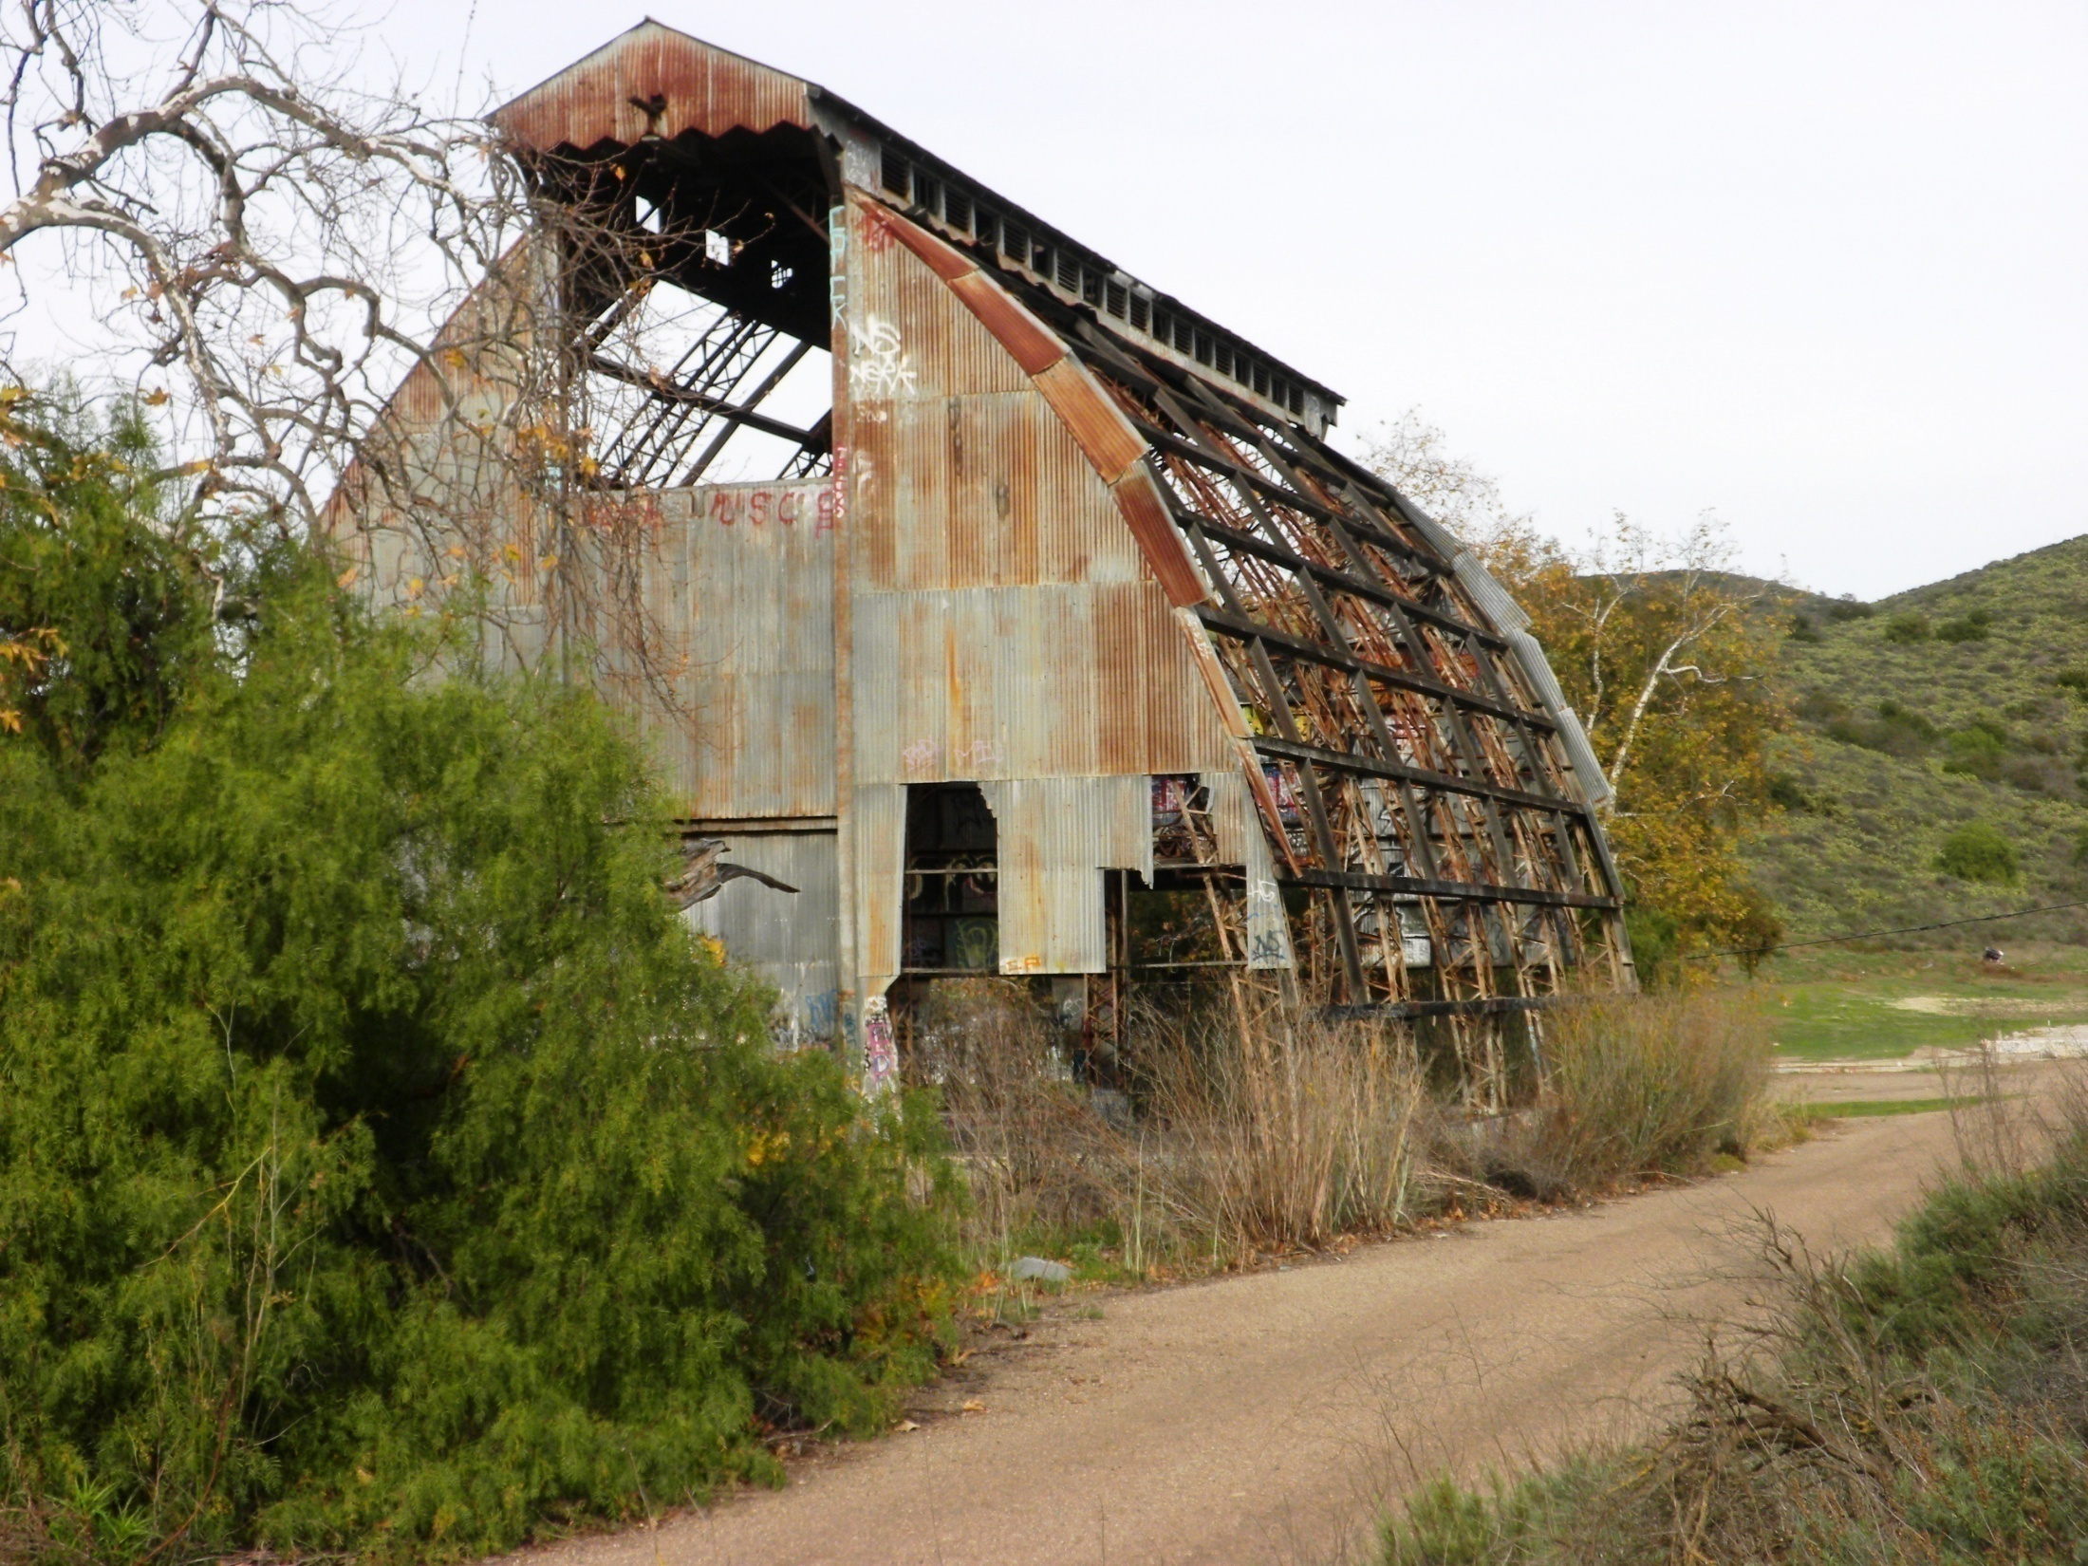

Slide 11
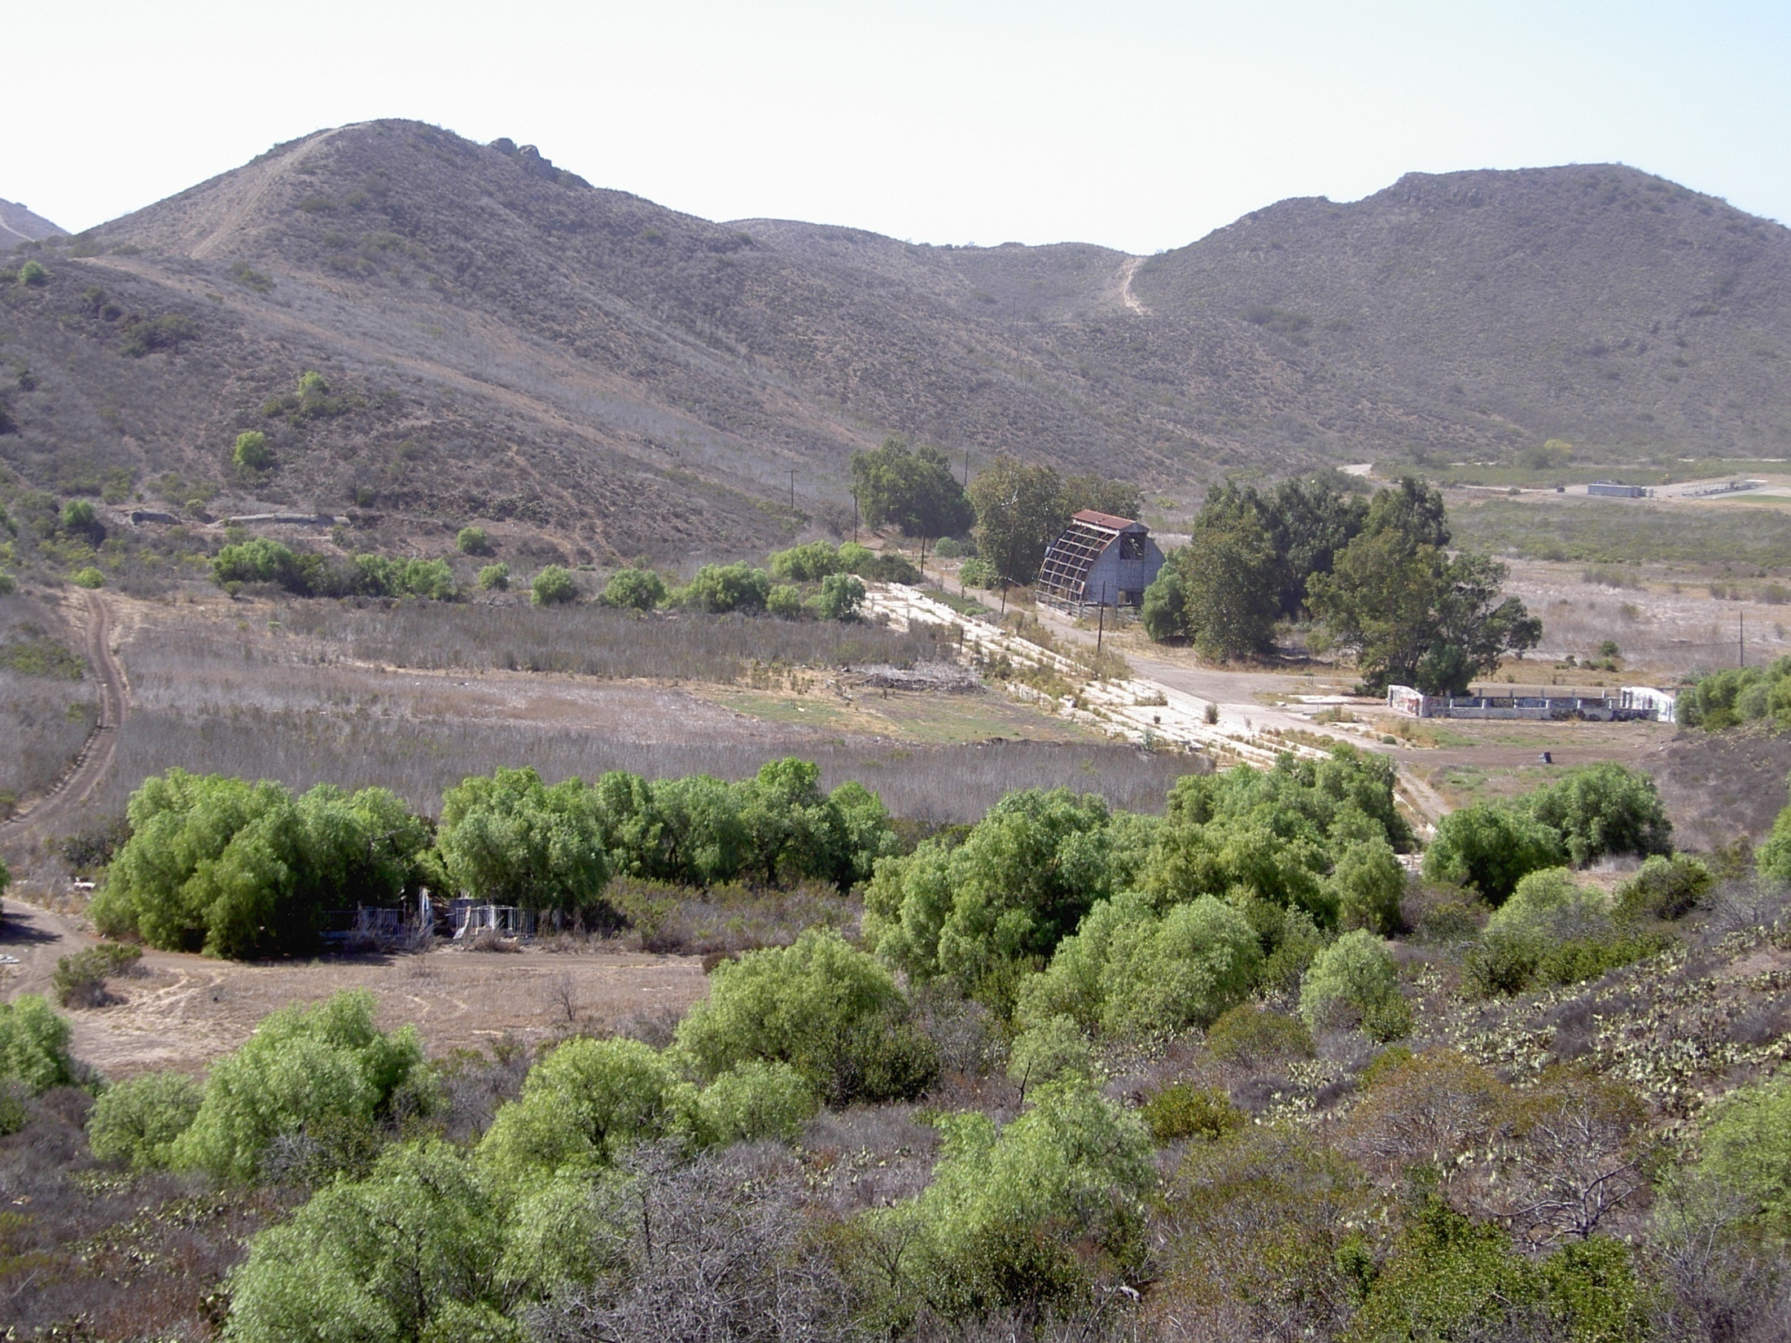

Slide 12
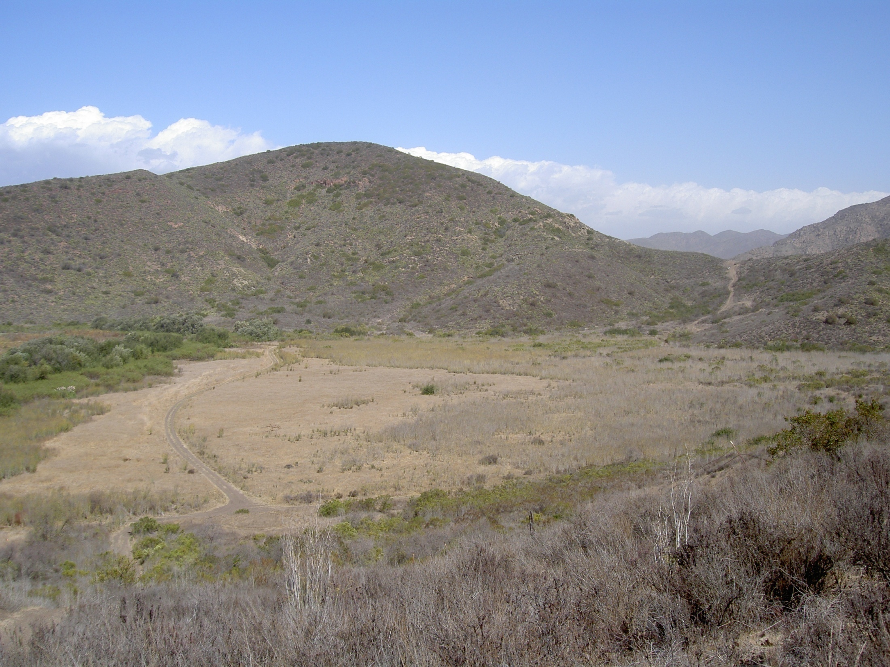

Slide 13
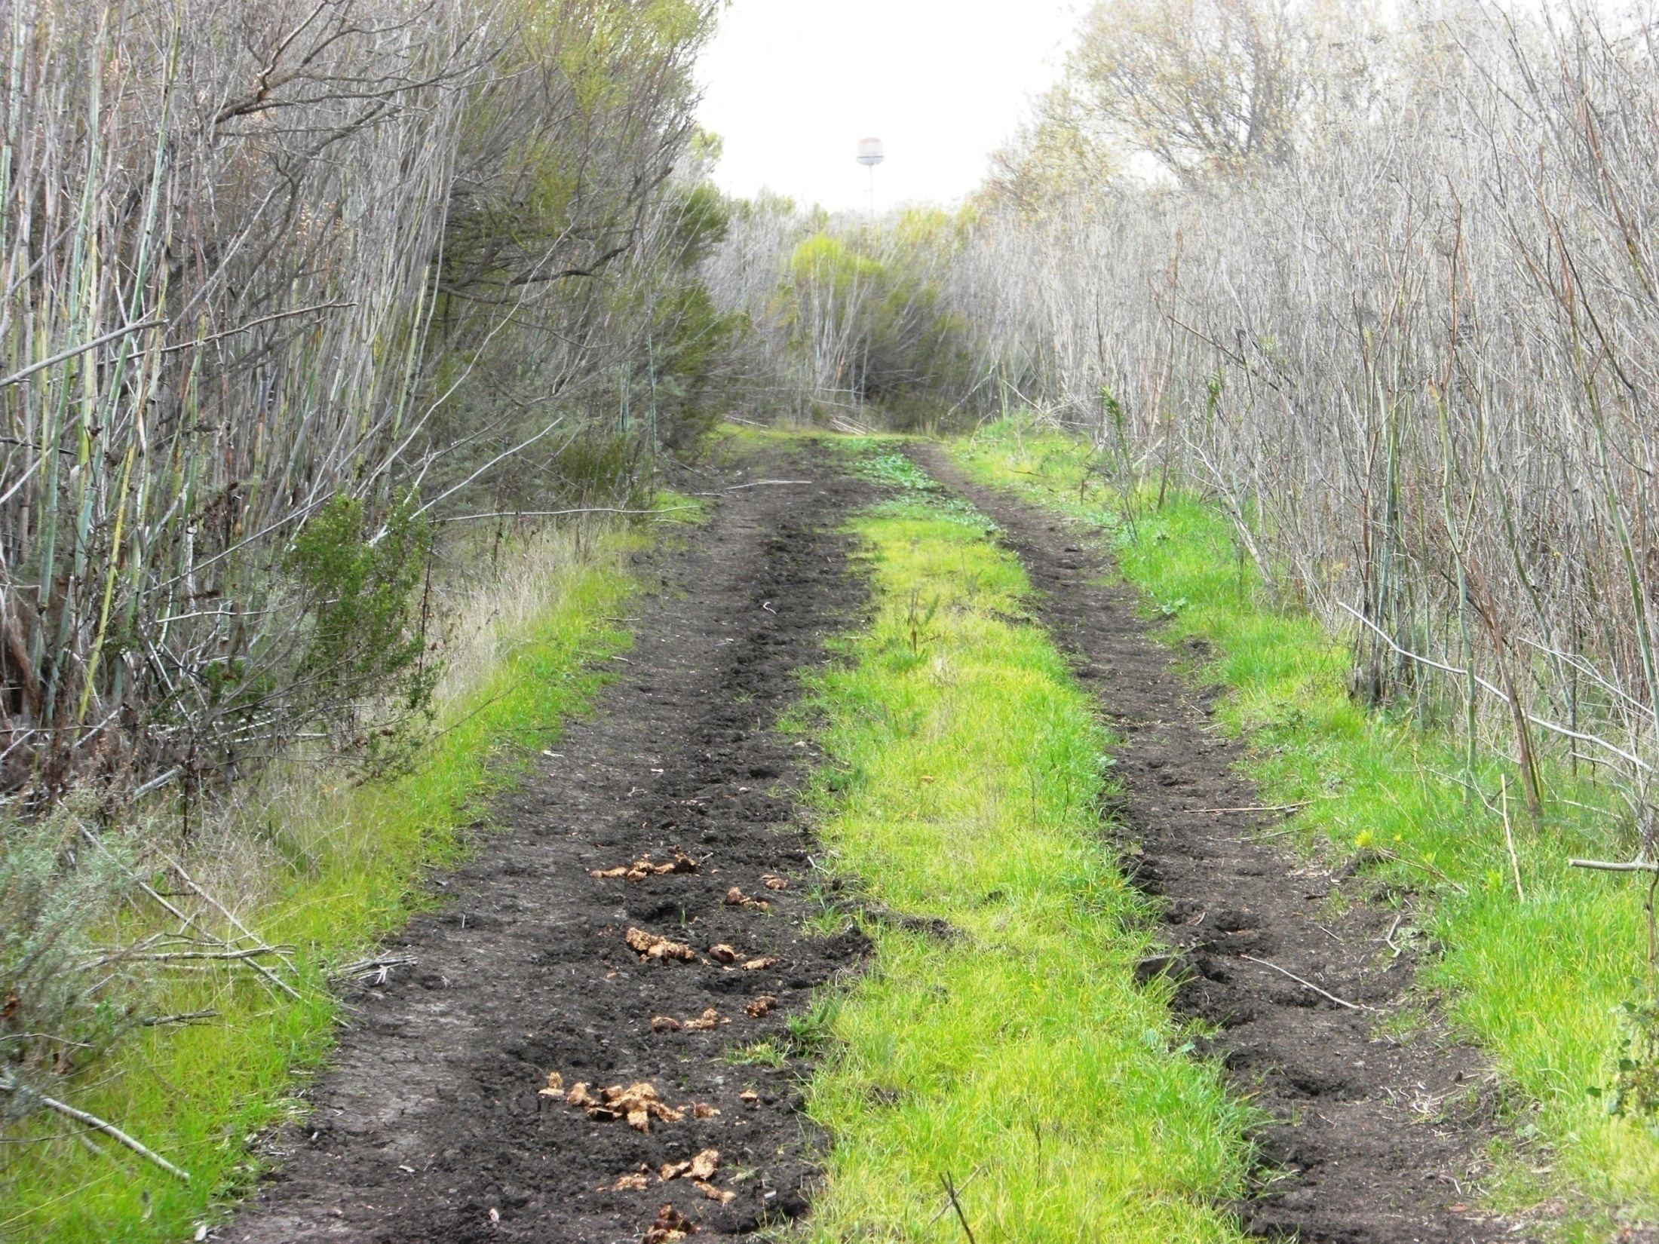

Slide 14
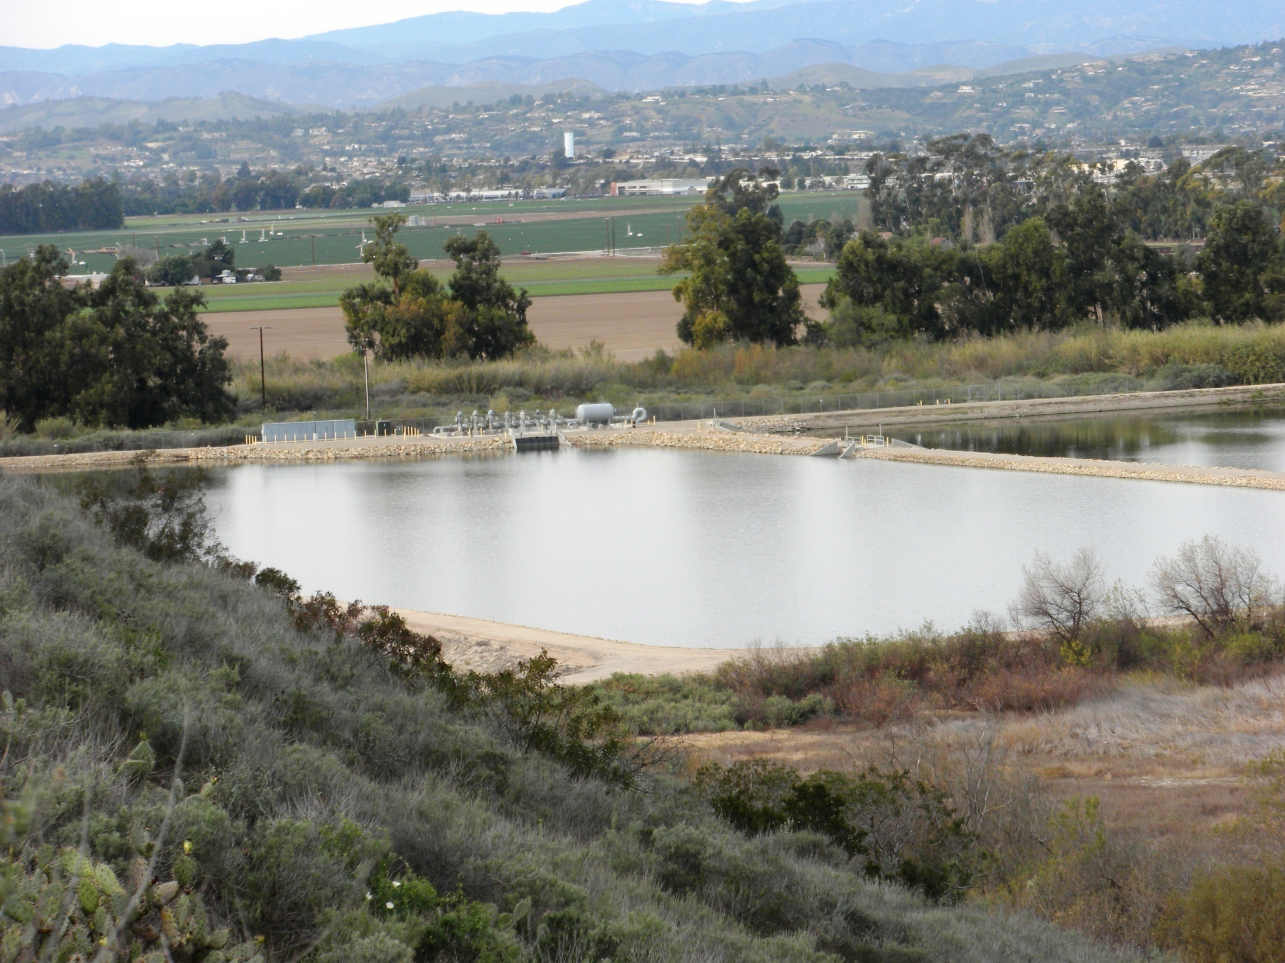

Slide 15
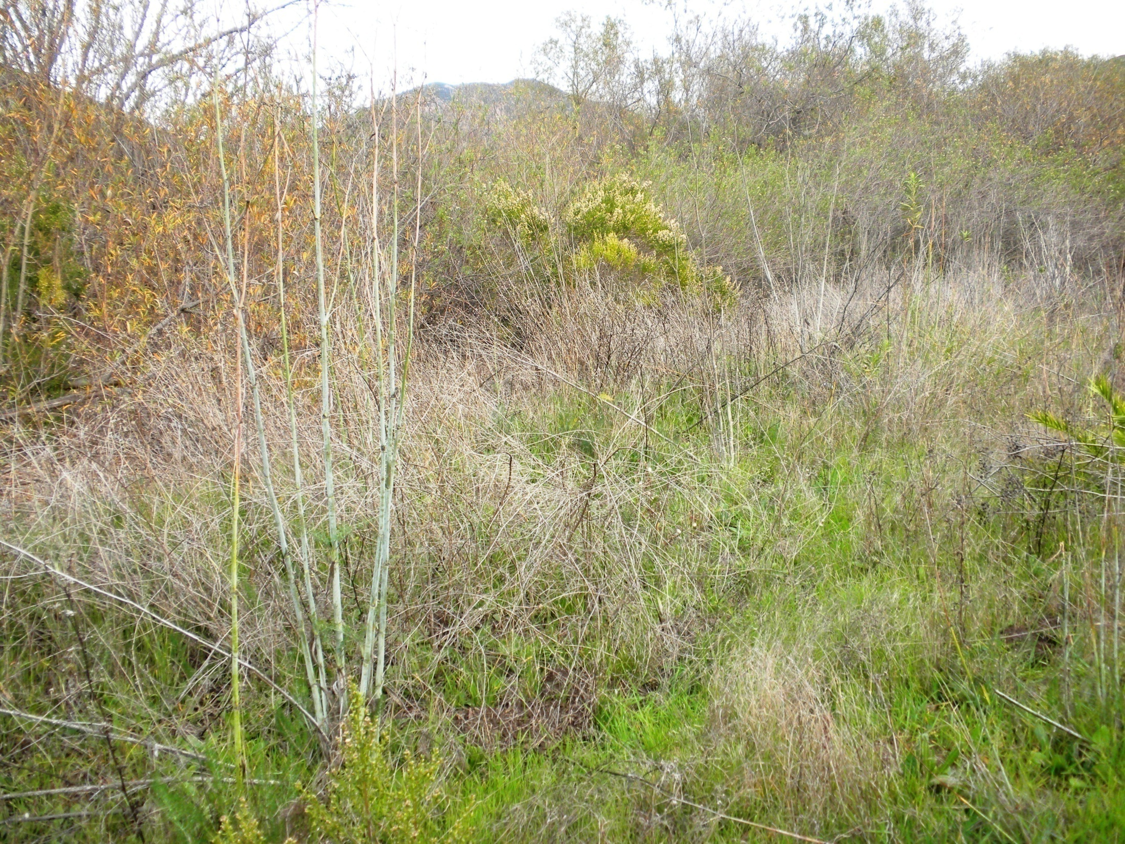

Slide 16
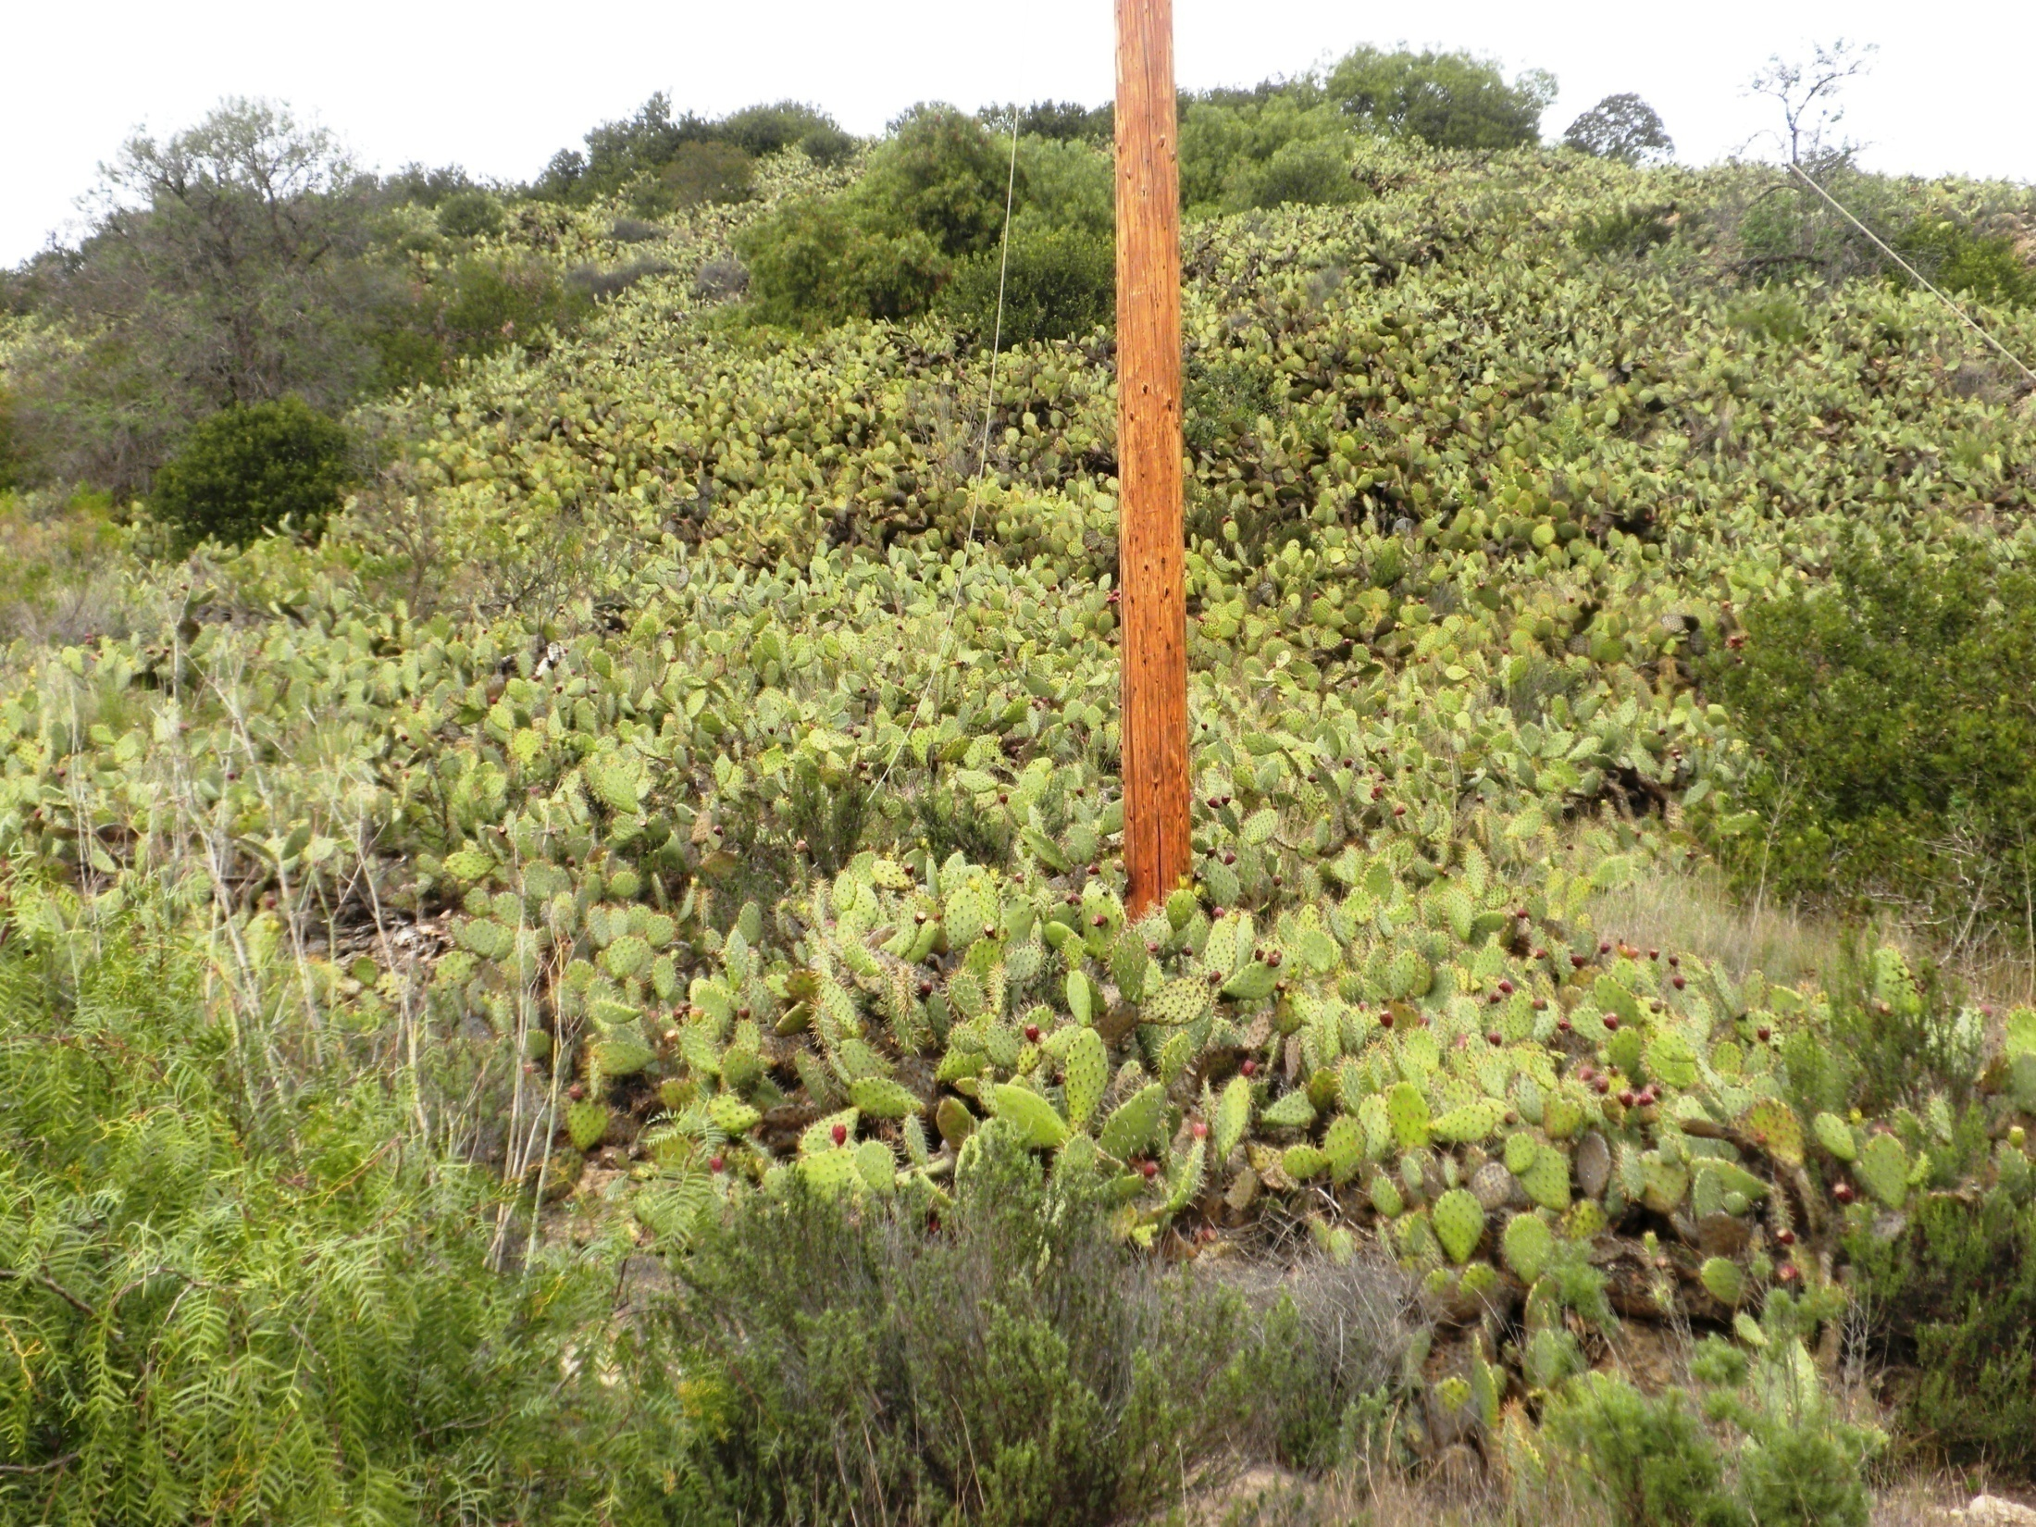

Slide 17
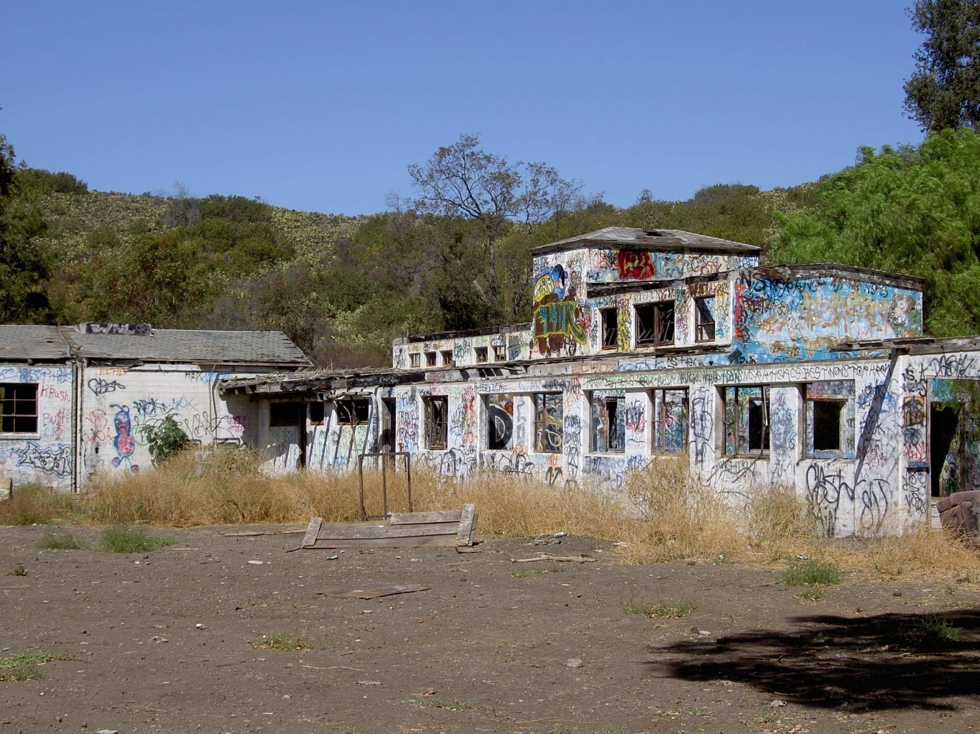

Slide 18
Initial Program Focus
Native Habitat Program
Preservation
Research
Wetlands restoration
Trailhead & Hiking Trails
Develop
Connect
Open Space
Preserve
Maintain accessibility for all
Program

Slide 19
Park Master Plan Committee
Purpose: The committee will discuss and make recommendations for a Master Plan that reflects the University’s Strategic Plan, particularly as it relates to Environmental Sustainability and to develop curricular and co-curricular programs for University and community use and recreation. Additionally the committee will research, discuss, and make recommendations which will lead to the development of operational procedures, processes, and fees related to use of the newly acquired property. The committee will identify those items which require immediate operational consideration and resolution.

Slide 20
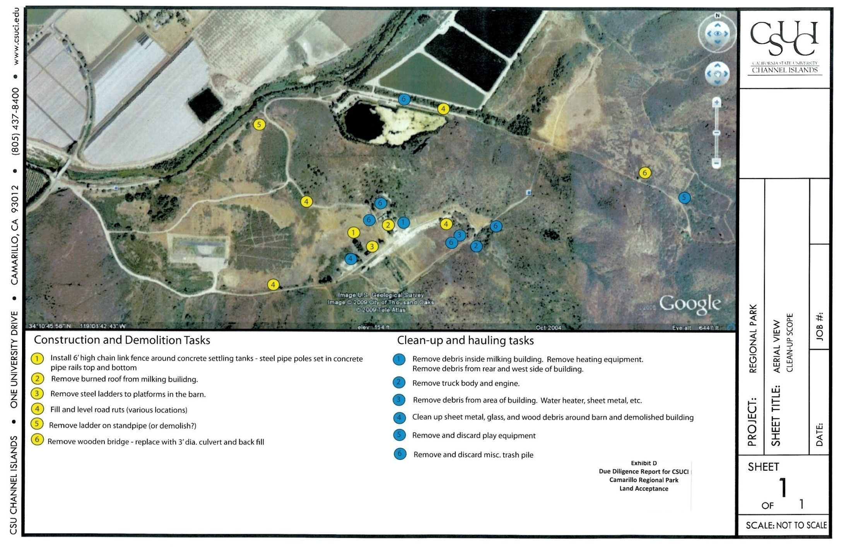

Slide 21
Provisional Park Rules Oct. 2010
PROVISIONAL PARK RULES
OCTOBER 2010
The Channel Islands Park is a regional educational and recreation area owned and operated by California State University Channel Islands (CI). As an extension of the academic campus, the Park embraces the mission, values and objectives of CI. The purpose of the Park is to provide educational and recreational opportunities open to all through habitat restoration activities, maintenance of open spaces, and development of ecological, cultural, and recreational facilities and programs.
Park Open Hours and Access
The Park is generally open and accessible seven days a week from sunrise to sunset with the following exceptions:
• Access to some or all sections of the Park and its trails may be restricted as a result of a public safety concern, inclement weather, or planned events;
• No person shall enter areas restricted or closed for restoration or research projects, or any other area, as indicated by posted signs, fences, gates, or other barriers,
except through the express written permission of the University.
General Rules and Guidelines
• Comply and conform to established CI rules and any applicable municipal government ordinances and requirements now in force, all of which are subject
to revision from time to time.
• Observe park boundaries by staying within them and avoiding adjacent private property.
• Stay on designated trails. Avoid trampling vegetation. Never shortcut switchbacks.
• Do not disturb plants, animals, or habitat in the Park.
• Pack litter out or use trash receptacles if available.
Currently Approved Recreational Activities in the Park Include:
• Hikers: Be alert and courteous. Yield to bicycles and equestrians.
• Bicyclists: Always control your speed. Be cautious and maintain a safe distance from hikers. Use caution and yield to equestrians: stop completely as you approach
equestrians from either direction, calmly announce your presence; and seek approval to proceed. Once acknowledged, pass cautiously.
• Equestrians: Always control your steed. Exercise extreme care around other trail users.
• Dogs: Restrain and control pets on a leash no longer than six feet in length at all times. Pick up after your pe
THERE IS THE POTENTIAL TO ENCOUNTER WILD ANIMALS
• COYOTES
• RATTLESNAKES
• MOUNTAIN LIONS
• POISON OAK IS PRESENT

Slide 22
Policy Considerations
Existing policies:
Policy on Use of Facilities
Policy on Parking and Traffic
Policy on Acquisition/Artwork, Antiquities and Artifacts
Policy on Alcohol
Policy on the University Calendar of Events
Policy on Pre-Approval of Institutional Grant Proposals
Policy on Postings and Signage
Policy on Chargebacks
Policy on Animal Control
Policy on Firearms
Policy needs: To be determined.

Slide 23
Goals
Develop a Park Master Plan
Include trail head access to other regional trail systems, curricular and co-curricular programming elements, sustainability Efforts, long term development plans, operational issues, and interface with the community.
“Public Use”
Recommend guidelines for governance mindful of the mandate the property be a park in perpetuity. Consider access, fees, existing and future uses, promotions, fundraisers, regional uses, allied agency use, and the impacts various uses have on the project and the role of the university as the steward of the property.
Events and Facilities Committee’s (EFC)
Consider the current process and determine if changes are necessary to include park use within that process.

Slide 24
Goals Continued
Calleguas Creek - Issues to consider treatment/non-treatment, history of dredging, wildlife corridors, safety precautions/concerns, the bridge.
Park Structures. Research history, make recommendations about preservation and/or demolition.
Sources of Funding –Identify.
Policy & Agreements – Development (Inter-agency, facilities use, MOUs including in-kind agreements, basic terms of agreements)

Slide 25
Faculty Task Force Report (June 2010)
Anthropology
ANTH 105: Introduction to Archaeology
ANTH 377: Archaeology Method & Theory
ANTH 323: Native Americans of CA.prior to the 1850s
UNIV 498: Faculty- Student Collaborative Research
Biology
BIOL 407: Behavioral Ecology
BIOL 433: Ecology
To be developed:
Entomology
Analysis of Ecological Communities
Chemistry
CHEM 101: Chemistry and the Environment
CHEM 250/251: Quantitative Analysis
CHEM 301/302: Environmental Chemistry
CHEM 311/312: Organic Chemistry I
CHEM 450: Instrumental Analysis
CHEM 460: Biochemistry I
Communication
COMM 443: Environmental Communication
COMM 450: Environmental Conflict Resolution
Environmental Science & resource Management
ESRM 100: Introduction to ES& RM
ESRM 105: Environmental Issues in Geography
ESRM 200: Principles of Resource Management, conservation, and Stewardship
ESRM 313: Conservation Biology
ESRM 328: Introduction to Geographic Information Systems
ESRM 350: Ecological Restoration Design and Construction
ESRM 351: Field Methods, Monitoring, and Assessment
ESRM 410: Environmental Impact Assessment
ESRM 428: Intermediate Geographic Information Systems
ESRM 462: Costal and Marine Resource Management
ESRM 463: Water Resource Management
ESRM 464: Land Use Planning and Open Space Management
ESRM 499: Capstone
Education
EDMS 529: Elementary Science, Health and PE Methods
EDMS 532: Middle School Science Teaching Methods
EDSS 542: High School Science Teaching Methods
English
ENGL 337: Environmental Literature
ENGL 464: Creative Nonfiction
Capstone Projects:
Integrating Creek Restoration & Ecosystem Values into the Campus Culture
Geospatial Analysis of Arundo donax in Lower Topanga Creek
Creating a Monitoring Protocol for the Least Bell’s Vireo at Camarillo Regional Park

Slide 26
CI Strategic Plan
General Strategy
1. Encourage and support student–centered learning through teaching, inquiry, scholarly, creative, and co-curricular activities.
2. Foster community engagement with our students and provide access to the University both regionally and globally.
3. Continue developing innovative practices that enhance the quality and effectiveness of the University including academic programs, student support services, the business enterprise, and physical infrastructure.
4. Develop support for the University with the community and public and private funders through inclusive partnerships and programs that encourage others to feel part of the University

Slide 27
Strategic Initiatives
Plan with diverse interests in mind.
Community Engagement
Education, Research
Work hand- in- hand with sustainability committee.
Calleguas Creek - Habitat conservation -
- Wildlife
Compliment outdoor exercise and recreation spaces on campus
Student Access/Retention/Success
STEM Crisis
Environmental Sustainability
Athletics

Slide 28
Master Plan Committee Membership
Campus representatives: faculty, staff, students, Site Authority
CA Coastal Conservancy
City Camarillo
Chumash Tribe
National Park Service
Pleasant Valley Recreation & Parks
Santa Monica Mountains Conservancy
Ventura County Watershed Protection District
US Fish & Wildlife Services

Slide 29
Regional Park Engagement Strategy
October 11, 2011 (draft)
Activity | Purpose | Audience | Outreach | Timeframe | Lead
Park Planning Steering Committee | Define and execute the goals, objectives and tasks of the park planning process. | Campus, community and regulatory agency members identified in the stakeholder analysis process | Phone calls, invitation letters | October 2011 (established)
Current Park Users Meetings Individualized meetings | Update key user groups on park planning process and open dialogue regarding impending changes to park use and access stemming from restoration and park development efforts underway. | Special Interest Groups: Condors, Pond Rats, and Water District | Phone calls, email | Nov-Dec 2011
Introductory Project Mailer and Follow-up Phone Call Options: Brochure, flier, newsletter, postcard | Provide general information on the park planning process, announce upcoming workshops/events, provide contact information and encourage attendance at workshops. | Regulatory agencies and other identified stakeholder groups | Stakeholder contact list | Nov-Dec 2011
Public Workshop 1 Presentation and Facilitated Breakout Groups | Introduce public to project goals, history of the site, current conditions, development framework (deed restrictions) and restoration efforts. Obtain input on public vision for the park, as well as any issues and concerns. | General Public | Press release, emails, fliers (on campus and sent to stakeholders), website | Jan-Feb 2012
Regional Park Website Options: Blog format, Google Site, CSUCI university page, Facebook page | Provide up-to-date information on the park planning process, events/news announcements, photo inventory, contact information, and provide a means for community-based feedback. | General Public | Emails, fliers (on campus and sent to stakeholders) | Launched w/ Workshop 1; maintained and updated throughout plan process
Online Survey Survey Monkey or other (?) | Identify anticipated types of park use, desired amenities, existing regional trail linkages, and key issues and concerns. | General Public | Emails, fliers (on campus and sent to stakeholders) | Launched w/ Workshop 1; open for 30 days (?)
Formal Project Presentations | Introduce local agency stakeholders to project goals, history of the site, current conditions, development framework, restoration and planning efforts. | City Councils, Parks Commissions, Park and Rec Districts, Ventura County | Phone calls to determine recommended forum | March-April 2012
Park Neighbors Meeting Group or Individualized meetings (as needed) | Provide park neighbors information on the park planning process and receive input on issues and concerns as restoration and park development moves forward. | University Glen Homeowners, Ag Landowners (?) | Phone calls, email | March-April 2012
Public Workshop 2 Presentation and Facilitated Breakout Groups | Report on general input received from public via the engagement process and confirm overall vision for park. Solicit input on trail routing opportunities, desired features and amenities, and potential trail policies. | General Public | Press release, emails, fliers (on campus and sent to stakeholders), website | May-June 2012
Public Workshop 3 Presentation and Facilitated Breakout Groups | Present draft recommendations and plan document for final comment and review. | General Public | Press release, emails, fliers (on campus and sent to stakeholders), website | Sept-Oct 2012
Other Potential Engagement Tactics
Open House Event | Provide an opportunity for the public to learn more about park restoration and future development plans, pickup any handouts and ask general questions. | General Public
Guided Park Walks | Provide an opportunity for groups to visit the park and learn about its natural and recreational resources, as well as the restoration and park development plans. | General Public and/or targeted stakeholder groups
Design Charette | Provide an opportunity for the public to engage in the conceptual design process, identifying trail routing, destinations, locations of specific features and potential interpretive themes. | General Public
Booths/Tables at University Special Events and Functions | Provide general project information and collect contact information for potential future park volunteers. | General Public
Targeted Group Meetings | Address issues and concerns regarding park plan development and restoration efforts impacting particular groups and organizations, on an as-needed basis. | Special Interest Groups, Targeted User Groups, Impacted Stakeholder Groups

