Slide 1

Graduate School vs. Full-Time Work
Presented by the Graduate Studies Center
Notes:
Start with ice breaker
Discuss no right or wrong – but what is best for the student and their journey
Takes time to know who you are and what you want
Different pressures from both perspectives

Slide 2


“Don’t ask what the world needs. Ask what makes you come alive, and go do it. Because what the world needs is people who have come alive.”
- Brene Brown

Slide 3


Agenda
Job vs Career
Pros & Cons
Graduate School
Job Preparation

Slide 4
Learning Objectives
Differentiate between jobs and careers
Identify pros and cons of earning a master’s degree before working full-time
Describe pros and cons of working full-time before earning a master’s degree
List resources in researching graduate school programs or full-time work.

Slide 5
Audience Poll
How many of you…
Want to go to graduate school full-time?
Want to begin work right after graduation?
Want to work full-time and go to graduate part-time?
Want to work part-time and go to graduate school full-time?
Not sure?

Slide 6

Job vs. Career
What is the difference between a job and a career?
Audience Poll
For Example: Are you looking for a job or a career in student affairs?
job
career
unsure

Slide 7
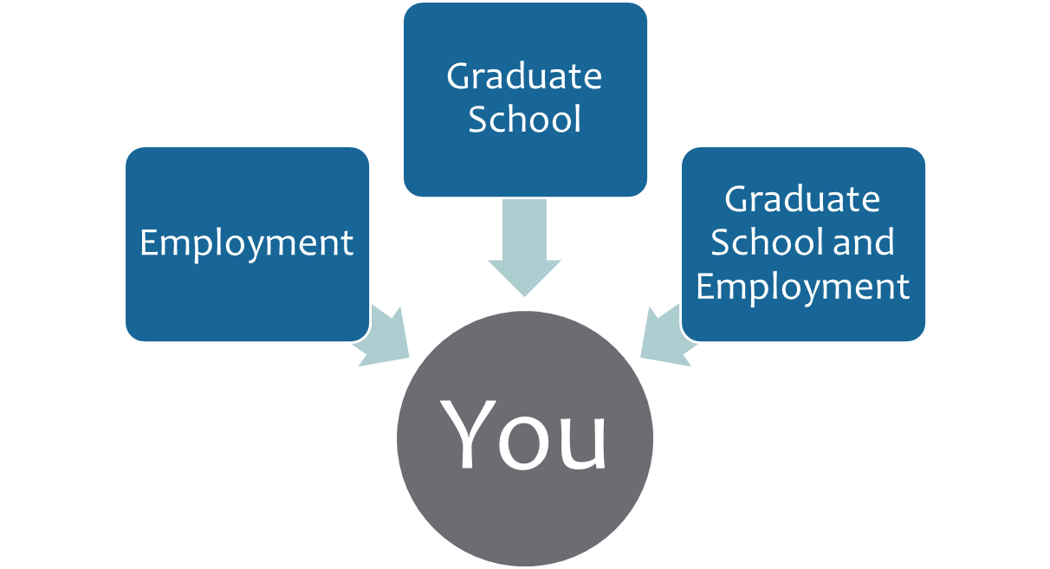
What is your Plan?

Slide 8


Why Graduate School?
Notes:
Going to graduate school is a major commitment of time and money; this decision should not be taken lightly.
It is generally not advised to attend graduate school because you “thought you were supposed to” or don’t know what else to do
It is extremely important to be sure and committed before deciding if graduate school is your next step.
What may be a few reasons you are interested in attending graduate school?

Slide 9
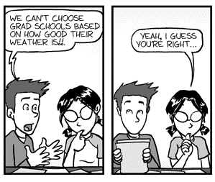
Why Graduate School?
The following is a list of reasons why graduate school might be ideal or potentially beneficial:
Career Goal
Compensation
Staying Marketable

Slide 10
Career Goal
Help you reach your career goal
Professions that require a graduate degree
You don’t want to be classified as overeducated and under experienced.
Notes:
There is generally three objectives or goals for pursing a graduate degree:
The first is to accomplish a specific Career Goal. Earning a graduate degree that will ultimately help you reach your career goal is a very legitimate reason for attending graduate school. There are several professions that require a graduate degree or credential program.
Attorneys, K-12 teachers, doctors, psychiatrists or Marriage & Family Therapists are just a few professions that require a graduate or professional degree. However, if you have any doubt at all about your professional goals, going to graduate school is not going to help you decide on a career.
If you have doubts on graduate school, consider completing self-assessments or working with a Career Counselor to help you figure out your career interests and goals. If you go to graduate school without a clear goal, you will probably end up wasting both time and money.
There are many other careers that offer job opportunities requiring an undergraduate degree. In some situations, having an advanced degree can actually hurt you in a job search if you have little or no job experience related to your graduate or professional degree. You don’t want to be classified as overeducated and under experienced.

Slide 11
Compensation
A college master's degree can be worth $1.3 million more in lifetime earnings than a high school diploma
Increase in compensation depends on the position and or industry
Notes:
Another objective for attending graduate school is compensation. Most studies show that people with advanced degrees earn more on average than people with a bachelor degree. According to a recent report from the U.S. Census Bureau, a master's degree can be worth $1.3 million more in lifetime earnings than a high school diploma,. However, these numbers change depending on the degree. The Masters in Business Administration can really mask or over compensate for the real numbers. For example, a person with a MBA with 3-5 years of experience might be making 65-150,000. While a person with a Masters of Social Work with 3-5 years of experience is making 35,000- 80,000. If you are considering graduate school to increase compensation, make sure you do some research. It is best to know in advance what kind of extra compensation you could get with an advanced degree, so you don’t spend significantly more money on the degree with little in return.

Slide 12
Staying Marketable
For some professions without an advanced degree continued advancement is limited
Having an employer pay for your advanced degree
It is important to know what are your own reasons for attending graduate school
Notes:
Staying Marketable: Getting a graduate degree is not required for many "entry-level" jobs. You may need to earn an advanced degree to keep your training and skills current and make you more marketable for career advancement. In the corporate world, you may hear people talking about “hitting a ceiling.” This means that without an advanced degree continued advancement is limited. I have a friend who is an engineer at Qualcomm in San Diego. He is an excellent Engineer and an even better supervisor. However, his executive team informed him that he could not get a management position until he had a Master’s in Engineering. They offered to pay for his advanced degree and guaranteed him a management position when he completed his degree. Now that is an excellent reason to get an advanced degree. So now I ask you to consider, what are your reasons for attending graduate school? It’s important to answer this question before you proceed.

Slide 13
When should you consider graduate school?
Immediately
Pros
Cons
Accustomed to being a student
Study Skills are sharp
Less obligations
Occupations that require advanced degrees
Could choose the wrong program
Not a competitive candidate to admissions committee
Unlikely to fund entire tuition and expenses
Notes:
When should you consider obtaining a graduate degree? One of the questions most often debated is when is the best time to consider a graduate degree. Is it better to attend graduate school right after you complete your bachelor's degree? Or is it better to wait a few years and gain some work/life experience first? As mentioned above, certainly do not consider going immediately to graduate school as a default move -- or to avoid getting a job.
Immediately: Reasons for going straight to graduate school after earning your bachelor's degree should be weighed as pros and cons. The following are pros for going to graduate school immediately: You are accustomed to being a student and have momentum; Your study skills are sharp; You often have few or less obligations; Some occupations require an advanced degree even for "entry-level" positions. Cons: You could choose the wrong program and end up spending money and time on the wrong profession; Without work experience you may not be a competitive candidate and or receive a poor financial package, increasing the cost of graduate school.

Slide 14
When should you consider graduate school?
After Work Experience
Pros
Cons
Confirmed your career goals through hands-on practical experience
Completed the needed work experience to apply for graduate programs
Bring actual work experience to the theory you will learn in class
Some employers may pay for partial or all of your tuition
Financial stability
Struggle with study skills
Work, life & school balance
Attending class and working with students significantly younger
Leave a paid position to complete an internship opportunity.
Notes:
After some work experience: Pros for working for a few years before going to graduate school or after some work experience could be: Confirming your career goals through hands-on practical experience: Some graduate programs require work experience: you bring a broader world view to your studies; you have a more mature outlook on school and work; some employers will pay for partial or most of your graduate school expenses; For some of you, you are more than a student. You could be a parent, spouse or caregiver going to graduate school after some work experience can help you gain solid financial footing; you can improve your chances for acceptance to graduate programs - especially if you were not the best student in your undergraduate program. Cons: You may struggle with your study skills; It may be very difficult to find a structure or a routine that balances your life with new educational demands. For some of you, you may feel less comfortable attending class, studying and collaborating with students significantly younger than you. A significant age gap with your peers and cohorts can make collaboration and communication difficult. Lastly, some graduate programs require you complete internship opportunities as part of your educational curriculum. Even though, this is a great opportunity to get some hands-on experience and confirm your career decision, for some you must leave your current full-time paid position to complete this educational obligation.

Slide 15
When should you consider graduate school?
During Entry level Career
Pros
Cons
Locate employers willing to pay for your education while you work
Financially stable while concurrently working on improving your skills
Minimal student loans
Know you already have a job after graduation
Balancing your job, school, and personal life
Organizing schedule to accommodate school, work and possible unpaid internships
Adjustment to work/school load; may take longer to complete program
Notes:
Going to graduate school during your entry level career. We understand that is not always possible, but we want you to know this method has many benefits and few drawbacks. Many of the reasons we stated earlier. You have the potential to locate an employer who is also willing to pay for your advanced education, while you build the skills and experience you need to excel in your career. So not only are you financially stable, you are concurrently working on improving your skills while connecting your education together. Yes, you may struggle a bit or take longer to complete your advanced degree, but you don’t have the financial burden of paying off student loans after you graduate, nor will you need to worry about finding a job. You will be more likely to gain the attention of your executive team on the next available promotion after you graduate.

Slide 16
Graduate School Resources How to get help…
Career Development Services
Faculty
Expert knowledge in career specific industry
Share personal career-path
Research information/opportunity*
Student selection process*
Review Essays*
Advise on information
Application process
Graduate & Professional School Fairs
External resources and referrals
Mock-interview preparation
Don’t forget the Admission Advisors at your Graduate School of interest!

Slide 17

Graduate School Resources
Graduate Studies Center
  Counseling
  Graduate Writing Studio
  Test Preparation Books
Graduate School Handbook
Career Counseling

Slide 18
Researching Employment & Career Outlook
From the Bureau of Labor Statistics, Occupational Outlook Handbook:
    Can help you find career information on responsibilities, education, training, pay, and outlook for hundreds of occupations
    http://www.bls.gov/ooh/

Slide 19
Research Career Options
U.S. Bureau of Labor & Statistics
  www.bls.gov
Educational and Career Planning
  www.myplan.com
Career exploring
  http://mynextmove.org
  http://www.onetonline.org/

Slide 20
Basic Job Search: Advertised Listing
Create a Dolphin CareerLink Profile
Review Resources (CDS website, Dolphin CareerLink)
Create a Resume, Cover Letter & References
Have Career Development Services, Faculty, Staff Friends, and Family review your documents
Notes:
Dolphin Careerlink lists full-time, part-time, internship, and on-campus positions by businesses, government agencies, nonprofit organizations, on-campus departments, and individuals who adhere to Equal Employment Opportunity

Slide 21
Research Companies: Access the Job Market
Candidates with Experience
Candidates with little or no experience
What types of employers interest you? Make a target list of employers to call or email
Know department’s needs and challenges and include that in email or phone script
Know your skills – in your industry’s terms
Bookmark 20 employers – BE PICKY
Informational Interviews
Volunteer/Internships that lead to jobs
Supplemental Income?
What are jobs you can do right now? Foot in the door?

Slide 22
Basic Strategy
Apply for 5 a day for 3 weeks to get search off to a great start
For each position BE SURE to change Objective, Highlights, and Cover letter for each individual opportunity
Follow-up after 1 week of waiting to ask when they are starting to interview

Slide 23

Employer Advice
Research, research, research
Be prepared for your interview
Gain relevant work experience
Stand out - demonstrate
Communication skills
Maturity/business etiquette
Work ethic

Slide 24

Proactive Job Search
What is “The Hidden Job Market?”
75-85% of all jobs
Don’t wait until the job is open!
Notes:
It is estimated that only 20% of all jobs are ever advertised, meaning 80% of jobs are filled by companies who never advertised the position. Instead these positions are filled by referral, the "who do you know" method of recruitment. So while keeping an eye on newspaper advertisements and internet job search sites is important, the percentages are in your favor if you investigate the hidden job market.
How do you tap into this market?
By following creative strategies such as: using personal contacts and contacting employers directly. But even using these approaches will not get you anywhere without follow up. It is essential to develop effective tools and dynamic strategies for job searching so you stand out from other applicants.
Learn about field(s)
▪ Develop mentoring relationships
▪ Tap the hidden job market

Slide 25
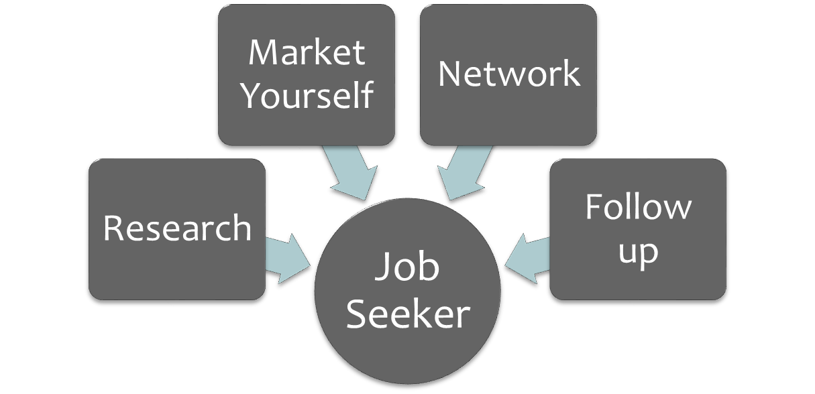
1. Active Engagement
Notes:
Designing a plan to conduct a proactive job search requires that you are actively engaged in the search process entirely. This type of strategic job hunting is critical to implement in today’s current career trends.
In today’s competitive job market it is more crucial than ever to take a proactive job search approach.
So, the question is… How do you tap into this “hidden job market?” The answer is through implementing innovative and creative methods for job hunting.
Today, we are going to strategize how to think outside of the box and be more innovative and creative in our job search techniques to help you stand out from other applicants.
Utilizing a proactive strategy will require the following components: Research, Marketing Yourself, Networking, and Follow Up.
Lets discuss the following strategies in more depth.

Slide 26
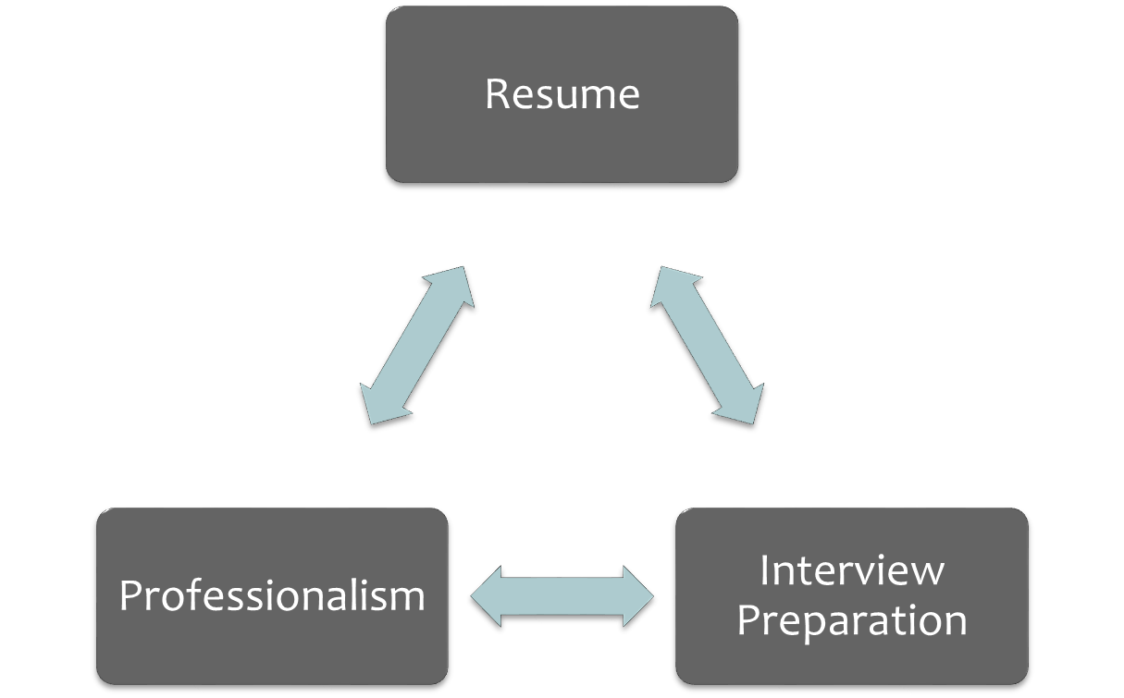
2. Market Yourself
Notes:
The next step is to market yourself.
Looking for a job or internship is similar to selling a new product. Although in this case, you are the product. You will need to appeal to your potential customers or employers.
First, you want to make sure that your resume is polished and that it accurately represents your skills, background, and preparedness for entering the field. Meet with a career counselor to discuss resume styles and cover letters to choose the best suited format for your resume.
Next, focus on professionalism. Create professional business cards, meet with a career counselor to discuss interview etiquette.
Lastly, you want to be well prepared for the interview so make sure that you practice and do mock interviews. There are some great online resources and programs to utilize. One program called perfect interview has about 1,500 interview questions all on a digital video.

Slide 27
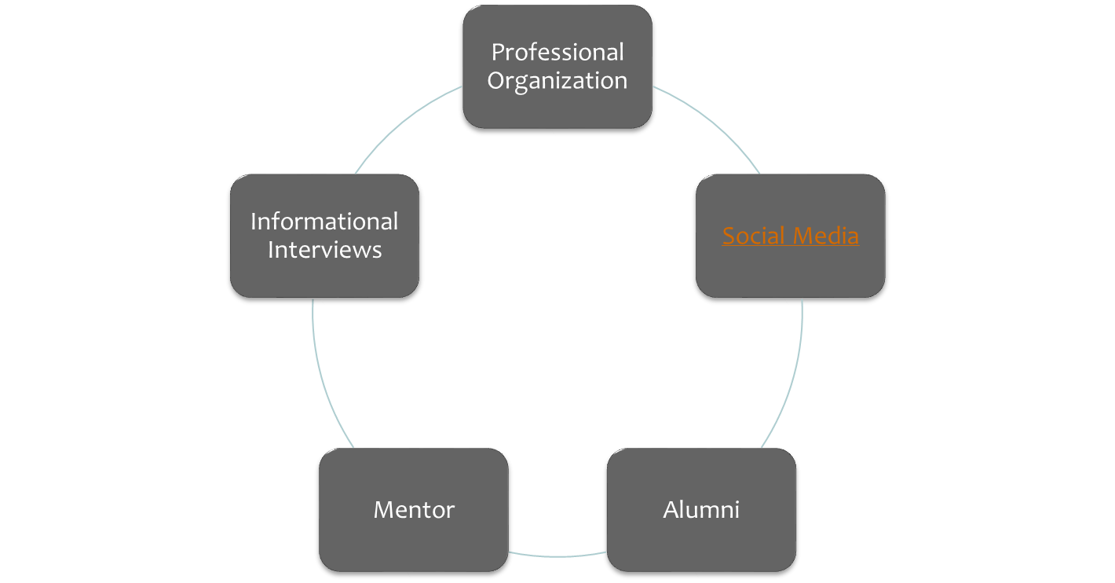
3. Networking
Notes:
Networking is the next step and a very key component of proactive job hunting. Get involved- join a professional organization- professional organizations are a great resource for a few reasons. First, most memberships have a professional development component to them which may include monthly or quarterly subscriptions to career related information which will be great information to know during an interview to demonstrate that you know about the hot topics in your field. Some may even have conferences which serve as an opportunity to build networks and gain professional development. Next, it’s a good thing to put on your resume to build experience. Lastly, student membership rates are typically much lower compared to professional rates after graduation.
join a job hunting support group, social media- linked in
Informational interviews-
Job Shadow
Join the Alumni Association to gain opportunities for networking
Find a mentor. Get involved in a mentorship program. Talk to faculty members
Conduct informational interviews which is a brief meeting that you schedule with someone who works in an industry that you may be considering for future employment. A great learning experience.

Slide 28

Tips for Success
Be focused, yet flexible
Revise, update, and tailor your resume, cover letter, and applications
Perfect your interviewing skills
Set short-term and long-term goals
Be realistic about investment in time
Be persistent and patient – follow-up
Maintain a positive attitude

Slide 29
Resources to help you …
Graduate Studies Center
Career Development Services can support you in career exploration, planning and preparation
Faculty members and staff
Professionals currently working in your field of interest

Slide 30
References
Dang. P. California State University Channel Islands. Plan B Graduate School or Full-Time Work [PowerPoint slides]. Retrieved from Career Development Services

Slide 31
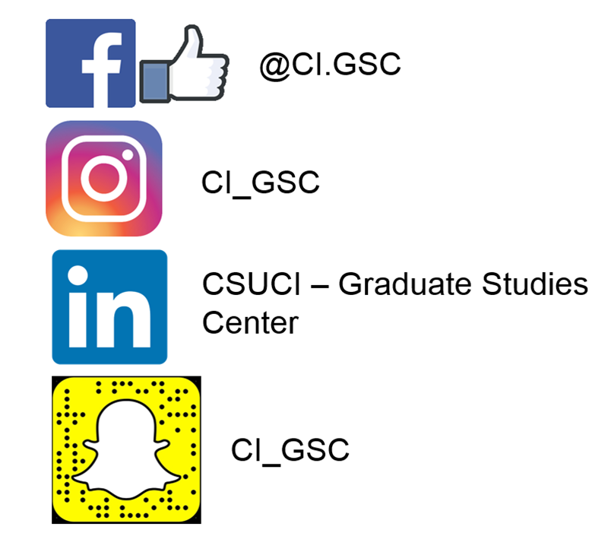
Follow us!

Slide 32


Center Hours & Contact Info
Monday - Thursday: 9 a.m. - 9 p.m.
Friday: 9 a.m. - 4 p.m.
Saturday: 10 a.m. - 2 p.m.

