Slide 1
Graduate School Application Planning
Presented by:
Patty Dang, M.S.
Career Development
Services Counselor
Please make sure you print Graduate School Application Planning Web PowerPoint Guide found on the Career Development Services Website.
It is crucial you complete the workshop guide to supplement the self-guided process. The content and structure of this self-guided workshop might be different than similar documents from an in-person workshop. Please contact Career Development Services if you have any questions regarding the information presented in the guide or workshop.
www.csuci.edu/careerdevelopment

Slide 2
Learning Objectives
Identify the key factors in pursuing an advanced degree
List two graduate school resources provided by Career Development Services
Reflect on the timeline process of preparing for graduate school testing.

Slide 3
Agenda
Key Factors To Consider: Slides
When To Attend
Testing
Application Timeline
Graduate School Resources

Slide 4
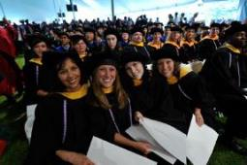
Why Graduate School?
Going to graduate school is a major commitment of time and money; this decision should not be taken lightly.
It is generally not advised to attend graduate school because you “thought you were supposed to” or don’t know what else to do.
You will face several years of intense work, research and a more demanding course load than in your undergraduate program.
It is extremely important to be sure and committed before deciding if graduate school is your next step.

Slide 5
Why Graduate School?
The following is a list of reasons why graduate school might be ideal or potentially beneficial:
Career Goal
Compensation
Staying Marketable
What is your reason for attending graduate school?
It is important to complete your answer in the guide before moving to the next slides

Slide 6
Career Goal
Earning a graduate degree that is part of your plan to reach a specific and carefully thought out career goal is a very legitimate reason for attending graduate school.
There are several professions that require a graduate degree or credential program. Attorneys, K-12 teachers, doctors, psychiatrists or Marriage & Family Therapists are just a few professions that require a graduate or professional degree.

Slide 7
Career Goal
If you are unsure or have doubts about your professional goals, going to graduate school is not going to help you find your career.
Questions or concerns regarding graduate school, should be addressed with faculty in professions you are considering or working with a Career Counselor to help you figure out your career interests and goals.
Attending graduate school without a clear specific career goal, can potentially lead to lower motivation and program drop-out.

Slide 8
Career Goal
There are many careers that offer job opportunities that don’t require an advanced degree.
In some situations, having an advanced degree can actually hurt you in a job search if you have little or no job experience related to your graduate or professional degree.
You don’t want to be classified as overeducated and under experienced.
Employers prefer education but require direct and related skills and experience for their competitive position.

Slide 9
Compensation
Most studies show that people with advanced degrees earn more on average than those with only a bachelor degree.
A college master's degree can be worth $1.3 million more in lifetime earnings than a high school diploma Recently reported from the U.S. Census Bureau.
However, increase in compensation depends on the position and or industry.

Slide 10
Compensation
The Masters in Business Administration can really mask national salary averages. For example, a person with a MBA with 3-5 years of experience might be making 65-150,000. While a person with a Masters of Social Work with 3-5 years of experience is making 35,000-80,000.
It is best to know in advance what kind of extra compensation you could get with an advanced degree. Researching the average income for those who have advanced degrees compared to those who do not within the same profession and
Learn more about Salary Comparisons at NACE

Slide 11
Staying Marketable
For some professions without an advanced degree continued advancement is limited.
You may need to earn an advanced degree to keep your training and skills current to make you more marketable for career advancement. In the corporate world, you may hear people talking about “hitting a ceiling.”
Getting a graduate degree is not required for many "entry-level" jobs.

Slide 12
Staying Marketable
Have an employer pay for your advanced degree. Example: An engineer at Qualcomm in San Diego could not get a management position until he had a Master’s in Engineering. His executive team offered to pay for his advanced degree and guaranteed him a management position when he completed his degree.
Is an advanced degree a tool in advancing your career?

Slide 13
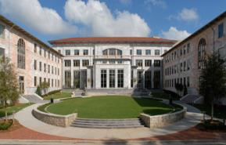
When should you attend graduate school?
One of the questions most often debated is when is the best time to consider a graduate degree. Is it better to attend graduate school right after you complete your bachelor's degree?
Or is it better to wait a few years and gain some work/life experience first?
As mentioned above, certainly do not consider going immediately to graduate school as a default move -- or to avoid getting a job.

Slide 14
Immediately
Pros
Accustomed to being a student and have momentum
Cons
Could choose the wrong program = spending money and time on wrong profession
Study Skills are sharp
Few or less obligations
Occupations that require advanced degrees for “entry-level” positions
Not a competitive candidate to admissions committee without work experience
Unlikely to fund entire tuition and expenses

Slide 15
After Work Experience
Pros
Confirmed your career goals through hands-practical experience
Cons
Struggle with study skills
Leave a paid position to complete an internship opportunity.
Attending class and working with students significantly younger
Work, life & school balance
Improve chances for acceptance to graduate programs
Financial stability
Some employers may pay for partial or all of your tuition
Bring actual work experience to the theory you will learn in class
Completed the needed work experience to apply for graduate programs

Slide 16
During Entry-Level Career
Pros
Locate employers willing to pay for your education while you work
Cons
Balancing work and education simultaneously.
Financially stable while concurrently working on improving your skills
Minimal student loans
Know you already have a job after graduation

Slide 17
Types of Tests
Which tests should you take?
Depends on the university/college and each program has different requirements. Check program requirements found on the application website. Don’t assume, Find out!
Typical tests include:
GRE General Tests
GRE Subject Tests
LSAT – Law School
MCAT- Medical School
GMAT – Business Schools

Slide 18
Test Preparation
Self- Study Options:
ETS website – offers practice test and registration information.
Test books- fairly comprehensive & offers a variety of practice tests.
Preparation Classes (community college courses):
Los Angeles Pierce College’s Extension offers a 2-part prep-test, 1 for verbal and analytical and the other on quantitative (math) course at $109 per course. If, you discover that you only need the verbal and analytical scores you may only need to take 1 course.

Slide 19
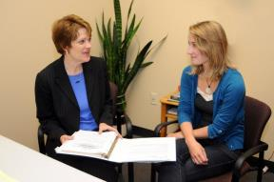
Test Preparation
Private test-prep schools:
Kaplan offers up several options including premium services that provides a money-back guarantee. However, their services can cost anywhere from $300 to several thousand dollars. If you are interested in obtaining high score results, Kaplan is ideal. But, the price for achieving a particular score with Kaplan is fairly expensive.
For more information please visit their website.

Slide 20
Test Preparation Costs
ETS Website – free
Test books ($10-$30)
Test-Prep classes ($109-$218)
Private test-prep ($500-several thousands)

Slide 21
Graduate School Application Timeline
Research
Select programs and schools of interests
Recommend 3-5 schools
Average acceptance is 15%
Find out about pre-requisites & special requirements
Application requirements & deadlines
Visit school’s website & contact admissions counselors.
Every school and program is different
Should start research 10 months prior to application deadline (February-July of the previous year for Fall)

Slide 22
Graduate School Application Timeline
Testing
Study for exam (May-August = Jan 15 deadline)
6-8 months prior to application deadline
Pay & Schedule ETS (3weeks-2months prior to exam day)
Take the Exam 2-3 months prior to application deadline
Anticipate the possibility of retesting
Pro: Improve better scores
Con: cost
Meet with admissions counselor for specific program questions & attend a campus visit.

Slide 23
Graduate School Application Timeline
Letters of Recommendation
Start around the same time you are taking the GRE or waiting for the results
Contact Professors and Supervisors
Who really know you & speak on your behalf
Can highlight the best qualities, & fill in any gaps, questions, or concerns
For example if you are applying for a MBA graduate program and you excel in the business courses but, your English courses are average. An admissions counselor is going to be concerned that the student might not do well in writing papers for their master’s thesis. However, if you get a letter of recommendation from your English professors explaining how well you have excelled in your last couple English courses, it alleviates their concerns regarding your writing ability.

Slide 24
Graduate School Application Timeline
Letters of Recommendation
Avoid getting a letter from someone who doesn’t know you well, or someone who can not speak about your ability to excel in your education
Personal friends, relatives and mentors who are ill-informed about your academics or hasn’t supervised you, have very little impact on the admissions committee.

Slide 25
Graduate School Application Timeline
Letters of Recommendation
Provide Summary & Transcripts to the writer
Detailed information about yourself
Reason you are applying, goals, and interests
Don’t assume that your letter writer knows everything about you and only has only good things to say, they may have concerns. For most circumstances you can address any issues and communicate what information is relevant to focus on in the letter of recommendation.
It is common for faculty to write letters that indicate they know little about the student, without the above information.
Request letters 6-8 weeks in advance

Slide 26
Graduate School Application Timeline
Statement of Purpose/Personal Statement
Research school information to draft essay. Include:
Faculty and program information
Mission of the department and institution
Speak with an admissions counselor, visiting the campus and meeting the faculty and staff has a significant advantage to those who don’t.
Write Rough Draft (summer)
Ideal time to write is 6 months in advance
Review & Edited by Faculty and Graduate Writing Studio
Roughly 3-4 months before the application deadline

Slide 27
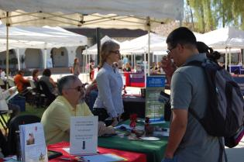
Graduate School Application Timeline
Attend Graduate & Professional School Fairs
Meet with Enrollment Advisors and learn about graduate school programs
Get tips and additional help for the application
Check GRE test results with Enrollment Advisors
Participate 1 year before you plan to attend graduate school
CDS hosts this event only during the Fall Semester.

Slide 28
Graduate School Application Timeline
Submit your Application
Majority of graduate program deadlines occur December 1-January 15
Double check each program, deadlines may vary
Need to apply to both the university and department
May have separate deadlines & requirements
Send 1-2 weeks early
Double check materials before you send application out
Have another person double check your materials
Interviews occur 2-4 months after application deadline(typically March-May)
Stay in contact with the admissions advisors for updates

Slide 29
Graduate School Resources How to get help…
Career Development Services
Faculty
Advise on Application process
Graduate & Professional School Fairs
Provide external resources and referrals
Conduct Mock-interview & preparation information
Expert knowledge in career specific industry
Share personal career-path
Research information/opportunity*
Student selection process*
Review Essays*

Slide 30
Graduate School Resources
Career Development Services Offers:
Graduate School Bound Program
Graduate School Application Advising
Graduate School Handbook
Eureka Career Cruising Resources
Weekly Resume Clinics and Drop-in Counseling

Slide 31
Graduate School Resources
Graduate School Bound Program
Incorporates 6 detailed modules covering the topics of testing, application process, financial aid, and writing a personal statement or statement of purpose.
The Graduate School Program is a hands on approach, that is not replaceable with a workshop or single counseling session. Please visit our website for more information.

Slide 32
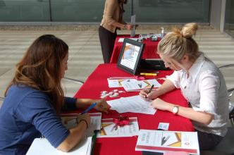
Graduate School Resources
Graduate School Application Advising
Visit us during Drop-in Career Counseling.
One-on-one appointments are available to all of our current students unable to attend Drop-In Career Counseling.
Please keep in mind that appointment slots are limited. Scheduling well in advance with the Career Center is highly recommended.
It is important that you come to the appointment with questions and a list of schools or programs you are interested in exploring.

Slide 33
Graduate School Resources
Graduate School Handbook
The handbook provides a basic overview of the graduate school application process as well as graduate school resources.
Eureka & Career Cruising Resources
An excellent online resource that can help you locate and research graduate school programs.
Also provides admission counselor's contact information for you to get your specific questions answered.

Slide 34
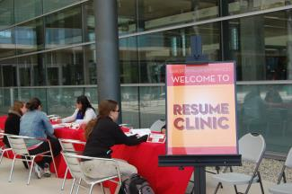
Graduate School Resources
Weekly Resume Clinics and Drop-in Counseling
Designed to help you create a polished resume or CV for graduate school application.
Opportunity to ask questions, and finalize your application process

Slide 35
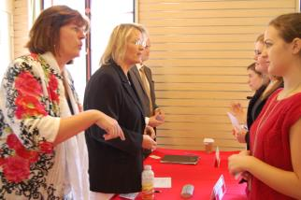
CDS Programs & Events
Employer Interviews
An opportunity to help you prepare for graduate school or job interviews with a local employer, staff or faculty.
Graduate School Panel
Provides advice and insight on the application process and tips to successfully navigate graduate school from admission counselors, current graduate students, & other key staff and faculty members

Slide 36
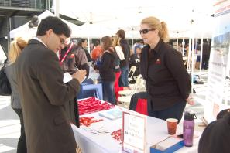
CDS Programs & Events
Graduate & Professional School Fair
50+ graduate programs/schools attend this annual event to provide students answers and insights.
Graduate & Professional School Week
Programs and services that includes the fair, panel, workshop, and Drop-In Career Counseling/Resume Clinic to help you prepare for the Fair.

Slide 37
Resources to help you …
Career Development Services can support you in career exploration, planning and preparation!
Career Development Services Website Facebook: go.csuci.edu/cdsFB
Twitter: go.csuci.edu/cdstweet Linkedin: go.csuci.edu/linkedingroup

Slide 38
Questions?
Visit us during Drop-in Career Counseling
Schedule & Availability can be found on our CDS Website
Amanda Carpenter, Ed.D. Assistant Director of Career Development Services & Henry L. "Hank" Lacayo Institute Internship Program California State University Channel Islands Bell Tower 1527 (805) 437-3565 (office) amanda.carpenter@csuci.edu Career Development Center California State University Channel Islands Bell Tower 1548 (805) 437-3270 (office) (805) 437-8899 (fax) career.services@csuci.edu
Patty Dang, M.S
Career Development Services Counselor California State University Channel Islands Bell Tower 1521 (805) 437-3544 (office) patty.dang@csuci.edu

Slide 39
Please help us provide better Career Development content and services by completing a 3-7 minute survey
Complete CDS Survey

