Slide 1

Graduate School or Full-Time Work?
Presented by:
Patty Dang, M.S.
Career Development Counselor
How to use this self-directed PowerPoint:
Since this workshop does not have a presenter to go into detail about each subject or topic, there are many hyperlinks throughout the presentation that links to additional information and resources. Please click and hold the control key to link to other sites and resources, as additional information and resources are provided to those interested in learning more information about the topics discussed in each slide.
Please make sure you print the Plan B: Graduate School or Full-Time Work? Guide found on the Career Development Services Website. It is crucial you complete this guide to supplement the self-guided process.
This workshop is a quick overview of the job search process including necessary documents, preparation, tips and tools to help students successfully locate employment post-graduation. It is not intended to completely cover the topics thoroughly in the workshop, and additional support and assistance from Career Development Services is highly recommended.
For more information on other workshops online and in person, please visit our website

Slide 2
Learning Objectives…
Describe an ideal purpose of attending graduate school
Reflect personally the benefits or drawback to attending graduate school vs. full-time work
Identify several resources in researching employment options

Slide 3
Agenda
Why Graduate School?
Job vs Career
Graduate School
Job Preparation

Slide 4
Audience Poll
How many of you…
Want to go to graduate school full-time?
Want to begin work job right after graduation?
Want to work full-time and go to graduate part-time?
Want to work part-time and go to graduate school full-time?
Not sure?

Slide 5
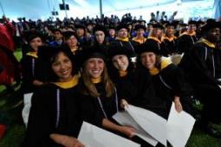

Why Graduate School?
Going to graduate school is a major commitment of time and money; this decision should not be taken lightly.
It is generally not advised to attend graduate school because you “thought you were supposed to” or don’t know what else to do.
You will face several years of intense work, research and a more demanding course load than in your undergraduate program.
It is extremely important to be sure and committed before deciding if graduate school is your next step.

Slide 6
Why Graduate School?
The following is a list of reasons why graduate school might be ideal or potentially beneficial:
Career Goal
Compensation
Staying Marketable
What is your reason for attending graduate school?
It is important to complete your answer in the guide before moving to the next slides

Slide 7

Career Goal
Earning a graduate degree that is part of your plan to reach a specific and carefully thought out career goal is a very legitimate reason for attending graduate school.
There are several professions that require a graduate degree or credential program. Attorneys, K-12 teachers, doctors, psychiatrists or Marriage & Family Therapists are just a few professions that require a graduate or professional degree.

Slide 8

Career Goal
If you are unsure or have doubts about your professional goals, going to graduate school is not going to help you find your career.
Questions or concerns regarding graduate school, should be addressed with faculty in professions you are considering or working with a Career Counselor to help you figure out your career interests and goals.
Attending graduate school without a clear specific career goal, can potentially lead to lower motivation and program drop-out.

Slide 9

Career Goal
There are many careers that offer job opportunities that don’t require an advanced degree.
In some situations, having an advanced degree can actually hurt you in a job search if you have little or no job experience related to your graduate or professional degree.
You don’t want to be classified as overeducated and under experienced.
Employers prefer education but require direct and related skills and experience for their competitive position.

Slide 10

Compensation
Most studies show that people with advanced degrees earn more on average than those with only a bachelor degree.
A college master's degree can be worth $1.3 million more in lifetime earnings than a high school diploma Recently reported from the U.S. Census Bureau.
However, increase in compensation depends on the position and or industry.

Slide 11

Compensation
The Masters in Business Administration can really mask national salary averages. For example, a person with a MBA with 3-5 years of experience might be making 65-150,000. While a person with a Masters of Social Work with 3-5 years of experience is making 35,000-80,000.
It is best to know in advance what kind of extra compensation you could get with an advanced degree. Researching the average income for those who have advanced degrees compared to those who do not within the same profession and
Learn more about Salary Comparisons at NACE

Slide 12

Staying Marketable
For some professions without an advanced degree continued advancement is limited.
You may need to earn an advanced degree to keep your training and skills current to make you more marketable for career advancement. In the corporate world, you may hear people talking about “hitting a ceiling.”
Getting a graduate degree is not required for many "entry-level" jobs.

Slide 13

Staying Marketable
Have an employer pay for your advanced degree. Example: An engineer at Qualcomm in San Diego could not get a management position until he had a Master’s in Engineering. His executive team offered to pay for his advanced degree and guaranteed him a management position when he completed his degree.
Is an advanced degree a tool in advancing your career?

Slide 14
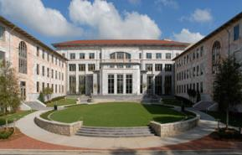
When should you attend graduate school?
One of the questions most often debated is when is the best time to consider a graduate degree. Is it better to attend graduate school right after you complete your bachelor's degree?
Or is it better to wait a few years and gain some work/life experience first?
As mentioned above, certainly do not consider going immediately to graduate school as a default move -- or to avoid getting a job.

Slide 15
Immediately
Pros
Accustomed to being a student and have momentum
Cons
Could choose the wrong program = spending money and time on wrong profession
Study Skills are sharp
Few or less obligations
Occupations that require advanced degrees for “entry-level” positions
Not a competitive candidate to admissions committee without work experience
Unlikely to fund entire tuition and expenses

Slide 16
After Work Experience
Pros
Confirmed your career goals through hands-practical experience
Cons
Struggle with study skills
Leave a paid position to complete an internship opportunity.
Attending class and working with students significantly younger
Work, life & school balance
Improve chances for acceptance to graduate programs
Financial stability
Some employers may pay for partial or all of your tuition
Bring actual work experience to the theory you will learn in class
Completed the needed work experience to apply for graduate programs

Slide 17
During Entry-Level Career
Pros
Locate employers willing to pay for your education while you work
Cons
Balancing work and education simultaneously.
Financially stable while concurrently working on improving your skills
Minimal student loans
Know you already have a job after graduation

Slide 18

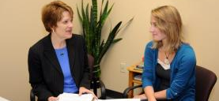
Graduate School Resources
How to get help…
Career Development Services
Faculty
Advise on Application process
Graduate & Professional School Fairs
Provide external resources and referrals
Conduct Mock-interview & preparation information
Expert knowledge in career specific industry
Share personal career-path
Research information/opportunity*
Student selection process*
Review Essays*

Slide 19

Graduate School Resources
Career Development Services Offers:
Graduate School Bound Program
Graduate School Application Advising
Graduate School Handbook
Eureka Career Cruising Resources
Weekly Resume Clinics and Drop-in Counseling

Slide 20

Graduate School Resources
Graduate School Bound Program
Incorporates 6 detailed modules covering the topics of testing, application process, financial aid, and writing a personal statement or statement of purpose.
The Graduate School Program is a hands on approach, that is not replaceable with a workshop or single counseling session. Please visit our website for more information.

Slide 21
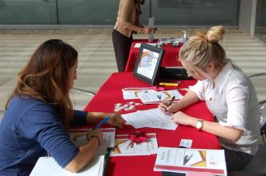
Graduate School Resources
Graduate School Application Advising
Visit us during Drop-in Career Counseling.
One-on-one appointments are available to all of our current students unable to attend Drop-In Career Counseling.
  Please keep in mind that appointment slots are limited. Scheduling well in advance with the Career Center is highly recommended.
  It is important that you come to the appointment with questions and a list of schools or programs you are interested in exploring.

Slide 22

Graduate School Resources
Graduate School Handbook
The handbook provides a basic overview of the graduate school application process as well as graduate school resources.
Eureka & Career Cruising Resources
An excellent online resource that can help you locate and research graduate school programs.
Also provides admission counselor's contact information for you to get your specific questions answered.

Slide 23
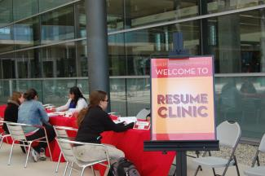
Graduate School Resources
Weekly Resume Clinics and Drop-in Counseling
Designed to help you create a polished resume or CV for graduate school application.
Opportunity to ask questions, and finalize your application process

Slide 24
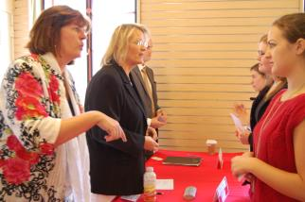
CDS Programs & Events
Employer Interviews
An opportunity to help you prepare for graduate school or job interviews with a local employer, staff or faculty.
Graduate School Panel
Provides advice and insight on the application process and tips to successfully navigate graduate school from admission counselors, current graduate students, & other key staff and faculty members

Slide 25
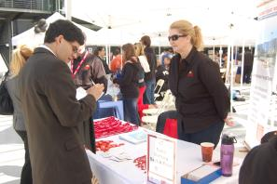
CDS Programs & Events
Graduate & Professional School Fair
50+ graduate programs/schools attend this annual event to provide students answers and insights.
Graduate & Professional School Week
Programs and services that includes the fair, panel, workshop, and Drop-In Career Counseling/Resume Clinic to help you prepare for the Fair.

Slide 26
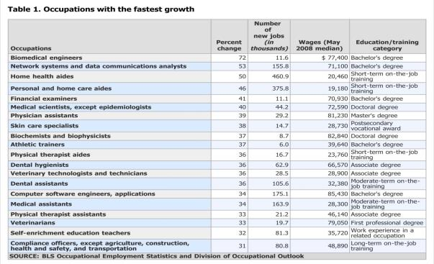
Researching Employment Opportunities for Full-Time Work
Employment Trends
Fastest Growing Occupations
www.bls.gov/oco
Notes:
Regardless of what you decide researching information about careers employment statistics and graduate schools will help guide your decision making.

Slide 27
Research Career Options
www.bls.gov
www.myplan.com
http://mynextmove.org
http://www.onetonline.org/
Notes:
Now that you know resources on researching career options. Lets discuss the steps to conduct a basic job search.

Slide 28


Basic Job Search:
Advertised Listing
Create a Dolphin CareerLink Profile
Review Resources (CDS website, Dolphin CareerLink)
Create a Resume, Cover Letter & References
Have Career Development Services, Faculty, Staff Friends, and Family review your documents

Slide 29


Research Companies:
Access the Job Market
Candidates with Experience
What types of employers interest you? Make a target list of employers to call or email
Know department’s needs and challenges and include that in email or phone script
Know your skills – in your industry’s terms
Bookmark 20 employers – BE PICKY
Candidates with little or experience
Informational Interviews
Volunteer/Internships that lead to jobs
Supplemental Income?
What are jobs you can do right now? Foot in the door?

Slide 30
Search Plan
Apply for __ positions a day for __ weeks to get job search off to a great start
For each position BE SURE to change Objective, Highlights, and Cover letter for each individual opportunity
Follow-up after 1 week of waiting to ask when they are starting to interview

Slide 31
Employer Advice
Research, research, research
Be prepared for your interview
Gain relevant work experience
Stand out - demonstrate
  Communication skills
  Maturity/business etiquette
  Work ethic

Slide 32
Proactive Job Search
It is estimated that only 15-20% of all jobs are ever advertised, meaning 80-85% of jobs are filled by companies who never advertised the position. Instead these positions are filled by referral, the "who do you know" method of recruitment. So while keeping an eye advertised positions is important, the percentages are in your favor if you investigate the hidden job market.
What is “The Hidden Job Market?”

Slide 33
Proactive Job Search
Don’t wait until the job is open!
By following creative strategies such as: using personal contacts and contacting employers directly. It is essential to develop effective tools and dynamic strategies for job searching so you stand out from other applicants.
Develop mentoring relationships. When you establish professional working relationships with mentors, you enlist personal recruiters to help you find opportunities that may not be posted, and gain tips and insights from seasoned and experience professionals.

Slide 34
1. Active Engagement
Designing a plan to conduct a proactive job search requires that you are actively engaged in the search process entirely. This type of strategic job hunting is critical to implement in today’s current career trends.
First, By utilizing the following components, you will engage in a more targeted approach to your job search.
Job Seeker
Research
Market Yourself
Network
Follow up

Slide 35
2. Market Yourself
Looking for a job or internship is similar to selling a new product. Although in this case, you are the product. You will need to appeal to your potential customers or employers.
Resume
Interview Preparation
Professionalism
Polished and accurately represents your skills, background, and preparedness for employment
Create professional business cards
60 second elevator speech
Practice mock interviews
Dolphin CareerLink has an online mock-interview system to help you prepare for potential questions

Slide 36
Networking
Professional Organizations
  Connect with skilled and experienced mentors and professionals in your career
  Engage in opportunities to build networks and gain professional development at conferences
  Student membership rates typically much lower compared to professional rates after graduation.
Social Media
  Job search tool
  Support groups to improve your job search and interview skills
  LinkedIn
Informational Interviews
  Brief meeting with someone who works in an industry that you may be considering for future employment
  Job shadow
Alumni
  Gain opportunities for networking
Mentors
  Get involved in a mentorship program
  Talk to faculty members

Slide 37
Tips for Success
Be focused, yet flexible
Revise, update, and tailor your resume, cover letter, and applications
Perfect your interviewing skills
Set short-term and long-term goals
Be realistic about investment in time
Be persistent and patient – follow-up
Maintain a positive attitude

Slide 38

Resources to help you …
Career Development Services can support you in career exploration, planning and preparation!
Career Development Services Website Facebook: go.csuci.edu/cdsFB
Twitter: go.csuci.edu/cdstweet Linkedin: go.csuci.edu/linkedingroup

Slide 39
Questions?
Visit us during Drop-in Career Counseling
Schedule & Availability can be found on our CDS Website
Amanda Carpenter, Ed.D.
Assistant Director of Career Development Services & Henry L. "Hank" Lacayo Institute Internship Program
California State University Channel Islands
Bell Tower 1527
(805) 437-3565 (office)
amanda.carpenter@csuci.edu
Career Development Center
California State University Channel Islands
Bell Tower 1548
(805) 437-3270 (office)
(805) 437-8899 (fax)
career.services@csuci.edu
Patty Dang, M.S
Career Development Services Counselor
California State University Channel Islands
Bell Tower 1521
(805) 437-3544 (office)
patty.dang@csuci.edu

Slide 40

Please help us provide better Career Development content and services by completing a 3-7 minute survey
Complete CDS Survey

