Slide 1
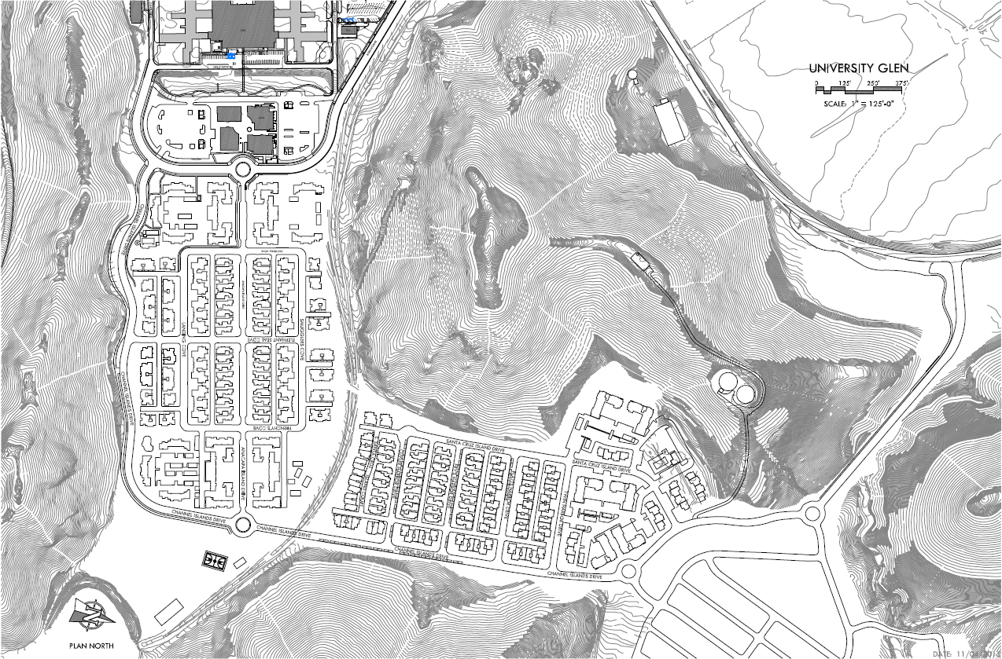
East Campus Landscaping and Infrastructure

Slide 2
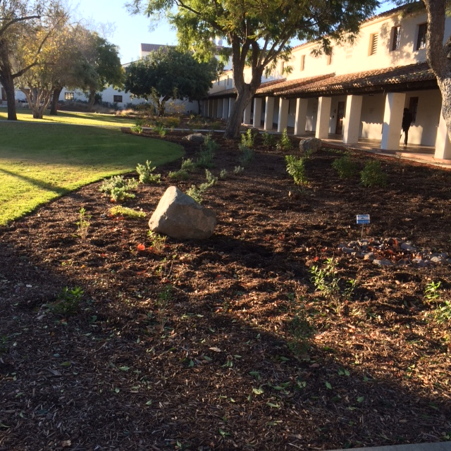
Landscaping Maintenance

Slide 3
Pride of Ownership
Facilities Services grounds brings a renewed sense of pride and ownership.
Main campus customer service scores shows 4 out of 5 rating (5 being the best) with minimal reports or complaints.

Slide 4
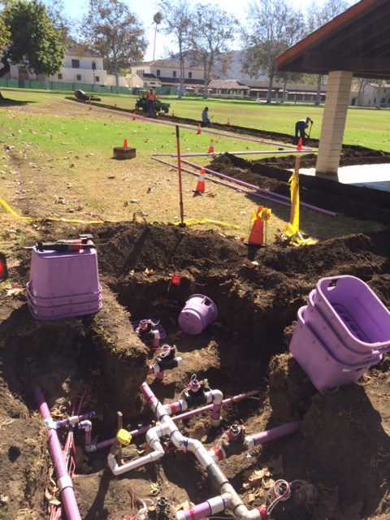
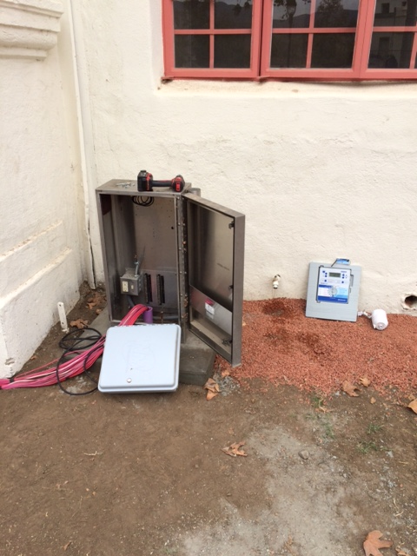
Irrigation Upgrade and Recycled Water Management
Management of water starts with infrastructure.
Skilled repair specialist on hand.
Cutting-edge controller technology.
CSU Channel Islands is currently at a milestone of 40% recycled water reduction in usage.
The campus is using 2009 usage levels and is irrigating 30 more acres.
This is critical with the State Mandates in water reduction and the campus plan in water conservation.

Slide 5
24/7 Emergency Response
Grounds services is always ready to respond to disaster.
Communication network is in place.
Employee’s live on or in surrounding community.
Equipment is onsite and always ready for use.

Slide 6
Environmental Protection
Monitoring and cleaning storm out falls.
Curb, gutter, and parking lot street sweeping.

Slide 7
Innovative conservation products

Slide 8
Pest Management

Slide 9
Tree Care

Slide 10
Water shed abatement & restoration

Slide 11
Community Service

Slide 12
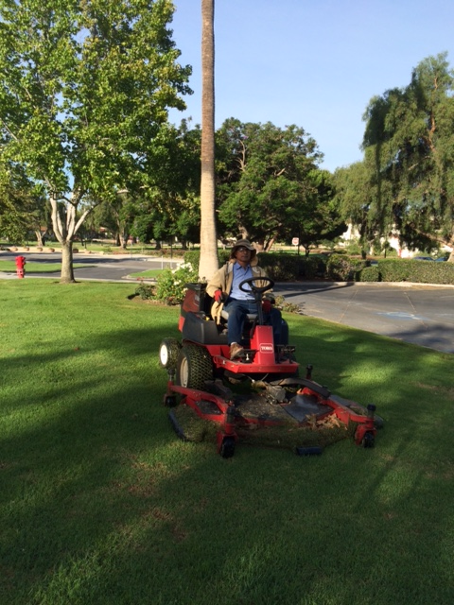
FS Grounds services is a one stop shop, fully equipped and staffed with professional, skilled, and friendly employees. They are ready to take on challenges and serve as a vital partner in the community.

Slide 13
Landscaping Work Schedule
Monday & Tuesday
Wednesday, Thursday, Friday
Mowing and edging of common lawn areas starting at 1A/1B
Ending on Tuesday at Phase 1C
Hedging, weeding, tree trimming, planter clean up, and chemical application
Other | Value Add
Street weeping University Glen phase 1A/1B and 1C : once per month

Slide 14
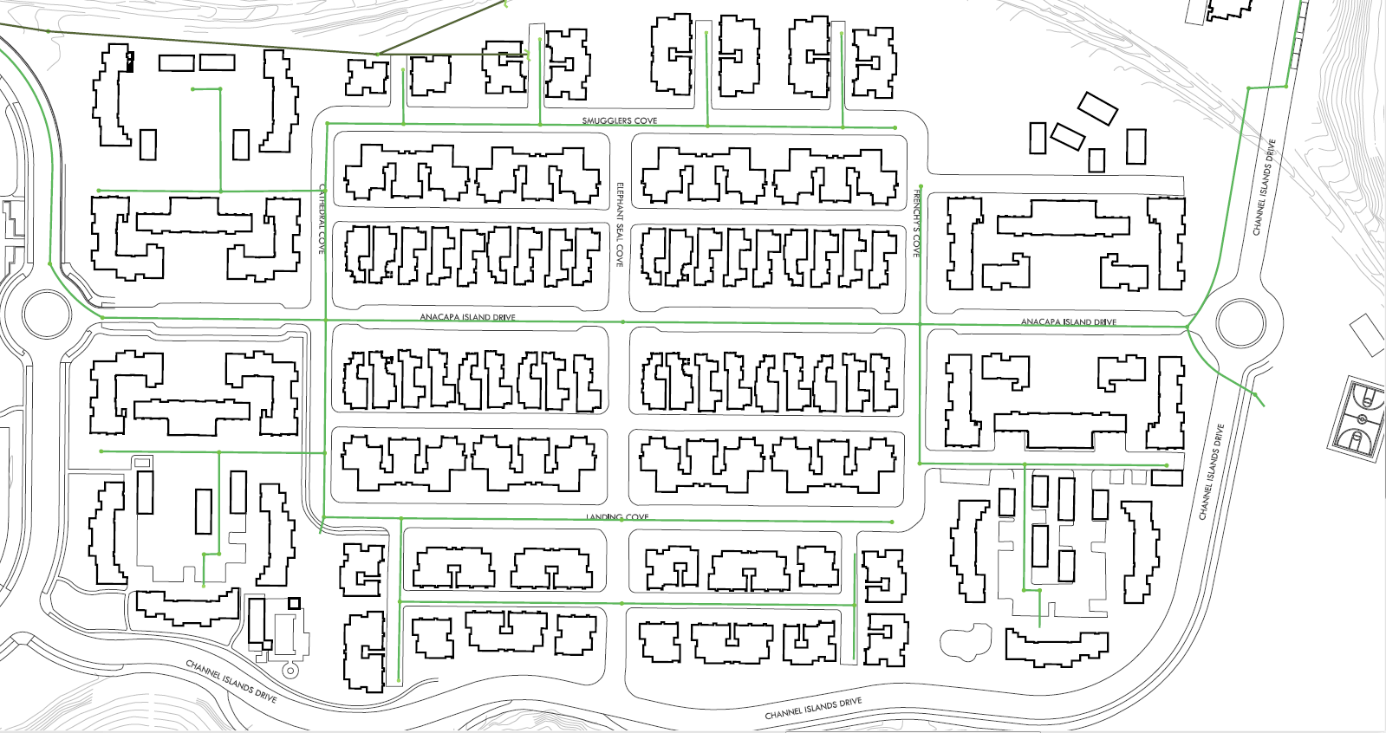
Infrastructure Maintenance

Slide 15
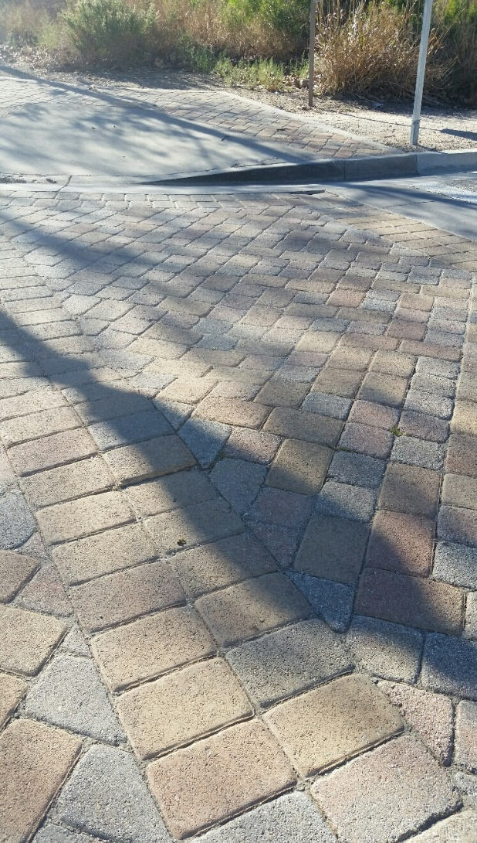
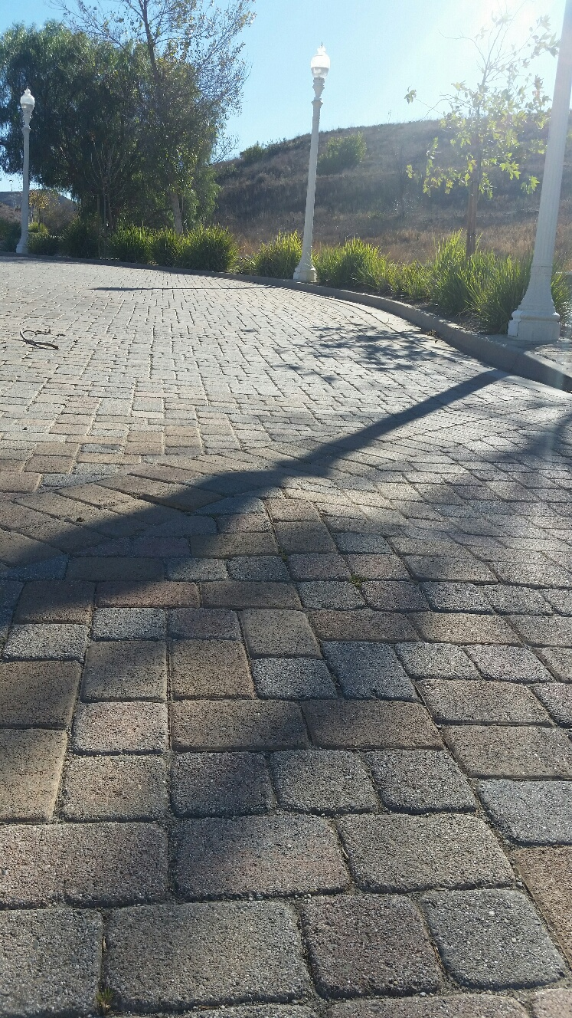
Road Repair Needs

Slide 16
Road Repair Needs and PMs
Routine Repairs
Repair Cracks and Pot Holes in Roadways
Repair Sunken Areas of Pavers
Curb and Gutter Repairs
Preventative Maintenance
Street Slurry Seal and Striping (Every 4-5 years)
Annual Curb Painting
Annual Man Hole Inspections

Slide 17
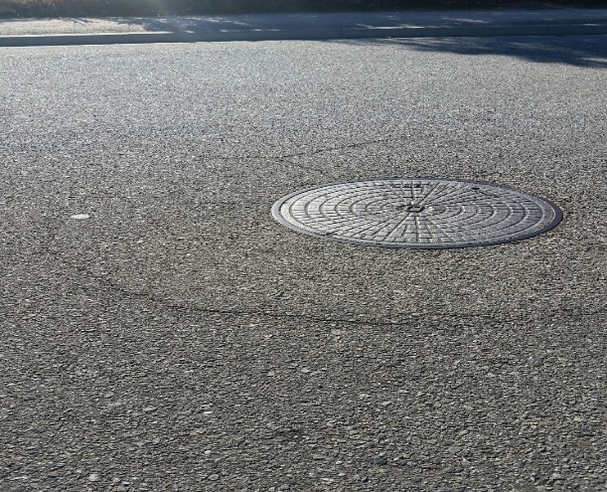
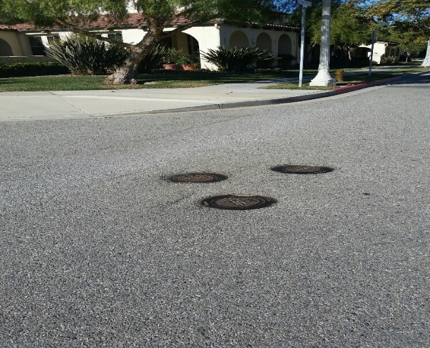
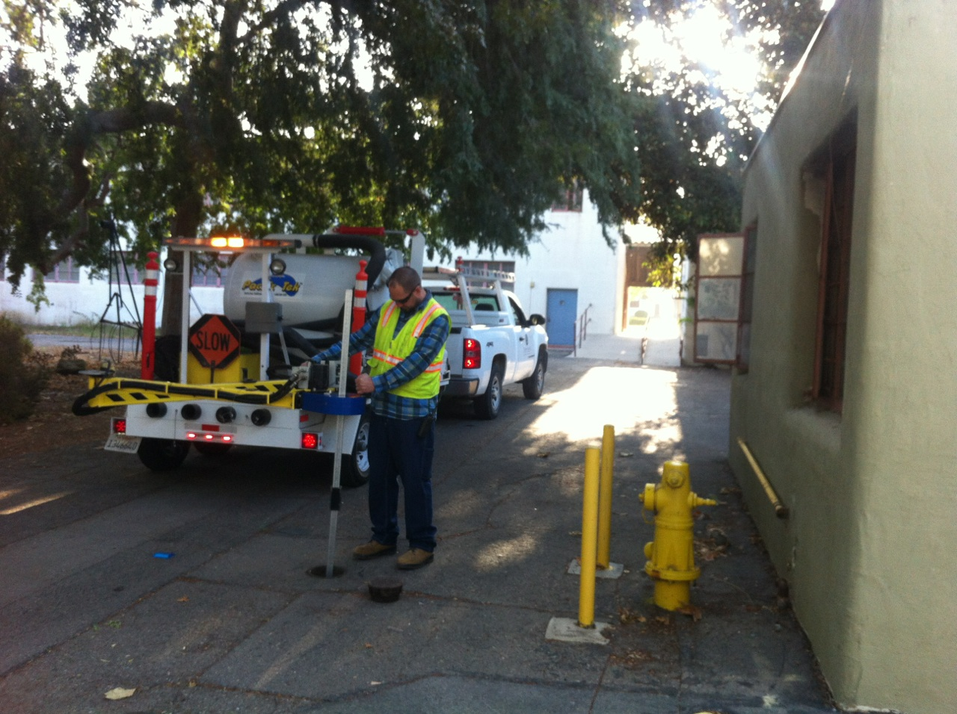
Water System, Sewer and Storm Drains

Slide 18
Water, Sewer and Storm Drain Systems
Monthly Water Valve Exercising
Quarterly Hydrant Flush
Annual Sanitary Sewer Cleaning and Inspection
Emergency Sewer Blockage Repairs on Mains and Laterals
Annual Storm Drain Cleaning and Inspection
Emergency Storm Water Blockage Repairs
Biannual Catch Basin Inspection and Cleaning

Slide 19
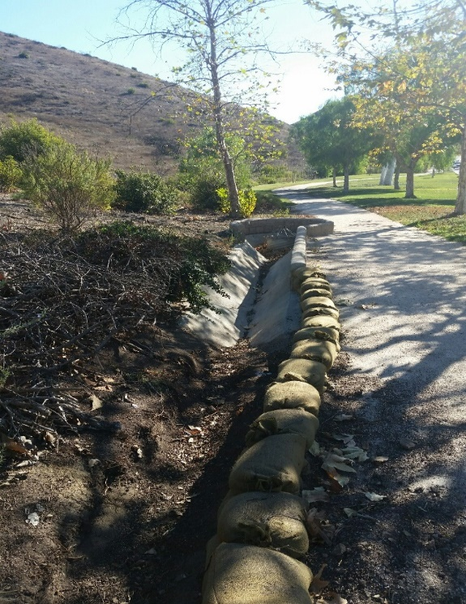
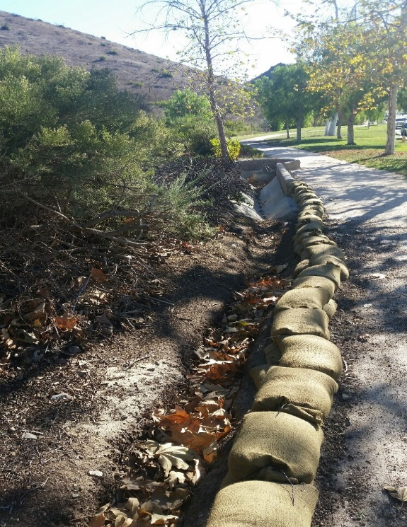
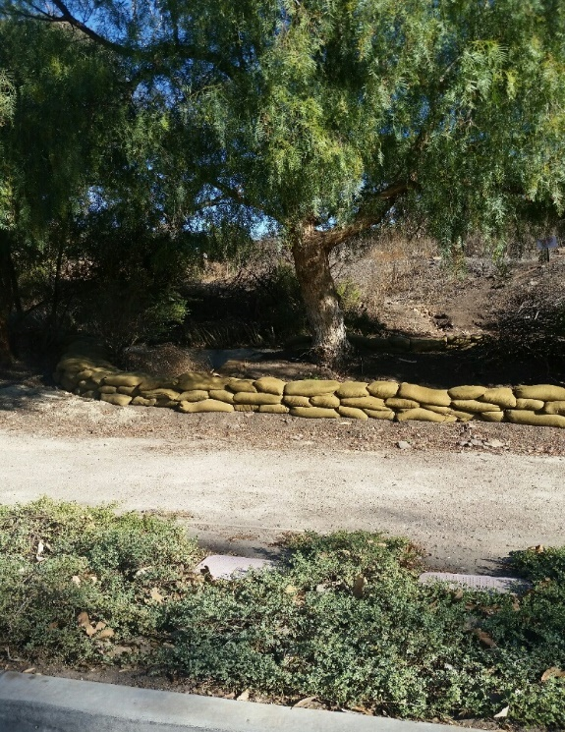
V-ditches & Drains
Annual V-Ditch Cleaning
Routine V-Ditch Repairs

Slide 20
Infrastructure Preventative Maintenance
All PMs are scheduled with ongoing repairs as needed.
Monthly Sidewalk Inspection and Repairs
Annual Backflow Testing and Certification
Walking Path Repairs (Decomposed Granite)
Monthly Street Light Inspections and Repairs
Basketball Court – Reseal and Strip (5 Year Need)
Monthly Landscape Lighting Inspections and Repairs
Annual Red Curb Painting
Annual Signage Inspections and Repairs

