Slide 1
Fall 2021 Update:
CSUCI Student Town Hall
July 2021
Richard Yao, Ph.D.
Interim President

Slide 2
OVERVIEW
Provide information on the interplay between CSU Policy, Cal-OSHA, CDC, CDPH and VCPH guidelines – which are we operating within and why?
Address recent questions from the campus community (i.e., why aren’t we mandating vaccinations regardless of FDA approval like the UC’s; will we require masks indoors like LA County; why are we using self-attestation instead of actual verification; etc.)
Preparations for a robust fall semester!
Q&A

Slide 3
CSU Vaccination Policy Update
Summary:
Requires vaccinations for all employees and students.
Baseline verification: self-attestation
Medical and religious exemptions.
Testing required for those with exemptions.

Slide 4
CSU Vaccination Policy Update
Current Status:
Proposed policy includes provision requiring students to provide proof of verification documents upon request.
Awaiting full FDA approval of at least one vaccine.
Earliest anticipated timeline: mid-Fall 2021
UC v. CSU:
UC has constitutional authority
https://blogs.berkeley.edu/2021/04/26/the-university-of-california-can-legally-require-covid-19-vaccinations/

Slide 5
Public Health Guidelines
CDC Guidance for Institutions of Higher Education:
Recommended baseline entry testing for those who are not vaccinated.
Determine testing frequency for unvaccinated based on entry testing results.
CDC Recommendations for Fully Vaccinated Individuals
California Department of Public Health (CDPH)
K-12: Masks recommended for all indoors regardless of vaccination status.
Higher education: directs to Cal-OSHA and CDPH general guidelines.
Ventura County Public Health:
July 16: VCPH is not modifying current guidance; mask wearing is optional for vaccinated individuals (except in some settings); unvaccinated individuals need to wear mask indoors.
July 19: strongly recommending that community members wear masks indoors regardless of vaccination status. Businesses are asked to expect universal masking for customers entering indoor areas.
Will continue to monitor situation

Slide 6
CSUCI Moving Forward: Students
Attestations:
Student portal is live.
Student communication has informed students that they are required to provide proof of vaccination upon request (portal allows for upload of vaccination verification)
Until FDA approval of one vaccine – COVID-19 Vaccine certification is not required.
Required Safety Measures:
Students who do not certify that they have been vaccinated for COVID-19 will be required to adhere to safety requirements, presently:
Mask-wearing indoors
Regular COVID-19 testing is required of all unvaccinated students.

Slide 7
Current Status: Data Points
Spring 2021 Survey: June 9
2748 responses
Students: n=2098
Faculty: n=272
Staff: n=294
Administrator: n=84
85% fully or partially vaccinated; 5% planning to get vaccinated
Employees: 67% response rate
85% fully vaccinated
2% partially vaccinated
2% planning to get vaccinated
Students:
69% fully vaccinated
10% partially vaccinated
6% planning to get vaccinated
HRE Survey (N=1159)
94.7% indicate that they are or intend to be vaccinated.

Slide 8
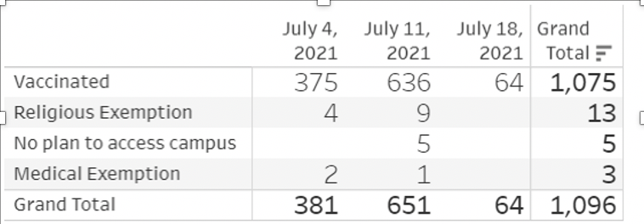
Current Status: Data Points

Slide 9
Current Status
Centralized reporting portal and contact tracing protocols in place
Case Management Response Team
Communication/notification protocols
Updated facilities/classroom/office area response for positive cases
Communications: Fall 2021 Webpage; Cross-Divisional Communications Group; Student Town Halls
Vaccination Clinics
Testing: 3rd party vendor plan in place, ready to implement
Teleworking Policy
Full range of academic support services; course offerings; cocurricular programming; student services

Slide 10
Next Steps
CSU Vaccination Policy – attestation and testing protocols will have us well prepared for when policy goes into effect
Moving forward with attestation process (employees and students)
Staffing & Resources:
Required testing: communication and tracking
Contact tracing
Mandatory mask wearing indoors?
Attestation for vendors and frequent visitors
Signage/communication
Enforcement/Discipline

Slide 11
Q&A / Discussion
REMINDER:
More information can be found on the campus fall planning website.

