Slide 1
President’s Planning and Policy Council
March 9, 2020

Slide 2
Topics
2020-21 Budget Planning
Context for the CSU 2020-21 Budget
State-Level Economic Climate
Economic Outlook
CSU Budget Request vs. Governor’s Proposed Budget (January 2020)
State and CSU Budget Issuance Timeline
Strategies for Campus-Level Budget Planning and Next Steps

Slide 3
2020-21 Budget Planning
Context for the 2020-21 Budget
Strategies for Campus-Level Budget Planning and Next Steps

Slide 4
State of the State: Economic Climate Remains Strong, but Recession Risks Rising
The Good News
California is projected to continue modest-paced economic growth and continue to add jobs, but more slowly than in recent years.
State anticipating its seventh budget surplus in eight years – current estimate at nearly $6 billion. Governor poised to continue to build reserves in preparation for next recession as well as pay down state debts and unfunded liabilities (pension liabilities).
The Cautions
Budgetary risks higher this year than recent past. Weakening seen in certain economic data points, including housing markets, trade activity, new car sales, and business startup funding.
“The Budget continues to reflect the principle that maintaining a balanced budget and strong budget resiliency is non-negotiable and a necessary predicate for expanding programs, especially with the growing risks facing the state.”
- Governor’s Budget Summary January 10, 2020
Notes:
Sources:
Legislative Analyst’s Office. 2020-21 Budget. California’s Fiscal Outlook (Nov 2019): https://lao.ca.gov/Publications/Report/4111
CSU Board of Trustees. Committee on Finance. Agenda Item 3. 2019-2020 Operating Budget Update: https://www2.calstate.edu/csu-system/board-of-trustees/past-meetings/2019/Documents/jan-22-23-full-agenda.pdf
“California state budget breaks record, tops $220 billion,” The Sacramento Bee (Jan. 10, 2020). https://www.sacbee.com/news/politics-government/capitol-alert/article239050443.html

Slide 5
CSU Trustees Budget Request vs. Governor’s Proposed Budget ($ Millions)
Investment Area |  | CSU Request | Governor’s January Proposal
Ongoing Funds | Compensation Increases | 177.4 | 199.0
 | Mandatory Cost Increases | 27.3
 | Graduation Initiative | 105.0
 | Increase in Resident Enrollment | 248.6
 | Facilities & Infrastructure | 75.0
 | Basic Needs Partnerships | 15.0
 | Total (Ongoing) | $648.3 | $199.0
One-Time Funds | Deferred Maintenance | 500.0 | -
 | Support for Degree Completion through CSU Extension Centers | - | 6.0
 | Total (One-Time) | $500.0 | $6.0
Total Combined |  | $1,148.3 | $205.0
Notes:
Sources:
CSU Board of Trustees. Committee on Finance. Agenda Item 3. 2019-2020 Operating Budget Update: https://www2.calstate.edu/csu-system/board-of-trustees/past-meetings/2019/Documents/jan-22-23-full-agenda.pdf
Governor Gavin Newsom’s 2020-21 Budget Proposal (January 10, 2020). Higher Education: California State University: http://www.ebudget.ca.gov/budget/2020-21/#/Department/6610
Legislative Analyst’s Office. 2020-21 Budget. Overview of Governor’s Budget (Jan 2020): https://lao.ca.gov/reports/2020/4135/budget-overview-2020.pdf

Slide 6
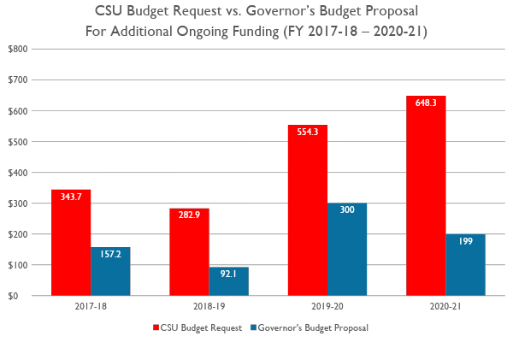
Historical Trend
Dollars in millions
Notes:
Sources:
Prior cabinet presentations:
2019/20: https://docs.google.com/presentation/d/1gM0EszpIJDqX6l6ashWyyBDwkfio5qZ1Dj5h3-i3Pxc/edit?usp=sharing
2018/19: https://docs.google.com/presentation/d/1uHZVbXrAD1GU24qceMBSxPJMyDvFiCUSuw19s93Ae5w/edit?usp=sharing
2017/18: https://drive.google.com/file/d/0B3oFJ96H8KxKTGdSNW1GQWQ1S2M/view?usp=sharing

Slide 7
Some Thoughts for CSUCI Budget Development
A balanced campus message:
California is in a fortunate economic climate, but growth is slowing.
Governor’s proposed budget means little room for expanded budgets.
CSU budget hearings and advocacy.
We are very early in the budget cycle.
Continue to support the momentum of CSUCI Strategic Initiatives.
CO preliminary budget memo pending

Slide 8
State and CSU Budget Issuance Timeline
January 10 | Governor Issues Initial Budget Proposal
January 31 | Divisional Budgets Due to Budget & Planning
March | Preliminary CO Allocations (publication unlikely)
May | Governor Issues May Revise Budget
June 15 | State Legislature Passes Annual Budget Act
July | CO Final Allocations

