Slide 2
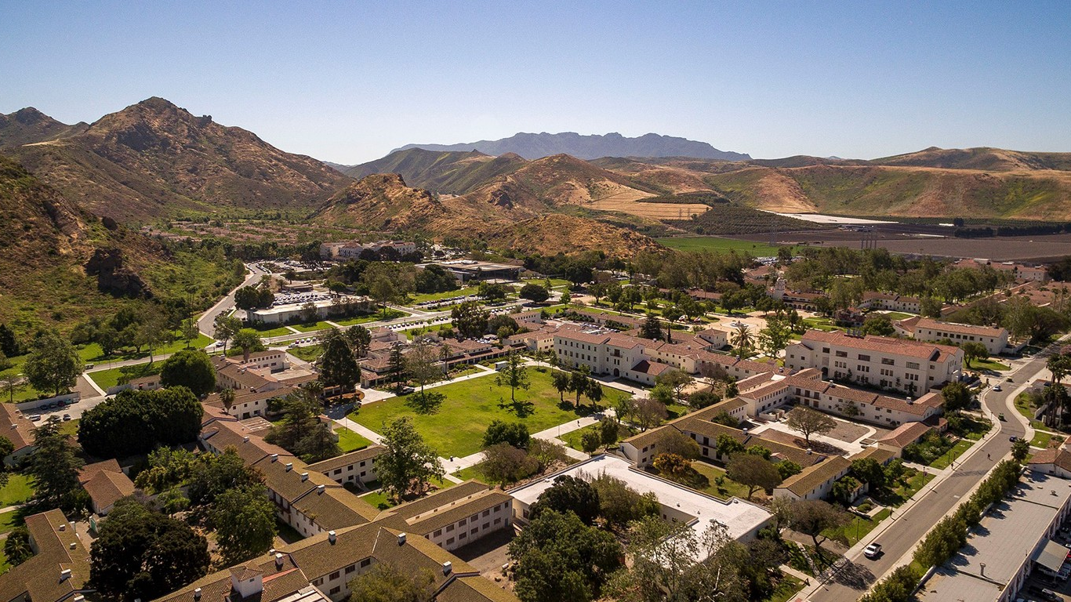
FALL CONVOCATION
INTERIM PRESIDENT RICHARD YAO
AUGUST 19, 2021

Slide 4
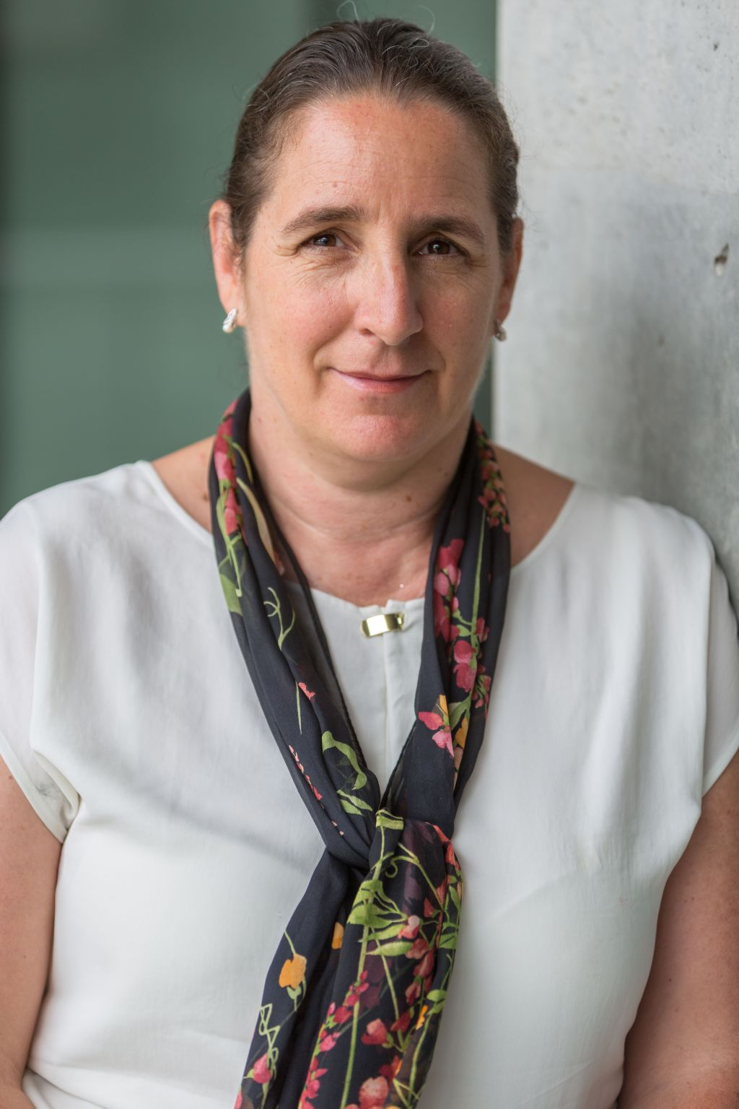
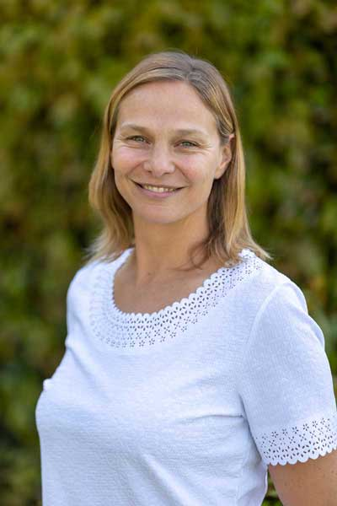
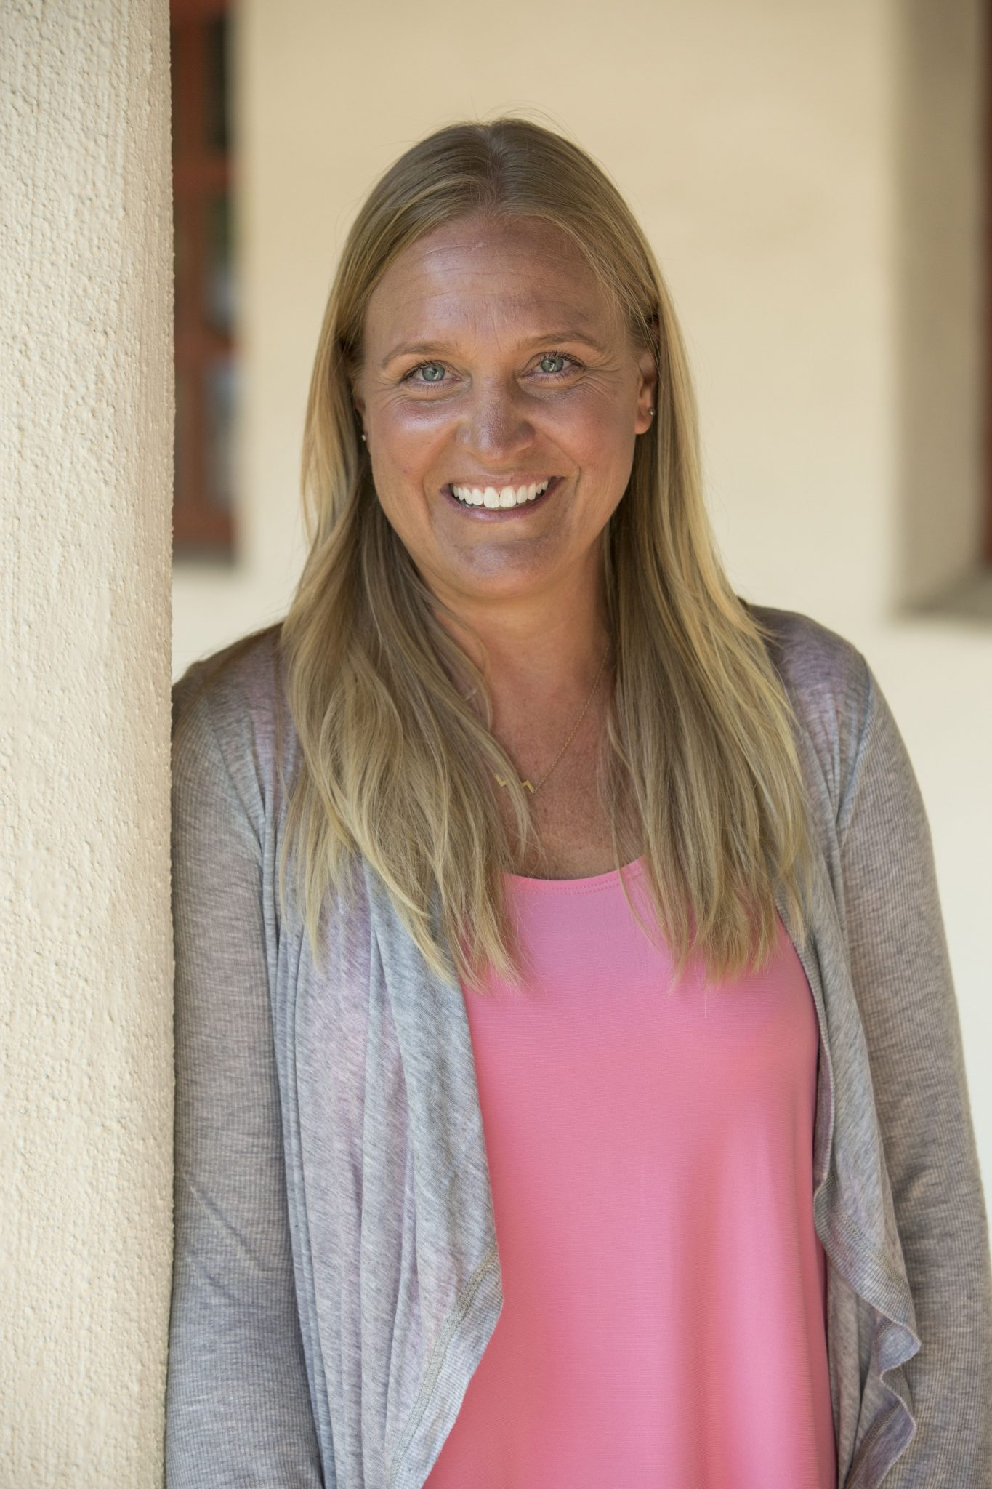
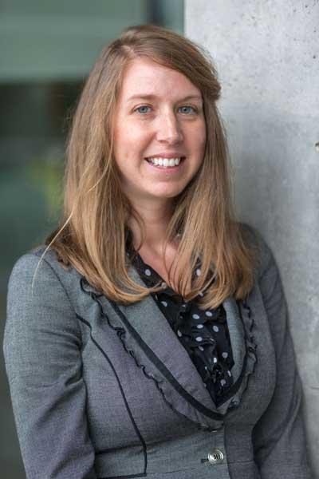
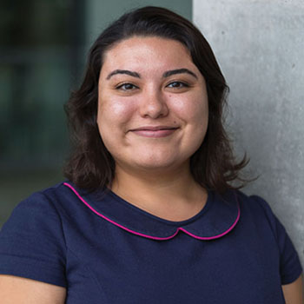
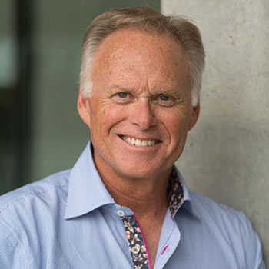
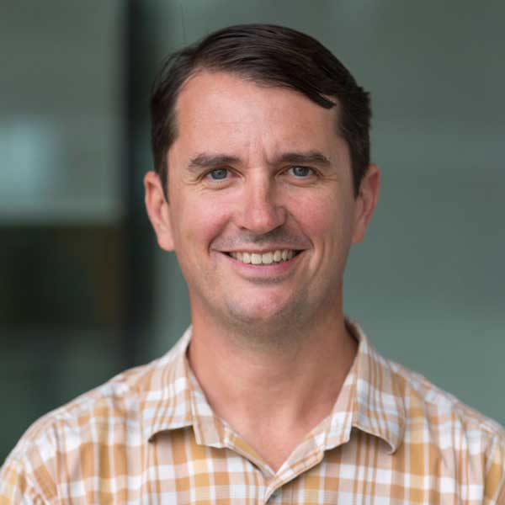
Annie White, EdD
Early Childhood Studies
Kara Naidoo, PhD
Education
Kristen Linton, PhD
Health Sciences
Kiersten Patsch, PhD
ESRM
Julia Ornelas Higdon, PhD
History
Charles Weis, PhD
Educational Leadership
Jason Isaacs, PhD
Computer Science

Slide 5
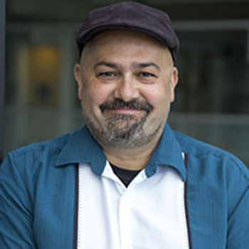
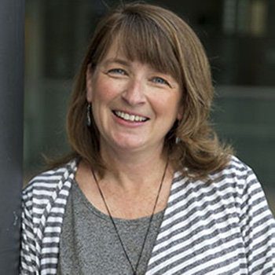
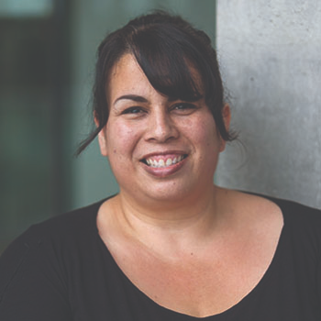
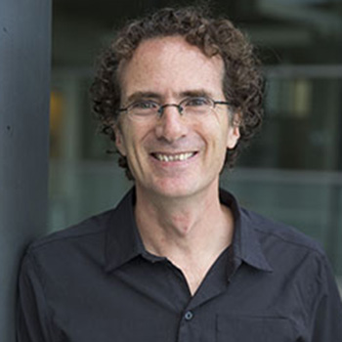
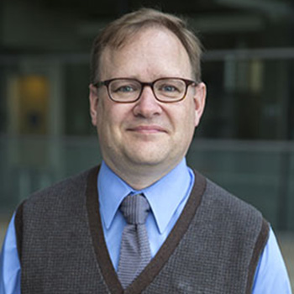
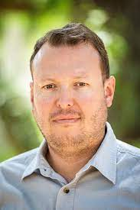
Javier Gonzalez, PhD
Spanish
Stacey Anderson, PhD
English
Jasmine Delgado, MFA
Art
Dylan Cooper, PhD
Management
Aaron McColpin, DNP
Nursing
Miguel Delgado Helleseter, PhD
Economics

Slide 6
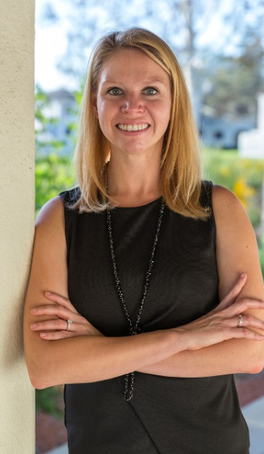
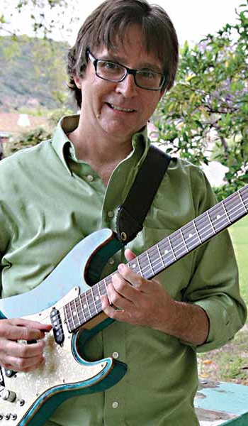
New Full Professors
Susan Andrzejewski, PhD
Marketing
Sean Carswell, PhD
English
Paul Murphy, DMA
Music

Slide 8
Bridging Institutional Values
Communication
Shared Governance
Priorities
of the Interim Presidency
Racial and Social Justice
Graduation Initiative 2025
Budget/Enrollment Management
COVID-19

Slide 9
Bridging Institutional Values

Slide 11
Inclusive Excellence

Slide 12
Inclusive Excellence Action Teams
IEAT 1
Provide Professional Development & Leadership Development for Racial & Social Justice
IEAT 2
Recruit, Hire, and Retain a Diverse Workforce
IEAT 3
Promote Inward- and Outward-Facing Advancement and Community & Government Relations Efforts for Racial & Social Justice
IEAT 4
Work Continuously Toward Realizing a Campus Culture of Inclusive Excellence
IEAT 5
Improve Data-Based Decision Making & Planning Processes
IEAT 6
Facilitate Student Access & Success

Slide 15
Deepening Relationships with the Chumash People

Slide 16
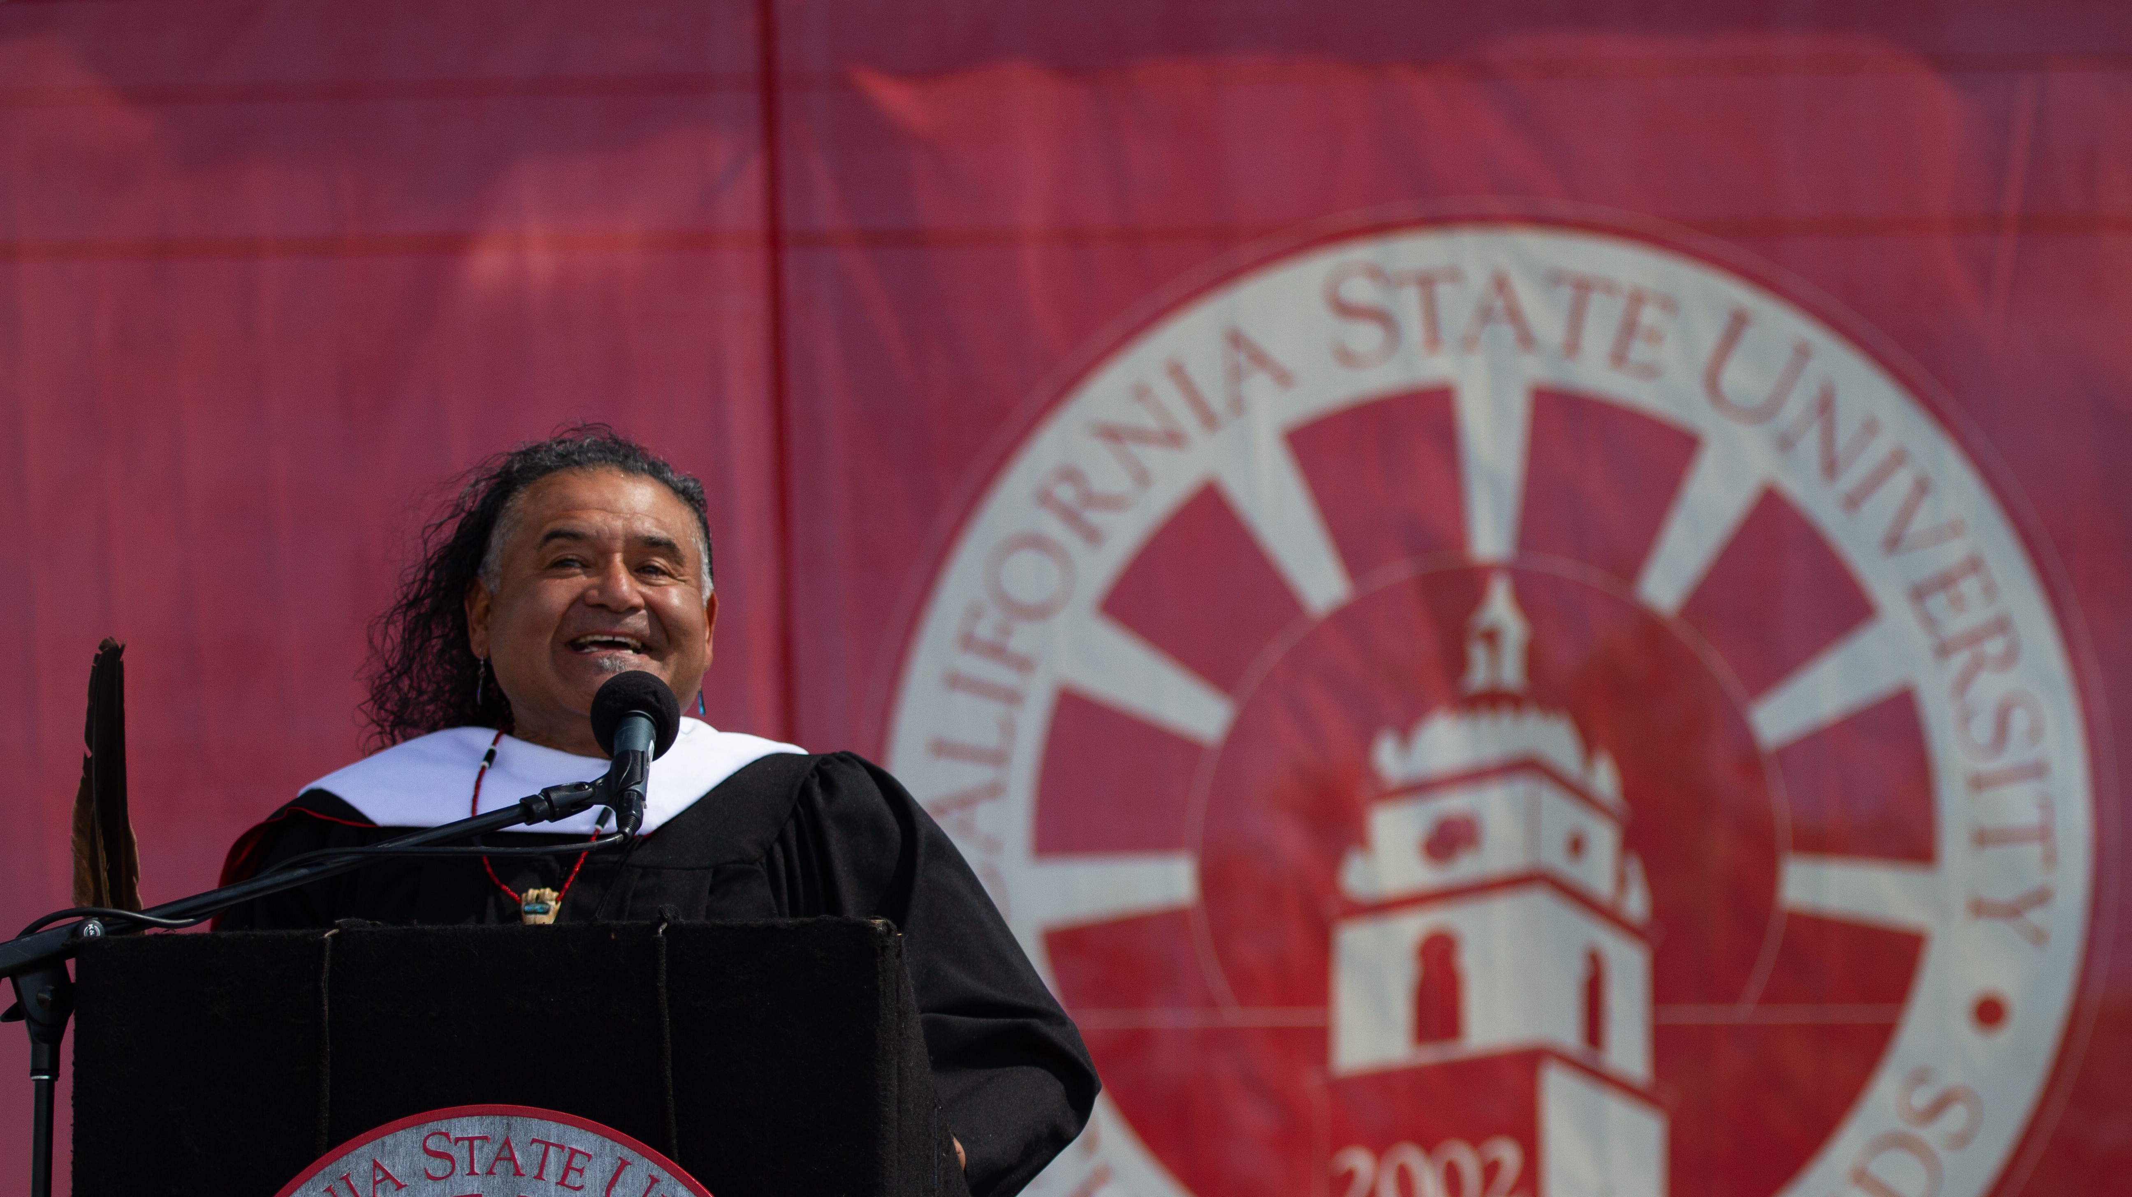
Dr. Raudel Bañuelos, CSU Honorary Doctorate, May 2021

Slide 17
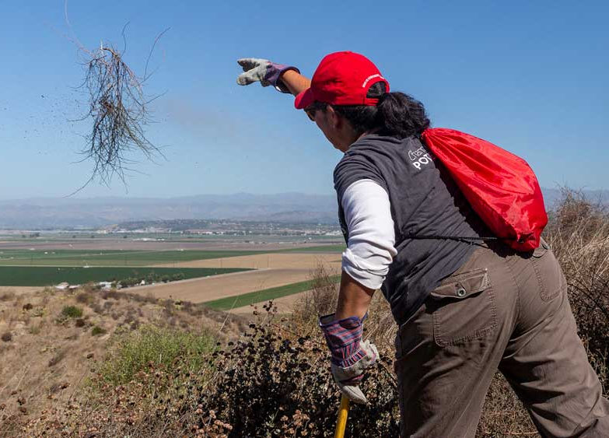
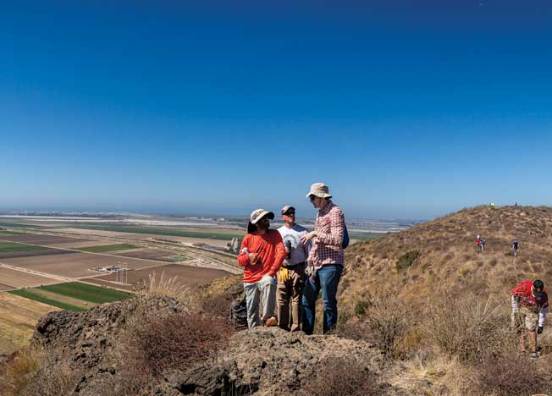
Coming Home:
Restoring Round Mountain
Phase I: Saturday, September 18
Clear brush that has grown back since the trail was last cleared in Fall 2019
Phase 2: Saturday, October 9
Extend the path to the top of the mountain and clear a circle at the top for Winter Solstice activities (private to the Chumash people)

Slide 18
Educational Excellence

Slide 19
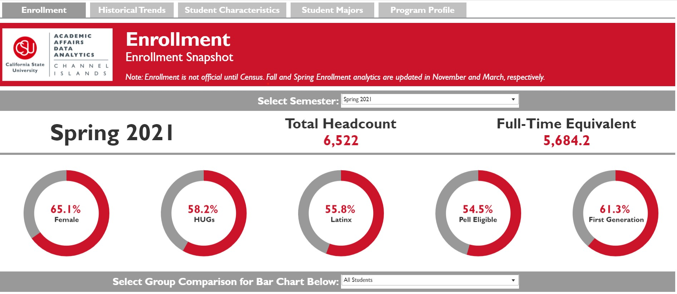

Slide 21
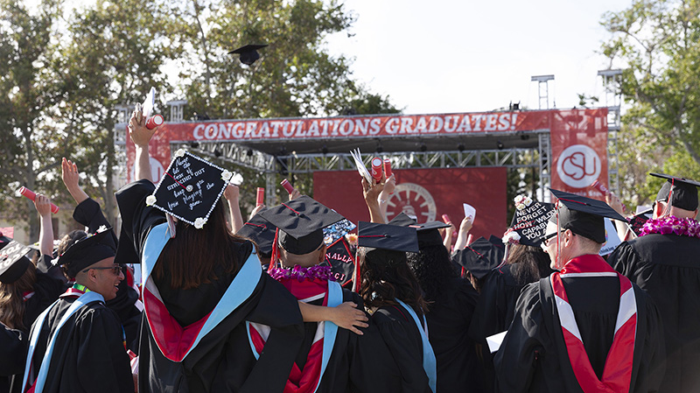

Slide 22
Student Success

Slide 23
Increasing the two-year graduation rate for transfer students to
54%
2025 Graduation Initiative
Goals
Increasing the four-year graduation rate for transfer students to
78%
Increasing the four-year graduation rate for first-time freshmen to
40%
Increasing the six-year graduation rate for first-time freshmen to 67%
Eliminating the equity gap

Slide 24
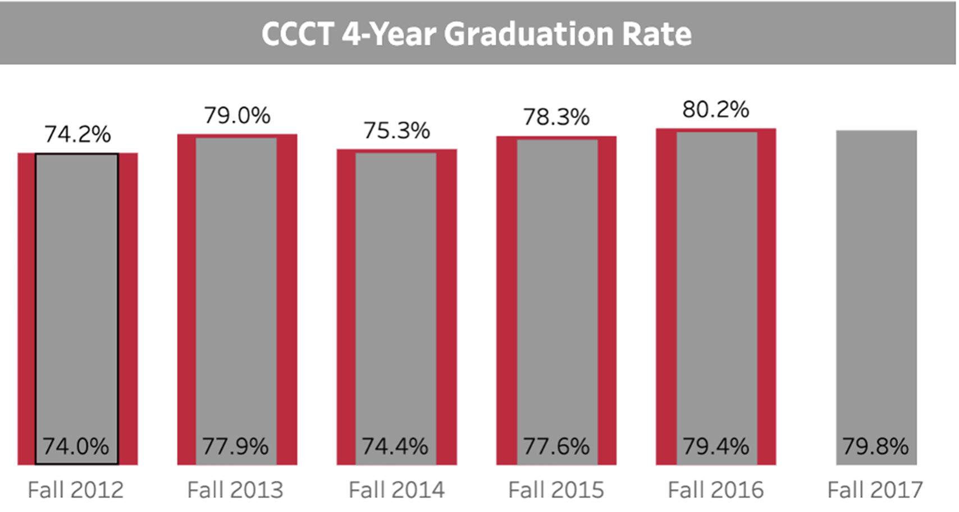
CI 2025 Graduation Goals
Four-year graduation rate for transfer students - 78 %
Two-year graduation rate for transfer students – 54%
Four-year graduation rate for first-time freshmen – 40%
Six-year graduation rate for first-time freshmen - 67%
Eliminating the achievement gap

Slide 25
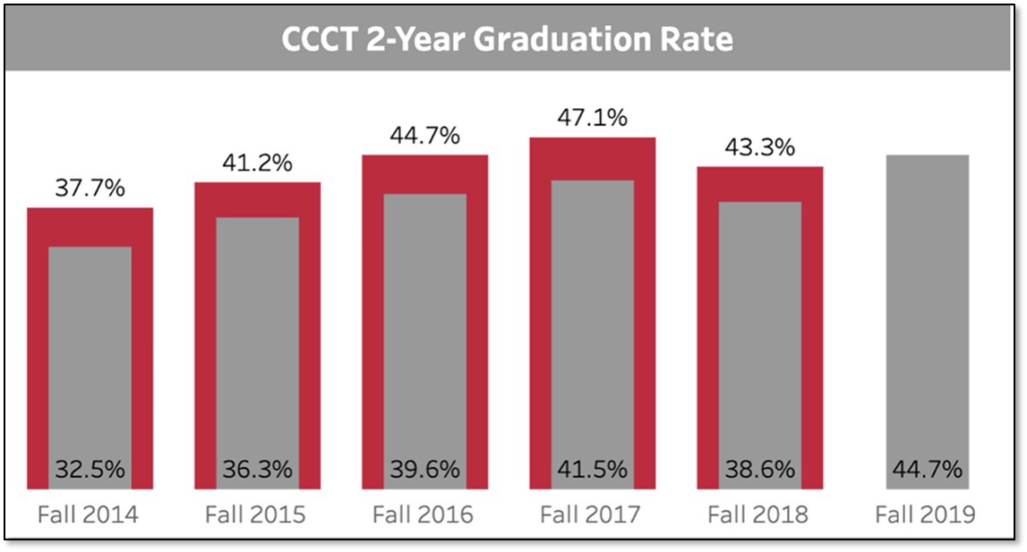
CI 2025 Graduation Goals
Four-year graduation rate for transfer students - 78 %
Two-year graduation rate for transfer students – 54%
Four-year graduation rate for first-time freshmen – 40%
Six-year graduation rate for first-time freshmen - 67%
Eliminating the achievement gap

Slide 26
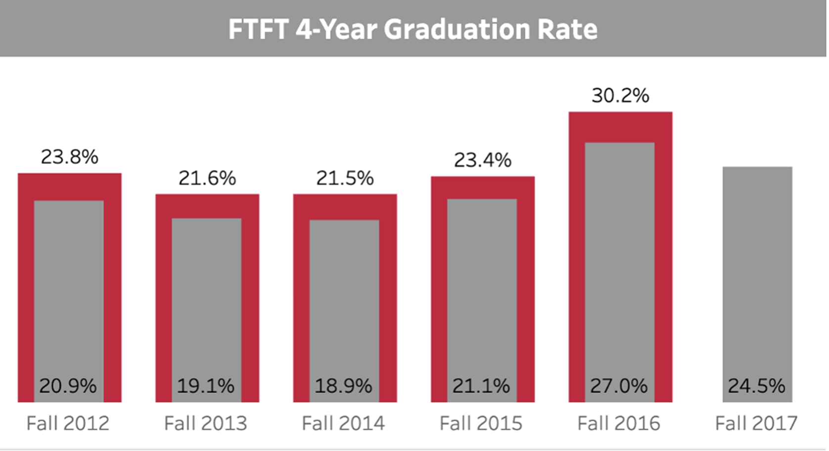
CI 2025 Graduation Goals
Four-year graduation rate for transfer students - 78 %
Two-year graduation rate for transfer students – 54%
Four-year graduation rate for first-time freshmen – 40%
Six-year graduation rate for first-time freshmen - 67%
Eliminating the achievement gap

Slide 27
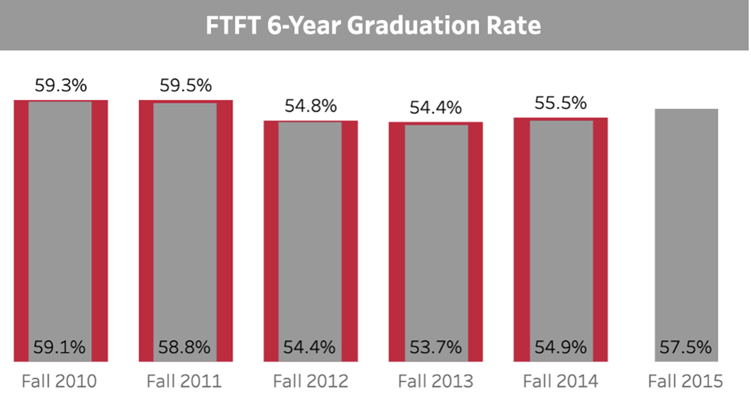
CI 2025 Graduation Goals
Four-year graduation rate for transfer students - 78 %
Two-year graduation rate for transfer students – 54%
Four-year graduation rate for first-time freshmen – 40%
Six-year graduation rate for first-time freshmen - 67%
Eliminating the achievement gap

Slide 28
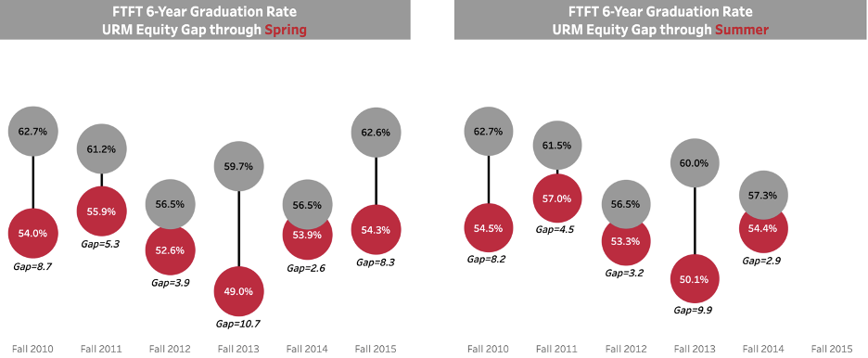

Slide 29
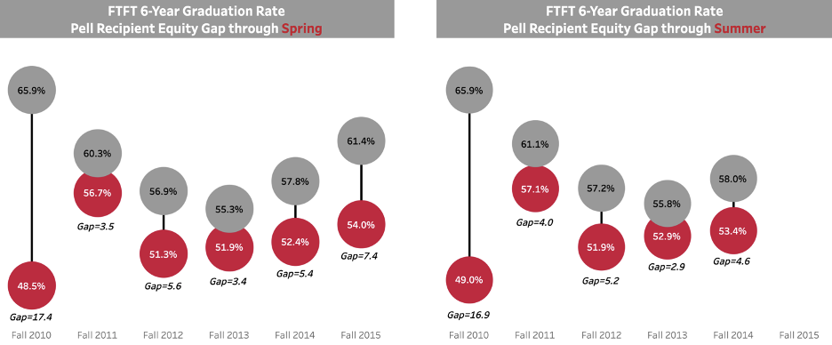

Slide 30
Notes: Persistence rates for the most recent cohorts are preliminary until after Census (Fall 2020 to 2nd Fall & Fall 2019 to 3rd Fall). Persistence rates include retained students as well as students who have graduated.

Slide 31
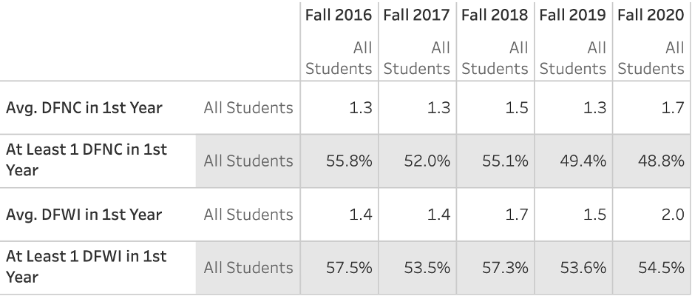

Slide 32
Capacity and Sustainability

Slide 34
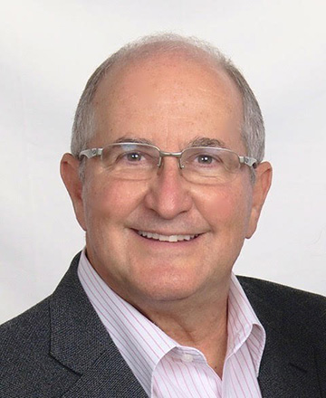
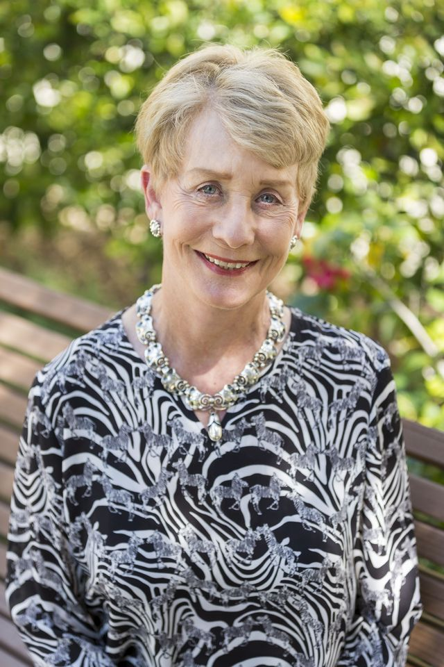
CSUCI Foundation Board Priorities:
Academic Planning and Programming
Student Success Initiatives that align with GI 2025 and our DEI efforts
Capital projects required to realize our long-term campus vision
CSUCI Foundation Board Leadership
Dr. Mark Lisagor
Chair
Lois Rice
Vice Chair

Slide 35
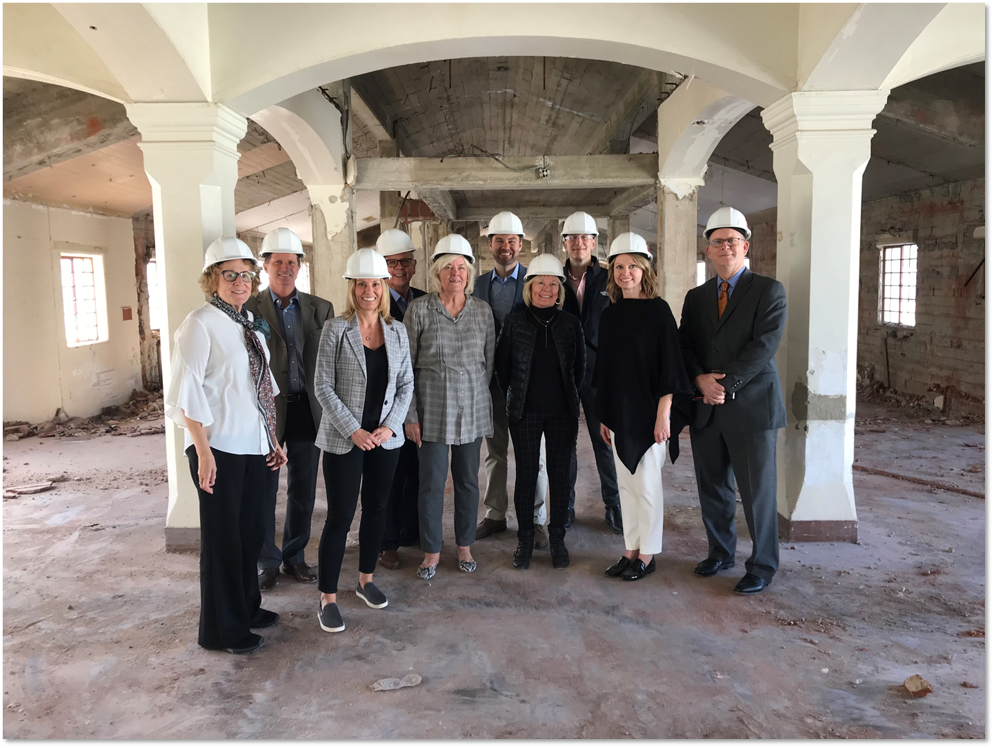

Slide 37
Current Capital Projects
Manzanita Hall Renovation
Gateway Hall
Early Childhood Education Center
Solar Array
Hydronic Loop Extension
University Glen Phase III

Slide 39
Communication

Slide 40
Shared Governance

Slide 41
Campus Appropriations FY21/22
Mandatory Increases
○ Health Insurance, Maintenance $ 703,000
Discretionary Increases
○ Budget Reinstatement 5,709,000
○ Ethnic Studies - AB 1640 626,000
○ GI 2025 2,368,000
Total Discretionary 8,703,000
Student University Grant (SUG) (207,000)
Deduct for Systemwide Priorities (2,607,000)
Total Change: Campus Appropriations $6,592,000

Slide 43
Campus Safety

Slide 45
Emergency Preparedness Enhancement Project
Replaced door locks for 251 classrooms and meeting spaces
Installed 65 additional security cameras at common areas across campus
Migrated 92 on-line door locks from an aging Cisco Network to the campus standard Avigilon Network
Final Phase: Approximately $1.1M
Replacement and network improvement of 120 perimeter door locks
Adding additional security cameras to select locations
Adding interior push button lock to 128 additional classroom doors
Installing 164 exterior loudspeakers for emergency messaging
Adding 8 digital message boards at key locations on campus
Adding digital marquee at University Drive entrance for emergency messaging

Slide 47
FUNDAMENTAL HABITS…
Transparency
Authenticity
Reliable data that is accessible and effectively utilized
Accountability to shared principles
Integrated planning efforts, using tools such as budget development as means rather than ends in themselves
6. Campus-wide awareness of GI 2025 goals and progress toward achieving them
TO ACHIEVE OUR PRIORITIES
Accreditation
Strategic Enrollment Managing, Academic Master Planning, and Budget Development
GI 2025, DEI, and IEAP
4. Post-Graduate Outcomes

