Slide 1
Instructions On How to Use CI SERVES
The Center for Community Engagement

Slide 2
STOP!
You must contact your community partner before registering your service-learning site placement with CI SERVES.
A sample phone script can be found here on the CI SERVES webpage:
www.csuci.edu/servicelearning/ci-serves

Slide 3
1. Start at the CSU Channel Islands homepage and type CI SERVES into the search browser.

Slide 4
2. Click CI SERVES.

Slide 5
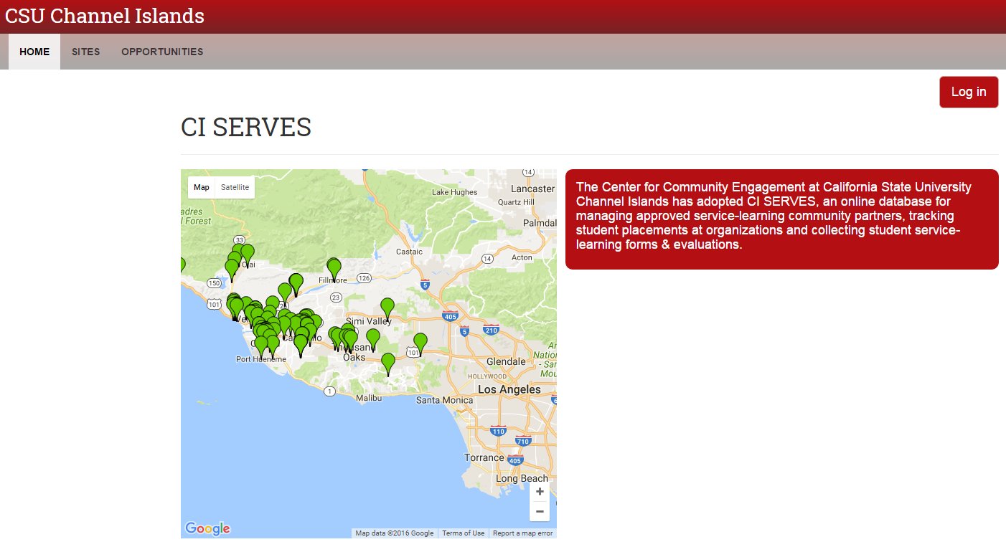
3. Click LOG IN.

Slide 6
4. Choose CSU Channel Islands and click LOG IN.

Slide 7
5. Type in your Dolphin name and password. Click SIGN IN.

Slide 8
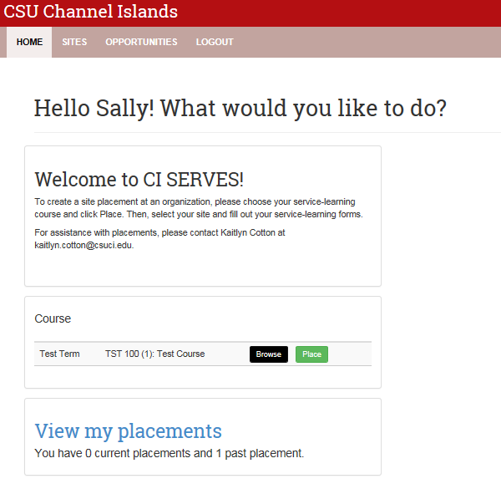
6. Find your service-learning course and click PLACE.

Slide 9
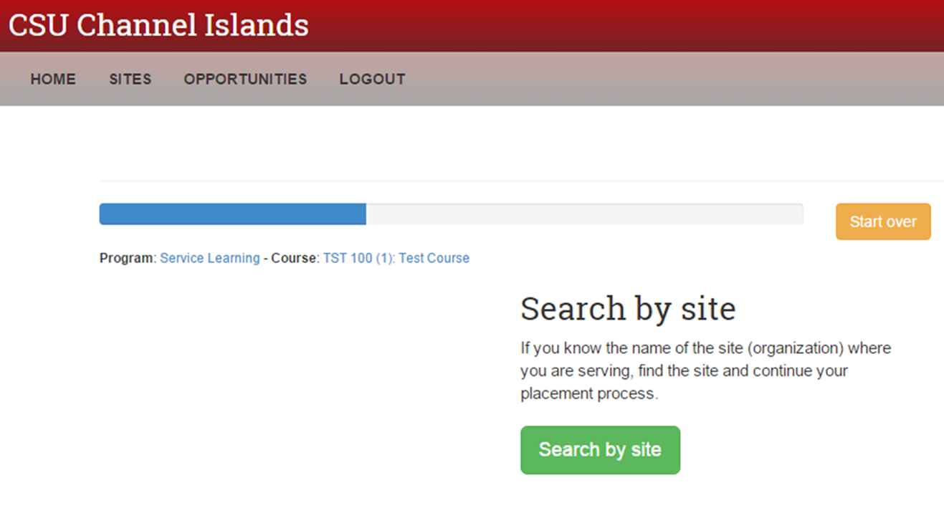
7. Click on SEARCH BY SITE.

Slide 10
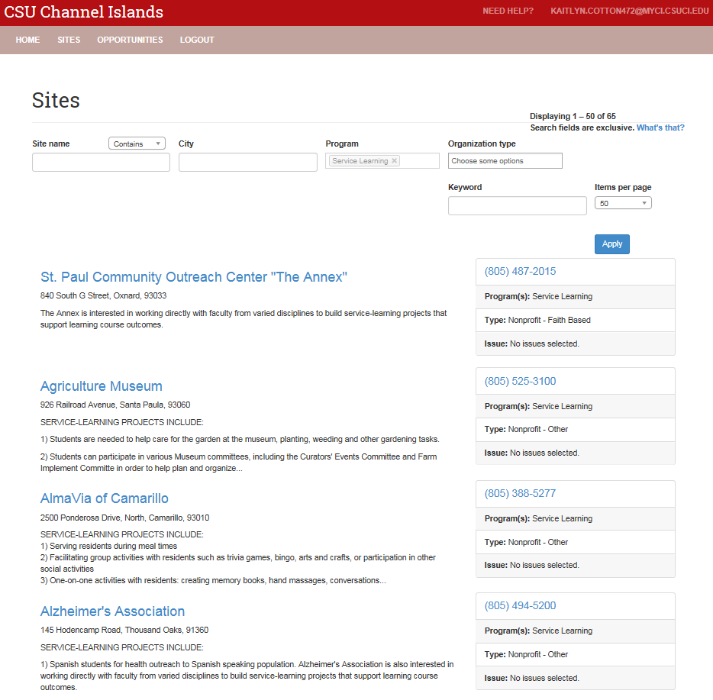
8. Click on the SITE WHERE YOU ARE SERVING.

Slide 11
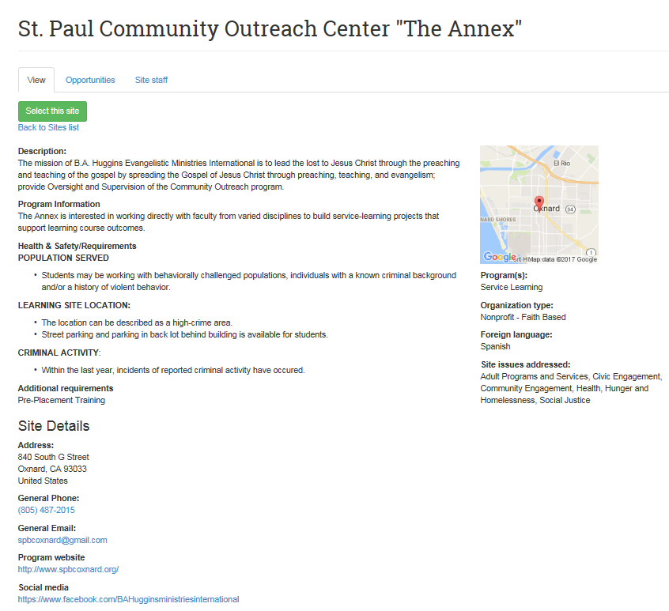
9. Click SELECT THIS SITE.

Slide 12
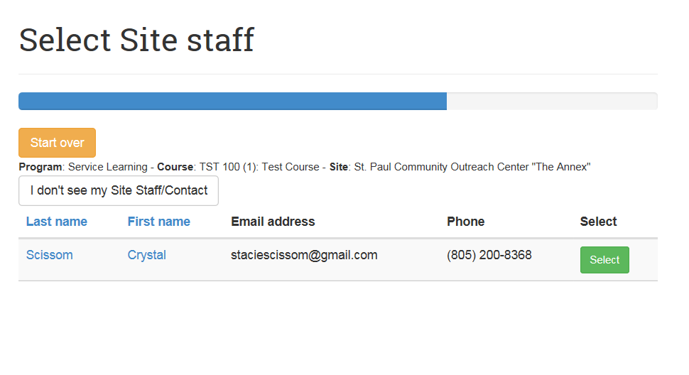
10. Find your site supervisor and click SELECT.
NOTE: If you do not see you site supervisor, select I don’t see my Site Staff/Contact. If at any time during your placement process you would like to change organizations, choose the Start over button at the top of your screen.

Slide 13
11. Read and review the Health & Safety Information for the site you have chosen. If you agree to the risks and requirements, Click “I HAVE READ AND UNDERSTAND THE ABOVE RISK ASSOCIATED WITH THIS SITE”.

Slide 14
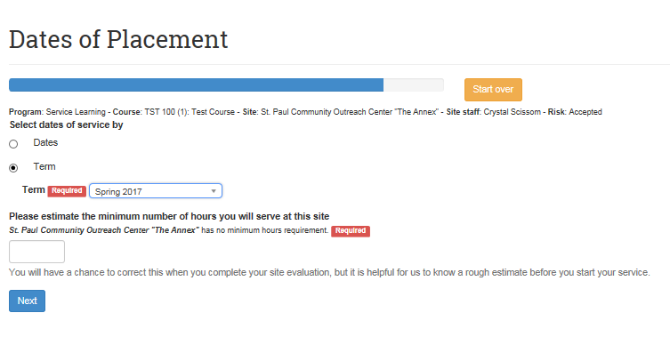
12. Enter the term of your placement. Then, estimate the number of hours you will be serving OR working on your service-learning project. Click NEXT.

Slide 15
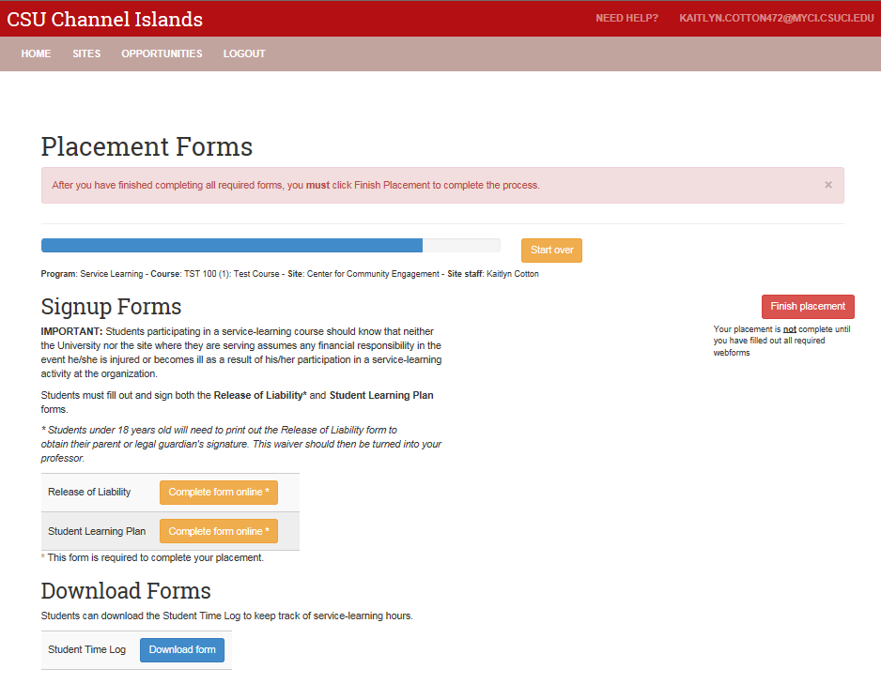
13. Find Release of Liability - click COMPLETE FORM ONLINE.

Slide 16
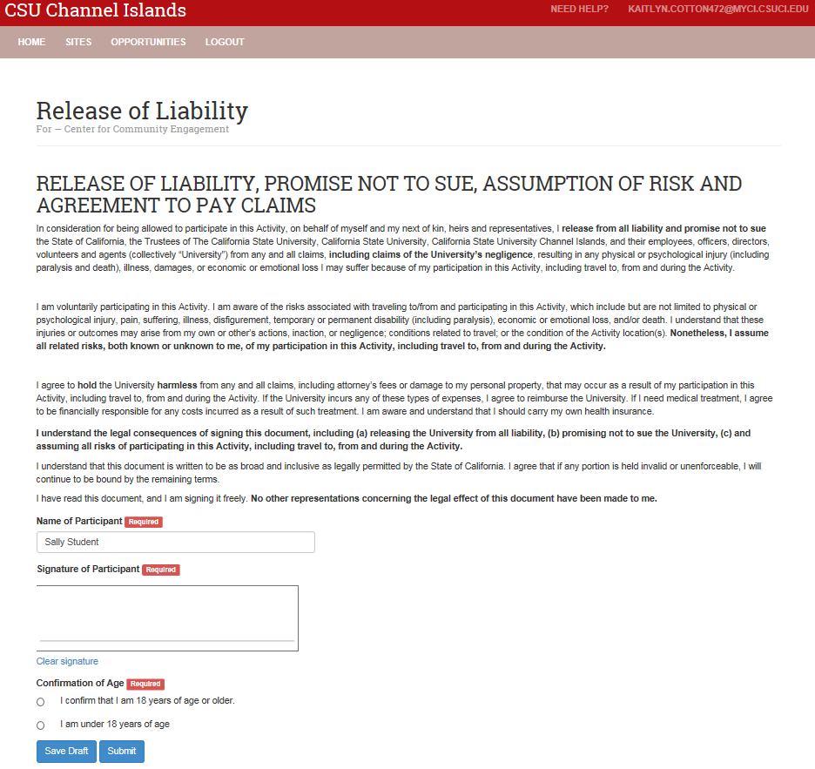
14. READ, sign and verify your age on the Release of Liability. Click SUBMIT.

Slide 17
15. Find Student Learning Plan – Click COMPLETE FORM ONLINE

Slide 18
16. Enter all information into the Student Learning Plan. NOTE: This information is emailed to your site supervisor.

Slide 19
17. READ, sign and verify your age on the Participation Guidelines. Click SUBMIT.

Slide 20
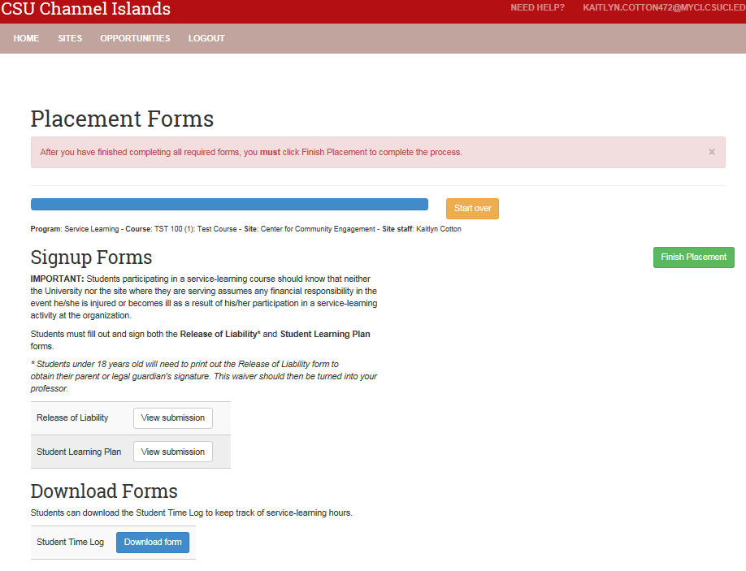
18. Download the Student Time Log to track your service-learning hours.

Slide 21
19. Click FINISH PLACEMENT.

Slide 22
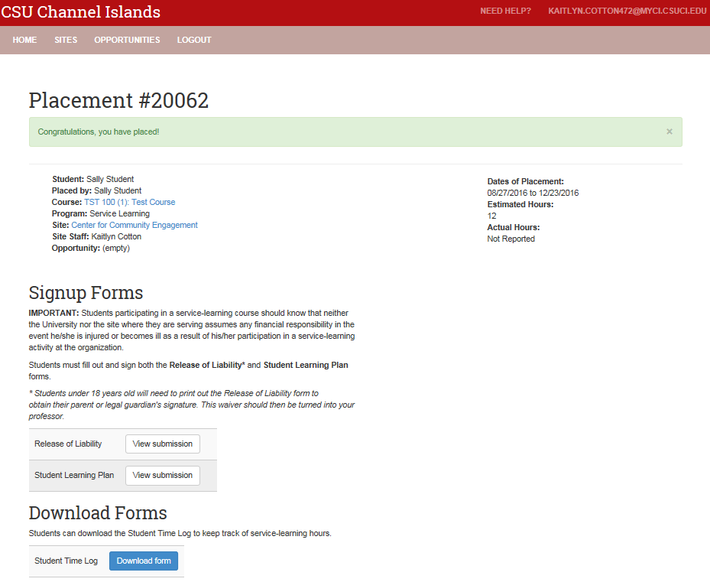
20. You will receive a confirmation email for your site placement. Your professor will view your forms and confirm that your site placement is completed.

Slide 23
For questions, please email ci.serves@csuci.edu

