Slide 1
On Wed, Feb 29, 2012 at 4:06 PM, Rodriguez, Donald <Donald.Rodriguez@csuci.edu> wrote:
Hi Frank,
I know we hardly know each other but I was recently contacted regarding your academic performance and wanted to let you know that there are additional options to seek help at CI. We recently opened the Science Technology Engineering and Math (STEM) center in El Dorado Hall here on campus. The Center operates with a staff of tutors and peer mentors that can help you negotiate many of the courses in the sciences here at CI. I know when I was an undergraduate I needed additional help to get through organic chemistry and would encourage you to seek help with any science course through the STEM center.
Let me know how your classes are going, and if you’d like to come in to talk about opportunities in the environmental field. I’d really like
to hear from you.
Regards,
Don Rodriguez

Slide 2
Sent: Wednesday, February 29, 2012 6:37 PM To: Rodriguez, Donald Subject: Re: Academic challenge
Hey Don!
I really appreciate your concern regarding my success with finishing up my academic career at Channel Islands. I have definitely looked into and have been planning on seeking some assistance from the STEM center. I've become increasingly nervous about my degrading quality of school work and motivation, and this is the figurative kick in the ass that I needed in order to shape up and realize that if I continue this way, it will result in my utter failure.
I would actually love to stop by your office and talk about school, environmental opportunities or whatever else comes up. I get out of class tomorrow at 11:50am, so I will head over to your office immediately after class. Would that work for you? Hope to
hear from you soon, and thanks again, I appreciate this
more than you can imagine.

Slide 3
Sent: from another male student
To: Donald Rodriguez
Subject: Re: Academic challenge
Hello,
It is not the academic challenge that is effecting my academic performance, its purely personal. I've been having trouble with the motivation aspect of staying in school. I want to pursue it but the problem is is that i feel that it will be all for little or nothing in return. I appreciate you emailing me about this and I will push myself for as long as I can.
(Signature)

Slide 4
Student Success Partnership www.csuci.edu/studentsuccesspartnership
Terry Ballman, co-lead | Damien Peña, co-lead | Marie Francois
Ginger Reyes | Kaia Tollefson | Cindy Wyels
The SSP is charged with responsibility for leading campus efforts in planning and measuring the effectiveness of strategies designed to lead to student success.
Task Forces to Date
At-risk Students and Student Success
Advising
Road Maps
Early Warning Students

Slide 5
Project ACCESO | Project ISLAS | Project Vista
STEM Tutoring | Freshman and Transfer Yr Seminars (UNIV 150 & 349) | Child & Family Care Needs Assessment Project – Yr2
Peer-Led Team Learning | Academic and Social Integration Programs | Graduate Studies Center: Financial Aid, Career Development, Graduate Writing Studio, Outreach
STEM Mentors | Redesign of UNIV 100 & UNIV 300 | Summer CFG Institute
STEM Posses | Development of UNIV 250 – 2nd Yr Seminar w/ Oxnard College | iPads for Scholars Initiative
Summer Scholars Institute | EOP Summer Bridge | Graduate Assistant Program
 | ISLAS Academy | Faculty-Student Research Learning Communities
 |  | Vista Scholarships

Slide 6
Six-Year Graduation Rate
Native Students | Non-URM | URM*
2003-04 | 53% | 48%
2004-05 | 58% | 55%
2005-06 | 54% | 48%
Transfer Students | Non-URM | URM*
2003-04 | 72% | 70%
2004-05 | 76% | 78%
2005-06 | 73% | 71%
“URM”; under-represented minorities (African American, Native American, Hispanic)
Source: CI Retention and Graduation Interactive Report
CI Institutional Research 3/14/12

Slide 7
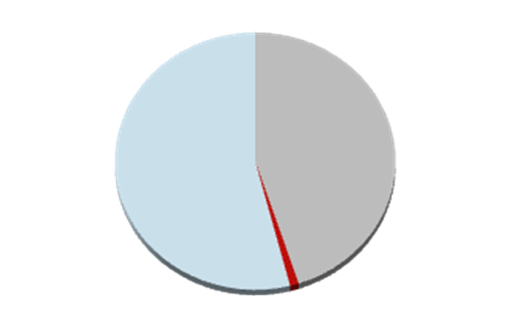
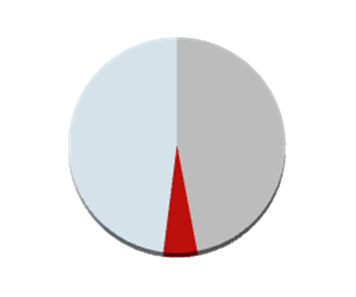
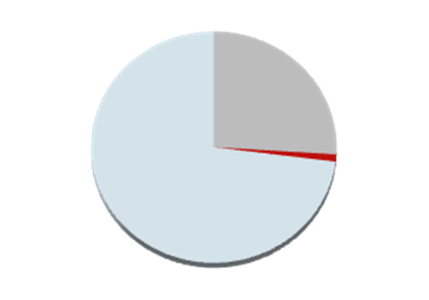
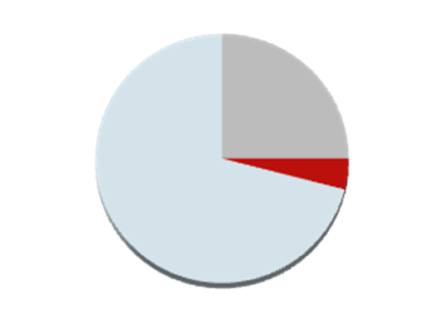
Six-Year Progress: 2005-06 Cohort
Non-URM*
URM*
Native
Freshman
Left campus
Enrolled
Graduated
Transfers
“URM”; under-represented minorities (African American, Native American, Hispanic)
Source: CI Retention and Graduation Interactive Report
CI Institutional Research 3/14/12

Slide 8
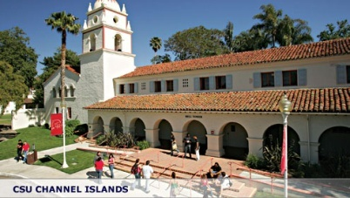
~ 27% of Fall 2011 students are 1st generation
 | Fall 2011 | Spring 2012
New Transfers | N= 714 | N=341
Non-URM | 466 (65%) | 216 (63%)
URM | 248 (35%) | 125 (37%)
Hispanic | 240 (34%) | 121 (35%)
1st Generation* | 196 (27%) | 86 (25%)
New Freshmen | N= 617 | -
Non-URM | 365 (59%) | -
URM | 252 (41%) | -
Hispanic | 221 (36%) | -
1st Generation * | 161 (26%) | -
* First Generation = neither parent has attended college
Source: ERS Enrollment Term Files
CI Institutional Research 4/10/12

Slide 9

Student Success
What’s wrong with that?

Slide 10
Quotes from “At Risk” CI Students
SSP Task Forces/Advising (2011-2012)
“What are office hours?”
“I'm afraid to talk with my professor” / “I’m afraid to go to my professor’s office hours.”
“There were only two papers – a mid-term and a final – but we never got the mid-term back. I only learned my grades when final grades were posted.”
“We didn’t have any quizzes or homework the first three weeks, so by the time I figured out I wasn’t doing well, it was too late to drop the class.”
“The tests are just so different from what we talk about in class. I don’t know what I’m supposed to study.”

Slide 11
High Impact Practices
We Know What Works at the Institutional Level
  First year seminars/experience
  Learning communities
  Undergraduate research
  Education/Study abroad
  Service learning
  Internships
What are “high impact practices” at
the classroom level?

Slide 12
“Colleges and universities have two nonnegotiable obligations to their students” (Kuh et al., 2006, p. 94).
Kuh, G. D., Kinzie, J., Buckley, J. A., Bridges, B. K., and Hayek,
J. C. (2006). What matters to student success: A review of the
literature. National Postsecondary Education Cooperative. Retrieved
from nces.ed.gov/npec/pdf/Kuh_Team_ExecSumm.pdf on 8/16/2012.
Notes:
Kaia: Find out background of the study – very briefly describe

Slide 13
“The first [non-negotiable obligation] is to establish high performance expectations, inside and outside the classroom, appropriate to students’ abilities and aspirations.” (Kuh et al., 2006, p. 94)
What are your “micro-practices” for…
learning about your students
helping students connect with you & each other (classroom as “locus of community” (p. 95)
teaching your expectations; discovering students’ expectations
teaching the role of successful student

Slide 14
What do you do to…
Learn about your students | e.g., How do you get students to come to office hours? | What else do you do to learn about your students?
Help students connect with you & each other | e.g, How do you make sure students get to know each other in and out of your class? | What else do you do to help students connect with you and with each other?
Teach your expectations and discover students’ expectations | e.g, How do you teach what’s in your syllabus? e.g., How do you learn what students hope for and expect from you? | What else do you do to teach your expectations and discover students’ expectations?
Teach the role of successful student | e.g., How, what & when do you communicate with students about… learning resources responsibilities outside of class | What else do you do to teach the role of successful student?

Slide 15
“The second obligation institutions have to their students is to give them prompt, frequent feedback as to how well they are meeting these expectations.” (p. 94)
What are your “micro-practices” for…
giving feedback early in the semester
giving prompt, frequent feedback
engaging students in assessing and evaluating learning

Slide 16
What do you do to…
Give feedback early in the semester | e.g., How do you make sure students know how they’re doing before the drop date? | What else do you do to give feedback early in the semester?
Give prompt, frequent feedback | e.g, How do you manage it??? | What else do you do to give prompt, frequent feedback?
Engage students in assessing and evaluating learning | e.g, How do you let students inside the process? How do you let them know what “success” looks like to you? | What else do you do to engage students in assessing and evaluating learning?

Slide 17
WHAT? Continuing the Conversation:
High Impact Classroom Practices
WHEN? September 6, 8-9am
September 27, 8-9am
October 25, 8-9am
November 15, 8-9am
WHERE? El Dorado Hall
Coffee/snacks provided
by Project Vista

Slide 18

CAMPUS WRITING GUIDE
“Hurray for a tool that makes my life easier!" -ESRM student.

Slide 19
Student Success Partnership www.csuci.edu/studentsuccesspartnership
Terry Ballman, co-lead | Damien Peña, co-lead | Marie Francois
Ginger Reyes | Kaia Tollefson | Cindy Wyels
The SSP is charged with responsibility for leading campus efforts in planning and measuring the effectiveness of strategies designed to lead to student success.
Task Forces to Date
At-risk Students and Student Success
Advising
Road Maps
Early Warning Students

Slide 20

CI students define success as...
Student Success Week
October 8-12, 2012
Student Success Week
October 8-12, 2012

Slide 21
Student Success Week
Oct. 8 – 12, 2012
Purpose: Explore what "student success" means to students, staff, faculty and administrators while raising individual awareness of all campus members' roles in promoting student success.
Activities include:
Majors Fair: T Oct. 9 11:00-2:30
Photos with the President (Class of 2016,…)
Coffee with the Faculty at the SUB
Driving your CARR

